Slide 1
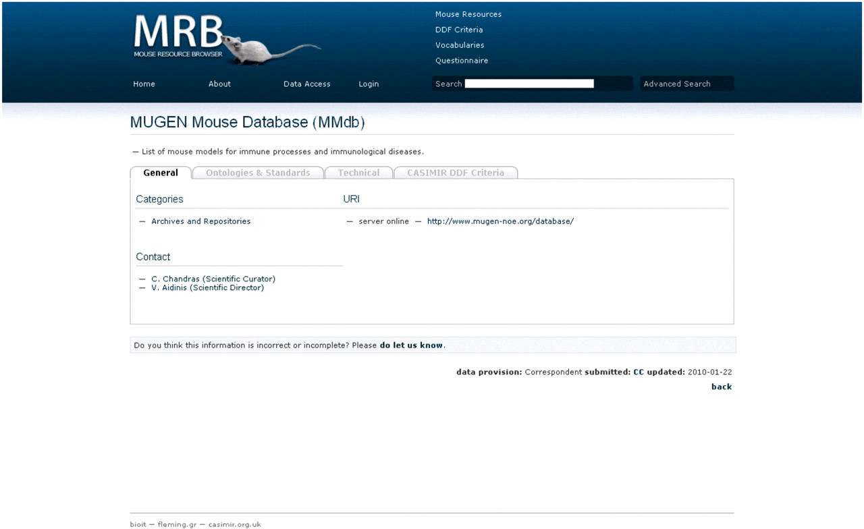
Figure 2. Screen shot of MRB; the view of a mouse resource demonstrating the use of tabs per data set section. Here the ...
Notes:
Figure 2. Screen shot of MRB; the view of a mouse resource demonstrating the use of tabs per data set section. Here the ‘General’ tab is on display, which includes a short description of the resource, the categories under which the particular resource is assigned, the URL(s) of the particular database with an interactive link provided and an interactive contact for users to get in touch with the personnel of the particular resource.
Unless provided in the caption above, the following copyright applies to the content of this slide: © The Author(s) 2010. Published by Oxford University Press.This is Open Access article distributed under the terms of the Creative Commons Attribution Non-Commercial License (http://creativecommons.org/licenses/by-nc/2.5), which permits unrestricted non-commercial use, distribution, and reproduction in any medium, provided the original work is properly cited.

