Slide 1
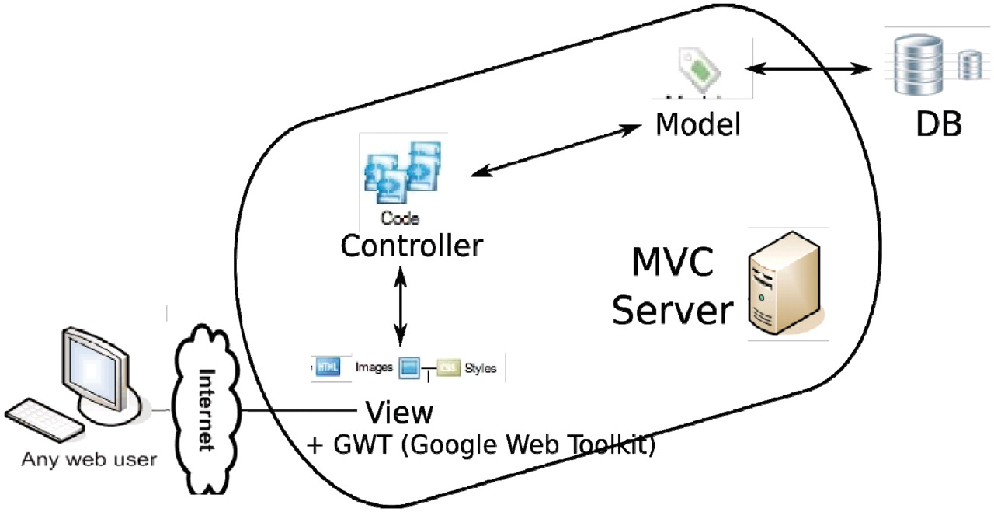
Figure 16. Overall architecture of the web app. An MVC (model-view-controller ...
Notes:
Figure 16. Overall architecture of the web app. An MVC (model-view-controller http://en.wikipedia.org/wiki/Model%E2%80%93view%E2%80%93controller) server, built out of pylons, is employed to separate the logic (model + controller) and user interface (view). The interaction between the MVC server and database server is facilitated by an ORM (object relational mapper) model. GWT is added to the view to enhance the user client experience.
Unless provided in the caption above, the following copyright applies to the content of this slide: © The Author(s) 2011. Published by Oxford University Press.This is Open Access article distributed under the terms of the Creative Commons Attribution Non-Commercial License (http://creativecommons.org/licenses/by-nc/2.5), which permits unrestricted non-commercial use, distribution, and reproduction in any medium, provided the original work is properly cited.

