Slide 1
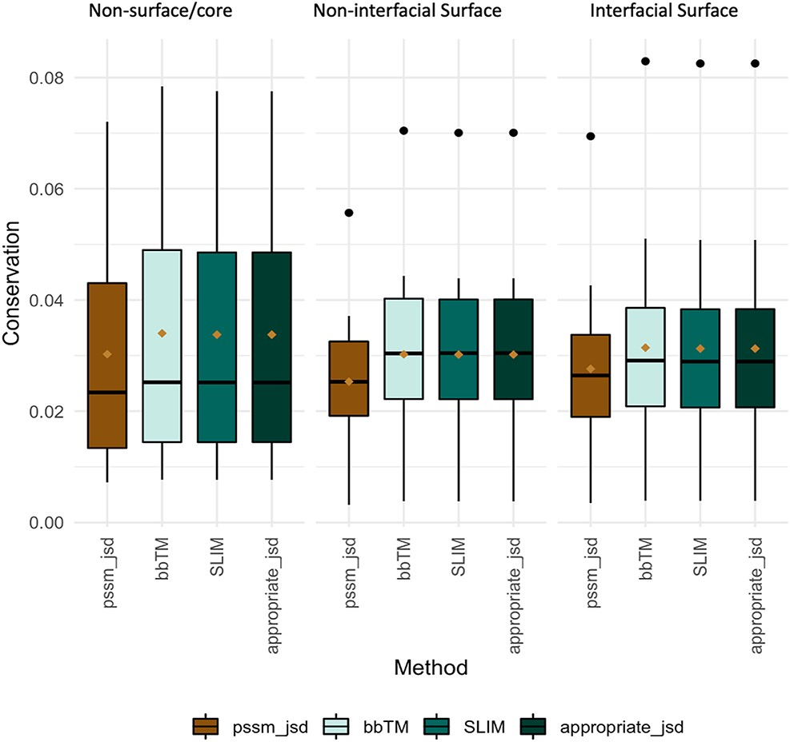
Figure 3. Conservation JSD distribution using BLOSUM62, SLIM, bbTM and the appropriate JSD background matrices (SLIM ...
Notes:
Figure 3. Conservation JSD distribution using BLOSUM62, SLIM, bbTM and the appropriate JSD background matrices (SLIM and bbTM were considered for α-helix and β-barrel proteins, respectively). Mean values are represented as a brown diamond. The results from the multiple pairwise test against all three background matrices yielded non-significant.
Unless provided in the caption above, the following copyright applies to the content of this slide: © The Author(s) 2021. Published by Oxford University Press.This is an Open Access article distributed under the terms of the Creative Commons Attribution License (http://creativecommons.org/licenses/by/4.0/), which permits unrestricted reuse, distribution, and reproduction in any medium, provided the original work is properly cited.

