Slide 1
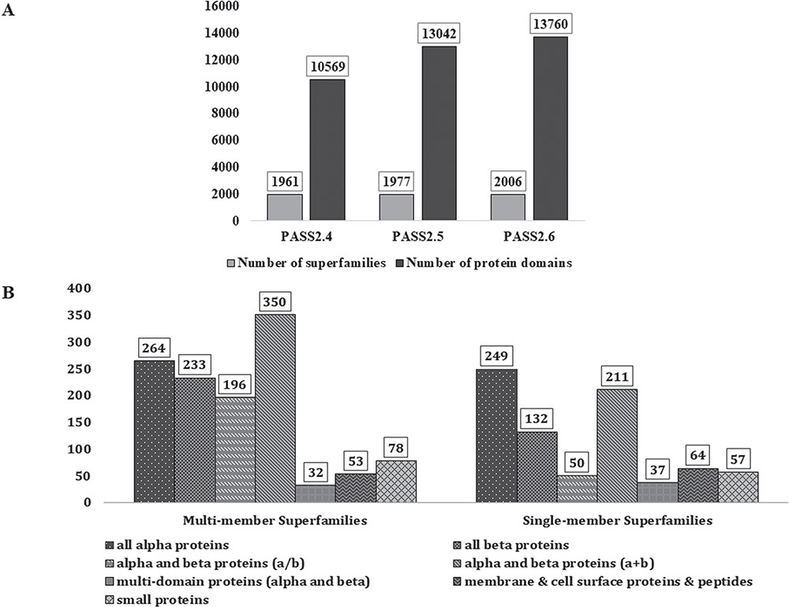
Figure 1 PASS2 statistics. (A) Statistics and comparison of current update with two earlier versions of PASS2, in ...
Notes:
Figure 1 PASS2 statistics. (A) Statistics and comparison of current update with two earlier versions of PASS2, in terms of number of superfamilies (light grey) and number of protein domains included (dark grey). (B) Distribution of SCOPe structural classes (all α, all β, α/β and so on) in single and MMS considered for alignment in PASS2.6.
Unless provided in the caption above, the following copyright applies to the content of this slide: © The Author(s) 2019. Published by Oxford University Press.This is an Open Access article distributed under the terms of the Creative Commons Attribution License (http://creativecommons.org/licenses/by/4.0/), which permits unrestricted reuse, distribution, and reproduction in any medium, provided the original work is properly cited.

