Slide 1
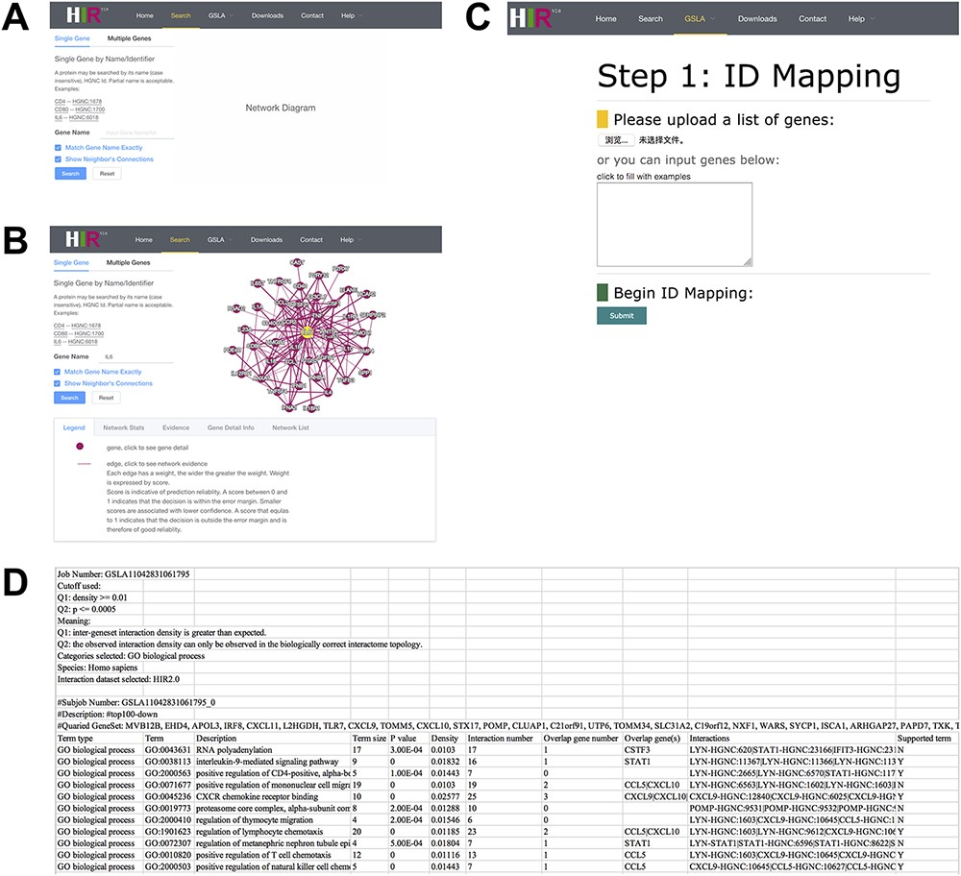
Figure 4. Interface of the HIR V2 and GSLA. (A) Two search options in the HIR V2. (B) Search result page. A right click ...
Notes:
Figure 4. Interface of the HIR V2 and GSLA. (A) Two search options in the HIR V2. (B) Search result page. A right click on the edge will show the interaction details. (C) Interface of the GSLA. (D) Results of a GSLA task.
Unless provided in the caption above, the following copyright applies to the content of this slide: © The Author(s) 2021. Published by Oxford University Press.This is an Open Access article distributed under the terms of the Creative Commons Attribution License (http://creativecommons.org/licenses/by/4.0/), which permits unrestricted reuse, distribution, and reproduction in any medium, provided the original work is properly cited.

