Slide 1
Figure 1. An example of a BEL statement with the associated context information.
Notes:
Figure 1. An example of a BEL statement with the associated context information.
Unless provided in the caption above, the following copyright applies to the content of this slide: © The Author(s) 2016. Published by Oxford University Press. This is an Open Access article distributed under the terms of the Creative Commons Attribution License ( http://creativecommons.org/licenses/by/4.0/ ), which permits unrestricted reuse, distribution, and reproduction in any medium, provided the original work is properly cited.

Slide 2
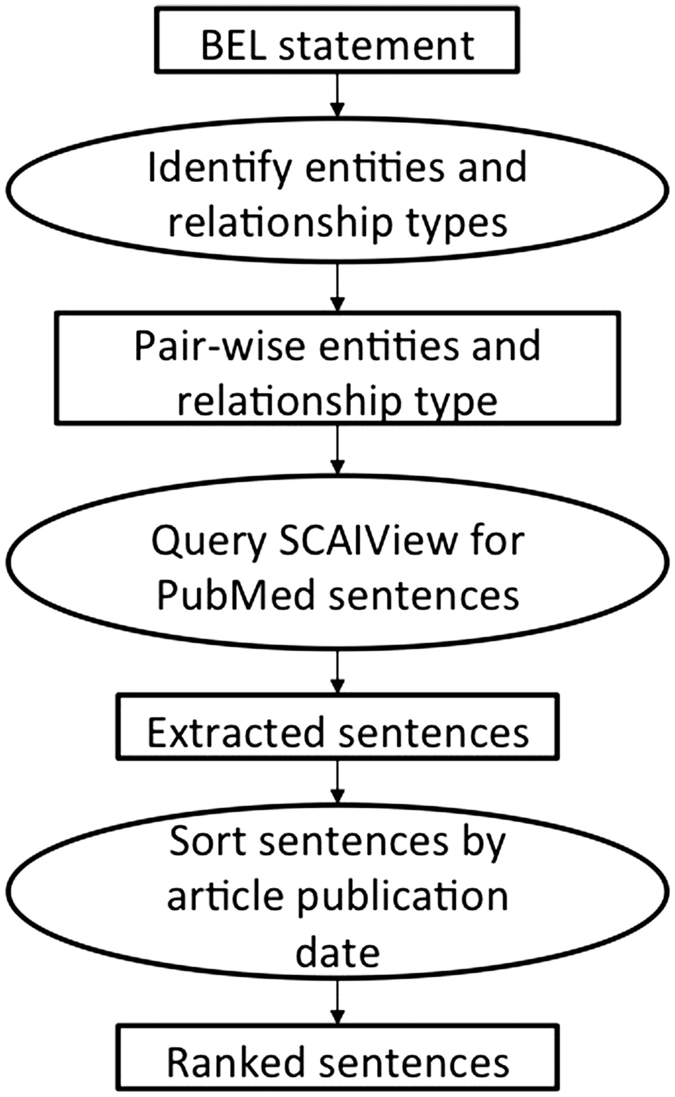
Figure 2. The workflow of the first method employing the semantic search engine SCAIView.
Notes:
Figure 2. The workflow of the first method employing the semantic search engine SCAIView.
Unless provided in the caption above, the following copyright applies to the content of this slide: © The Author(s) 2016. Published by Oxford University Press. This is an Open Access article distributed under the terms of the Creative Commons Attribution License ( http://creativecommons.org/licenses/by/4.0/ ), which permits unrestricted reuse, distribution, and reproduction in any medium, provided the original work is properly cited.

Slide 3
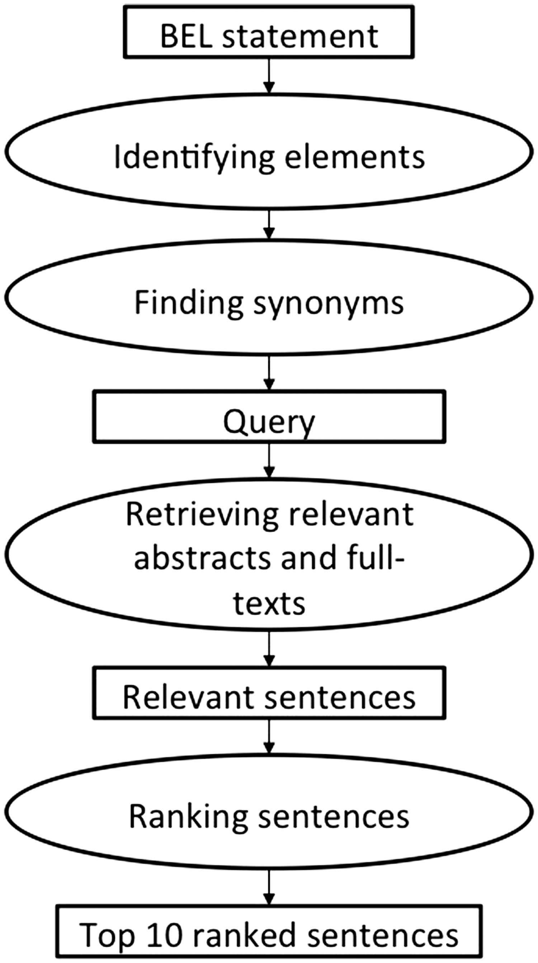
Figure 3. The workflow of the second method implemented by Rastegar-Mojarad et al. ( 44 ).
Notes:
Figure 3. The workflow of the second method implemented by Rastegar-Mojarad et al. ( 44 ).
Unless provided in the caption above, the following copyright applies to the content of this slide: © The Author(s) 2016. Published by Oxford University Press. This is an Open Access article distributed under the terms of the Creative Commons Attribution License ( http://creativecommons.org/licenses/by/4.0/ ), which permits unrestricted reuse, distribution, and reproduction in any medium, provided the original work is properly cited.

Slide 4
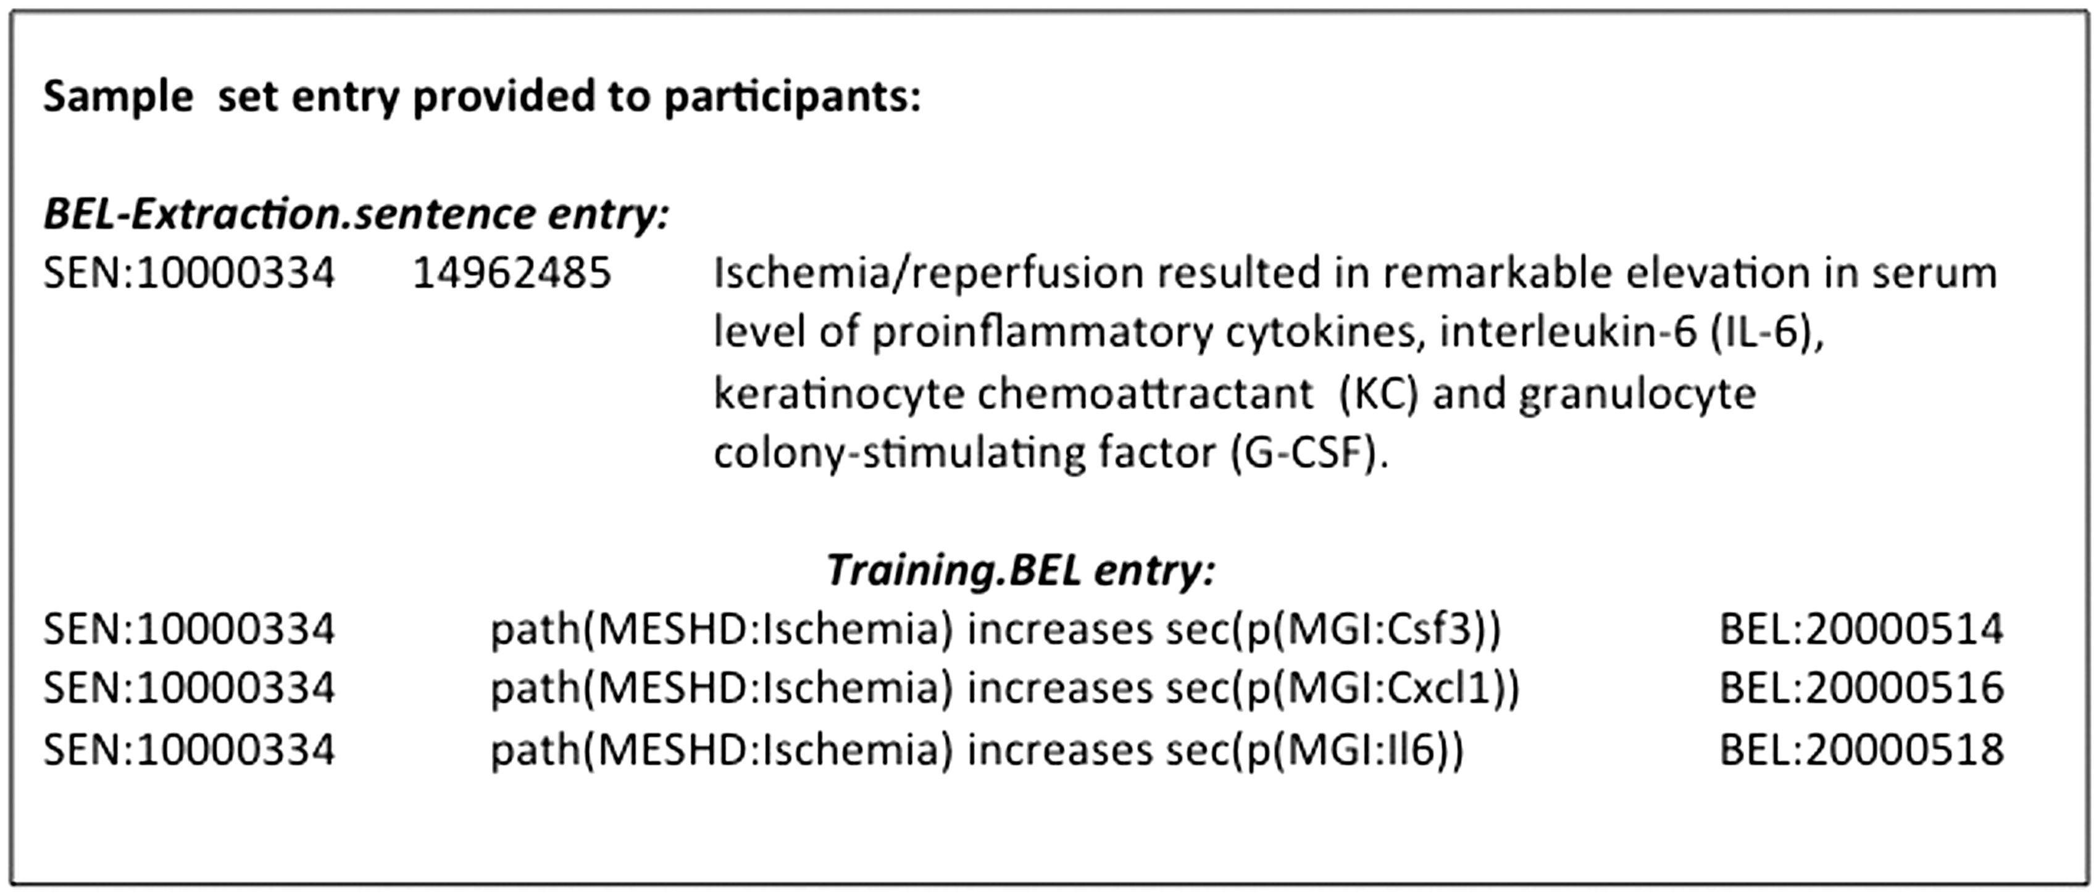
Figure 4. An example of the BEL_Extraction sample corpus.
Notes:
Figure 4. An example of the BEL_Extraction sample corpus.
Unless provided in the caption above, the following copyright applies to the content of this slide: © The Author(s) 2016. Published by Oxford University Press. This is an Open Access article distributed under the terms of the Creative Commons Attribution License ( http://creativecommons.org/licenses/by/4.0/ ), which permits unrestricted reuse, distribution, and reproduction in any medium, provided the original work is properly cited.

