Slide 1
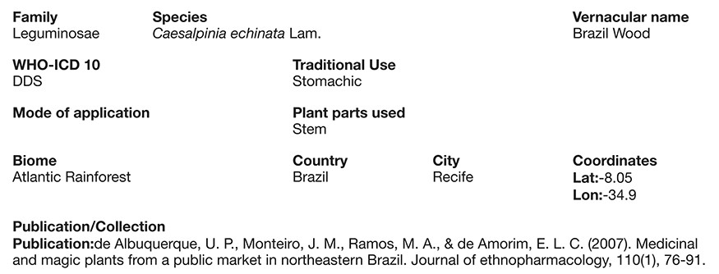
Figure 3 Screen shot of a full record (Caesalpinia echinata Lam.) illustrating its described uses, the part used, ...
Notes:
Figure 3 Screen shot of a full record (Caesalpinia echinata Lam.) illustrating its described uses, the part used, traditional use, forms of use (modes of application) and the paper reference from where it came from.
Unless provided in the caption above, the following copyright applies to the content of this slide: © The Author(s) 2020. Published by Oxford University Press.This is an Open Access article distributed under the terms of the Creative Commons Attribution License (http://creativecommons.org/licenses/by/4.0/), which permits unrestricted reuse, distribution, and reproduction in any medium, provided the original work is properly cited.

