Slide 1
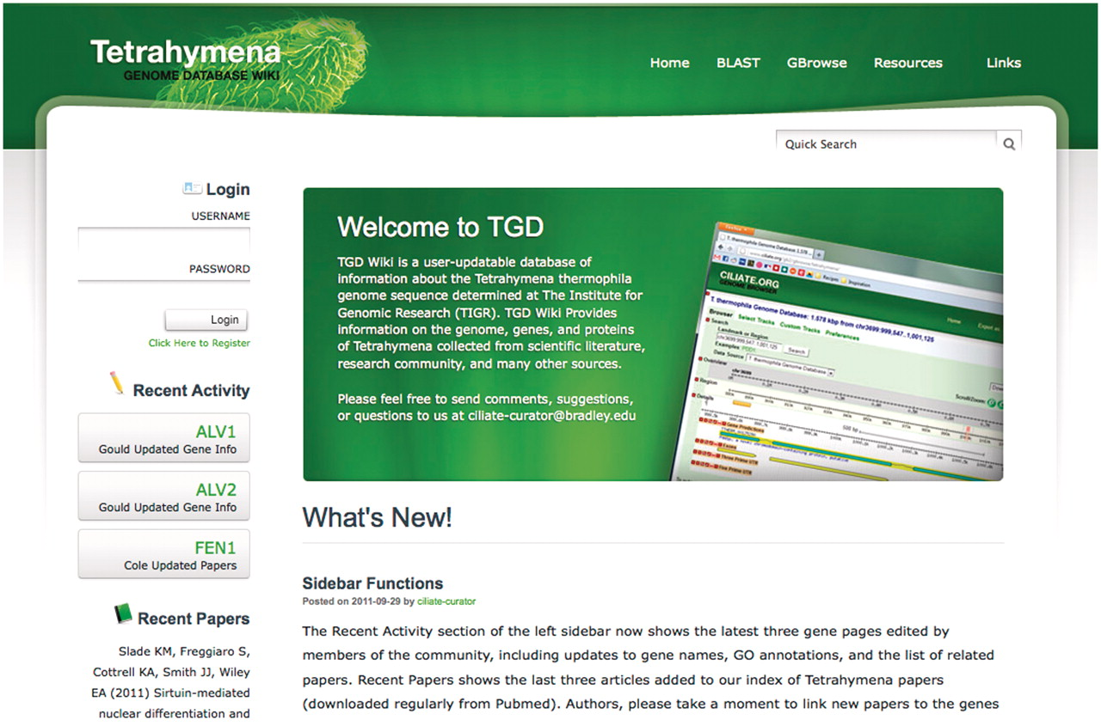
Figure 2. TGD Wiki home page. The latest community annotations are highlighted in the Recent Activity section, with the ...
Notes:
Figure 2. TGD Wiki home page. The latest community annotations are highlighted in the Recent Activity section, with the three most recent Tetrahymena papers available in Pubmed shown below. The Quick Search tool, administrator posts, and editor login are also found on this page, as are links to BLAST, GBrowse and external web sites.
Unless provided in the caption above, the following copyright applies to the content of this slide: © The Author(s) 2012. Published by Oxford University Press.This is an Open Access article distributed under the terms of the Creative Commons Attribution Non-Commercial License (http://creativecommons.org/licenses/by-nc/3.0), which permits unrestricted non-commercial use, distribution, and reproduction in any medium, provided the original work is properly cited.

