Slide 1
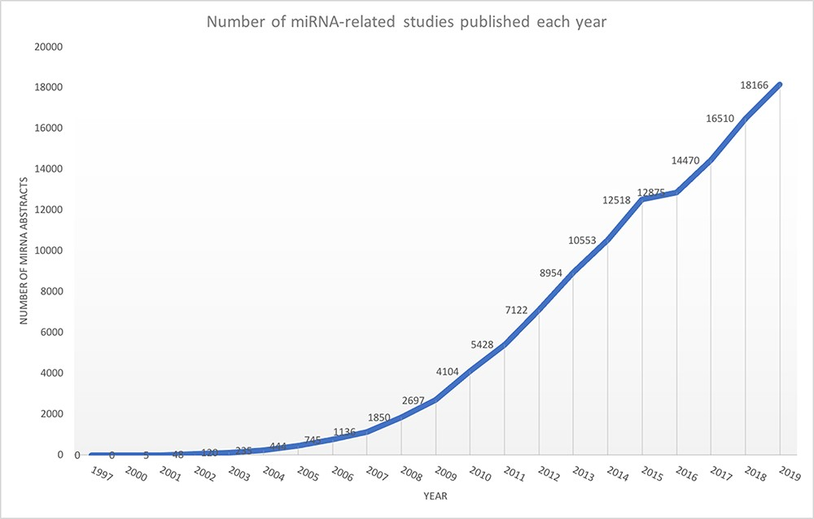
Figure 1. Exponential growth of miRNA publications obtained from Medline using keyword ‘miRNA’ OR ‘microRNA’.
Notes:
Figure 1. Exponential growth of miRNA publications obtained from Medline using keyword ‘miRNA’ OR ‘microRNA’.
Unless provided in the caption above, the following copyright applies to the content of this slide: © The Author(s) 2021. Published by Oxford University Press.This is an Open Access article distributed under the terms of the Creative Commons Attribution License (http://creativecommons.org/licenses/by/4.0/), which permits unrestricted reuse, distribution, and reproduction in any medium, provided the original work is properly cited.

Slide 2
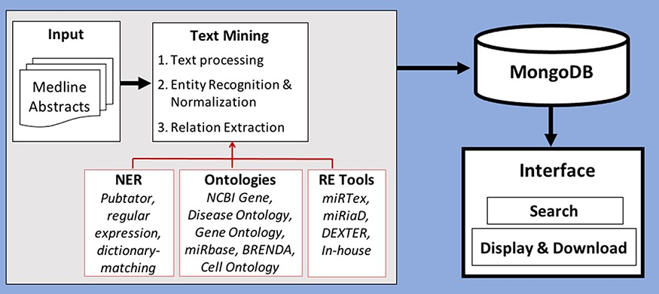
Figure 2. Workflow of creation of database by processing and storing miRNA-relevant information and viewing through an ...
Notes:
Figure 2. Workflow of creation of database by processing and storing miRNA-relevant information and viewing through an interface.
Unless provided in the caption above, the following copyright applies to the content of this slide: © The Author(s) 2021. Published by Oxford University Press.This is an Open Access article distributed under the terms of the Creative Commons Attribution License (http://creativecommons.org/licenses/by/4.0/), which permits unrestricted reuse, distribution, and reproduction in any medium, provided the original work is properly cited.

Slide 3
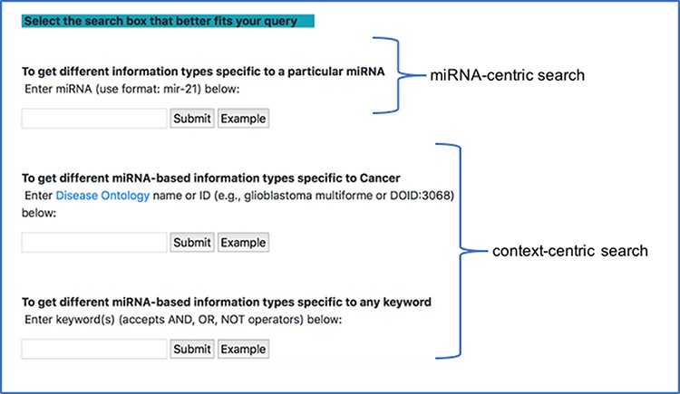
Figure 4. miRNA-centric search and context-centric search mode in the interface.
Notes:
Figure 4. miRNA-centric search and context-centric search mode in the interface.
Unless provided in the caption above, the following copyright applies to the content of this slide: © The Author(s) 2021. Published by Oxford University Press.This is an Open Access article distributed under the terms of the Creative Commons Attribution License (http://creativecommons.org/licenses/by/4.0/), which permits unrestricted reuse, distribution, and reproduction in any medium, provided the original work is properly cited.

Slide 4
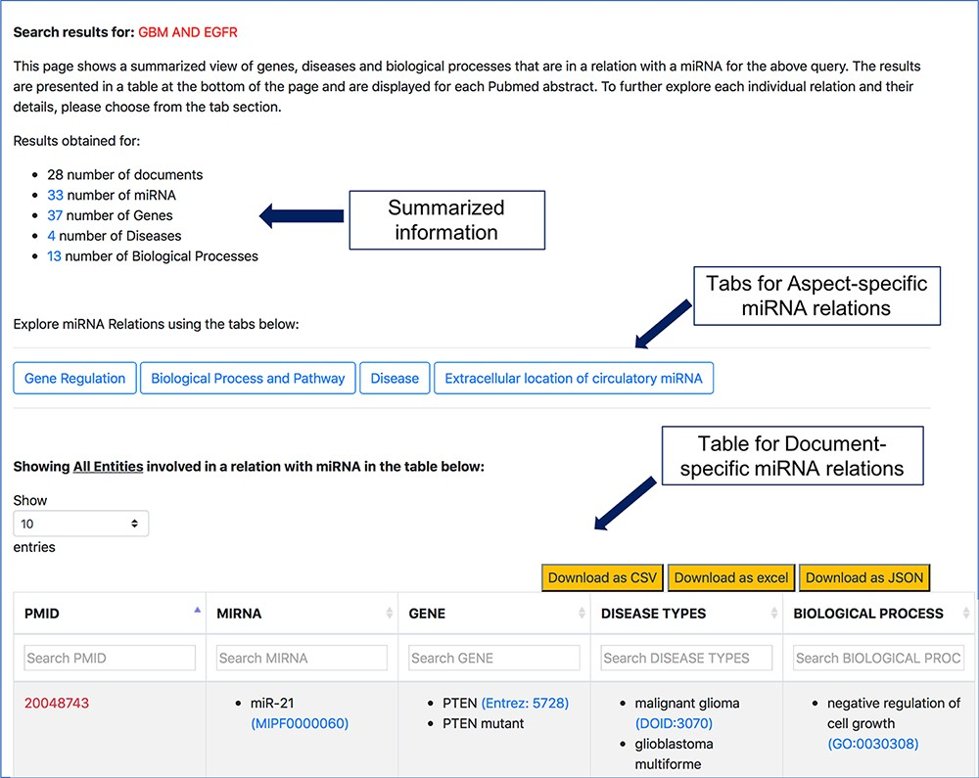
Figure 5. Screenshot of response page for context-centric query ‘GBM AND EGFR’.
Notes:
Figure 5. Screenshot of response page for context-centric query ‘GBM AND EGFR’.
Unless provided in the caption above, the following copyright applies to the content of this slide: © The Author(s) 2021. Published by Oxford University Press.This is an Open Access article distributed under the terms of the Creative Commons Attribution License (http://creativecommons.org/licenses/by/4.0/), which permits unrestricted reuse, distribution, and reproduction in any medium, provided the original work is properly cited.

Slide 5
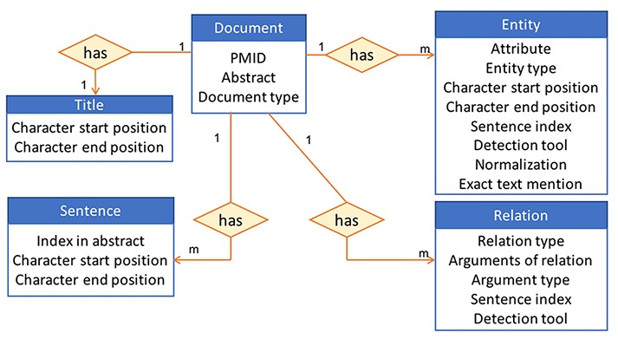
Figure 3. High-level view of the information stored in the database for an abstract.
Notes:
Figure 3. High-level view of the information stored in the database for an abstract.
Unless provided in the caption above, the following copyright applies to the content of this slide: © The Author(s) 2021. Published by Oxford University Press.This is an Open Access article distributed under the terms of the Creative Commons Attribution License (http://creativecommons.org/licenses/by/4.0/), which permits unrestricted reuse, distribution, and reproduction in any medium, provided the original work is properly cited.

Slide 6
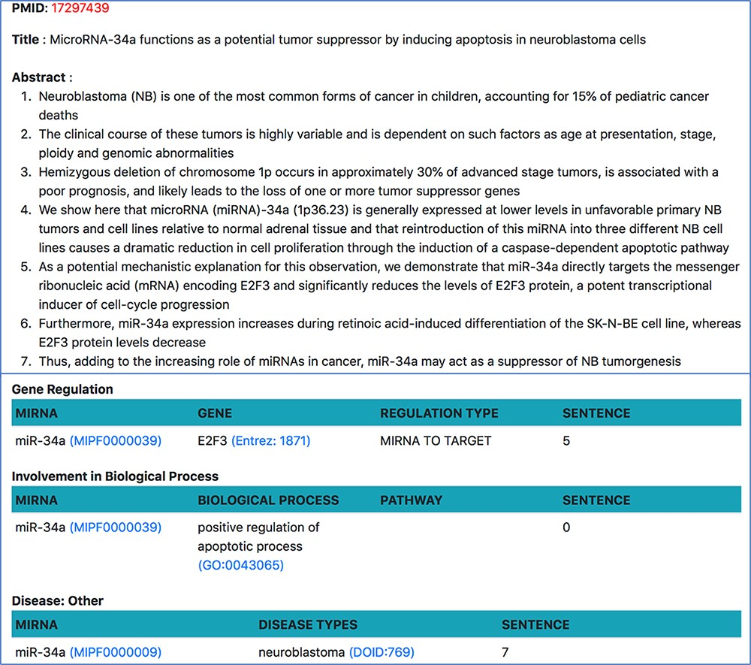
Figure 9. Document-specific view for PMID 17 297 439.
Notes:
Figure 9. Document-specific view for PMID 17 297 439.
Unless provided in the caption above, the following copyright applies to the content of this slide: © The Author(s) 2021. Published by Oxford University Press.This is an Open Access article distributed under the terms of the Creative Commons Attribution License (http://creativecommons.org/licenses/by/4.0/), which permits unrestricted reuse, distribution, and reproduction in any medium, provided the original work is properly cited.

Slide 7
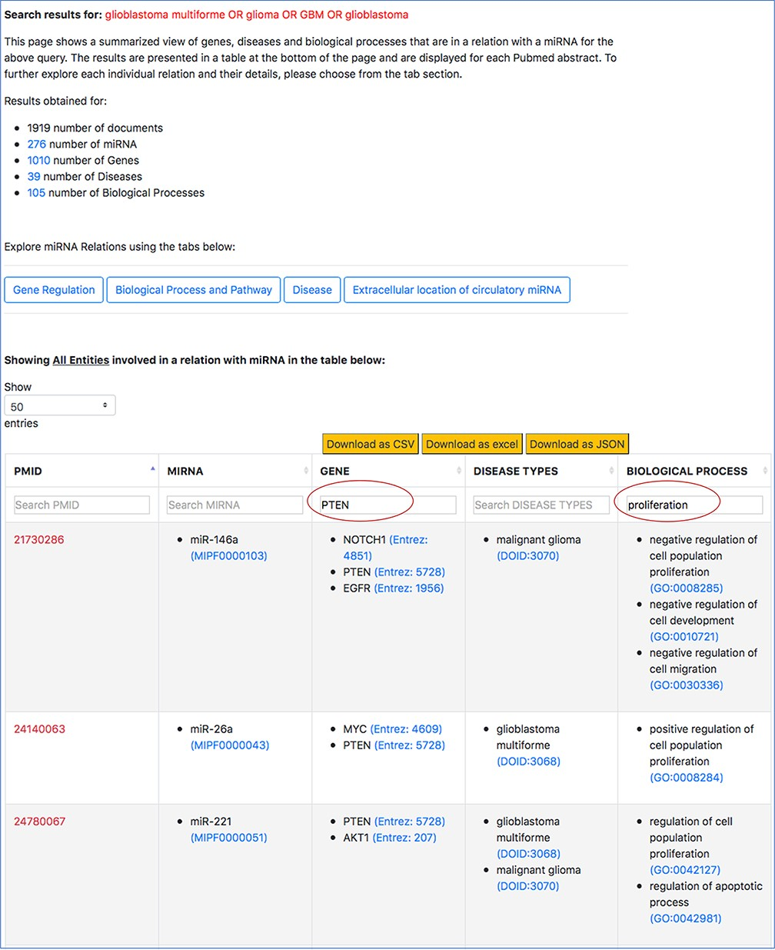
Figure 10. Filtered search result for ‘PTEN’ in the context of cell proliferation in GBM.
Notes:
Figure 10. Filtered search result for ‘PTEN’ in the context of cell proliferation in GBM.
Unless provided in the caption above, the following copyright applies to the content of this slide: © The Author(s) 2021. Published by Oxford University Press.This is an Open Access article distributed under the terms of the Creative Commons Attribution License (http://creativecommons.org/licenses/by/4.0/), which permits unrestricted reuse, distribution, and reproduction in any medium, provided the original work is properly cited.

Slide 8
Figure 6. Specific miRNA relation tabs at the top of the response page for a query.
Notes:
Figure 6. Specific miRNA relation tabs at the top of the response page for a query.
Unless provided in the caption above, the following copyright applies to the content of this slide: © The Author(s) 2021. Published by Oxford University Press.This is an Open Access article distributed under the terms of the Creative Commons Attribution License (http://creativecommons.org/licenses/by/4.0/), which permits unrestricted reuse, distribution, and reproduction in any medium, provided the original work is properly cited.

Slide 9
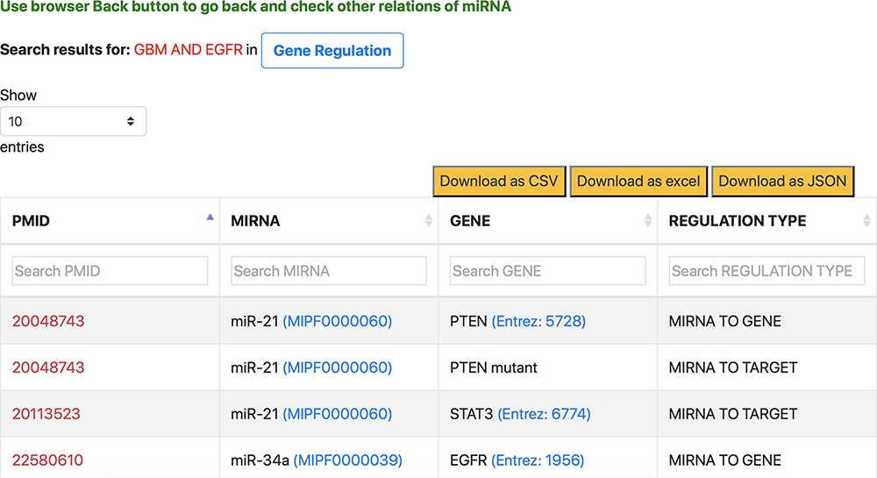
Figure 7. Response page of ‘Gene Regulation’ tab containing gene regulation information of miRNAs for context-centric ...
Notes:
Figure 7. Response page of ‘Gene Regulation’ tab containing gene regulation information of miRNAs for context-centric query ‘GBM AND EGFR’.
Unless provided in the caption above, the following copyright applies to the content of this slide: © The Author(s) 2021. Published by Oxford University Press.This is an Open Access article distributed under the terms of the Creative Commons Attribution License (http://creativecommons.org/licenses/by/4.0/), which permits unrestricted reuse, distribution, and reproduction in any medium, provided the original work is properly cited.

Slide 10
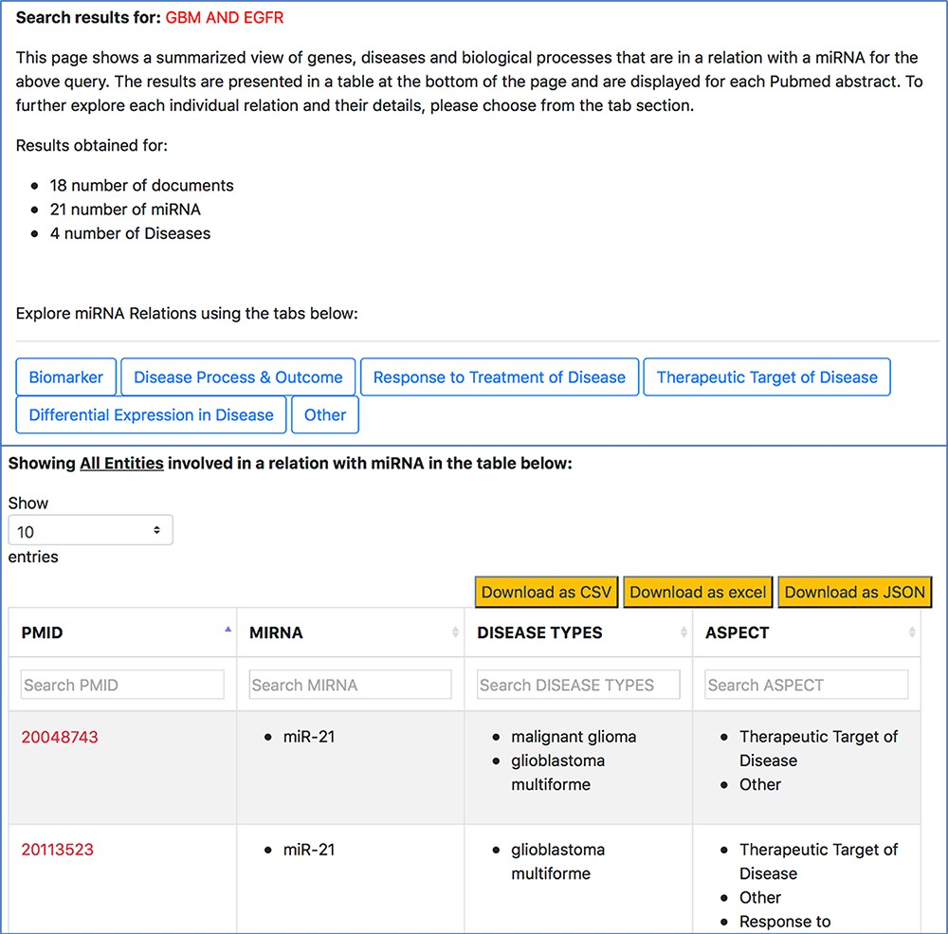
Figure 8. Disease-oriented information context-centric query ‘GBM AND EGFR’.
Notes:
Figure 8. Disease-oriented information context-centric query ‘GBM AND EGFR’.
Unless provided in the caption above, the following copyright applies to the content of this slide: © The Author(s) 2021. Published by Oxford University Press.This is an Open Access article distributed under the terms of the Creative Commons Attribution License (http://creativecommons.org/licenses/by/4.0/), which permits unrestricted reuse, distribution, and reproduction in any medium, provided the original work is properly cited.

Slide 11
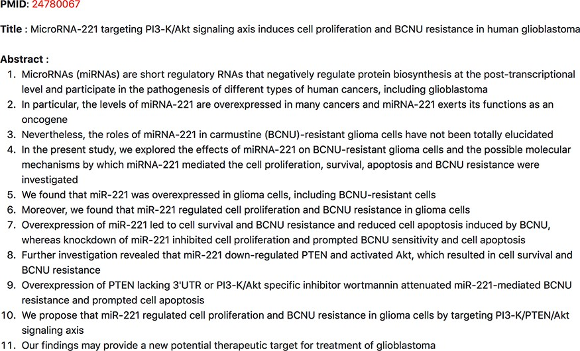
Figure 11. Abstract evidence for ‘miR-221’ promoting ‘proliferation’ by targeting ‘PTEN’ in the context of GBM.
Notes:
Figure 11. Abstract evidence for ‘miR-221’ promoting ‘proliferation’ by targeting ‘PTEN’ in the context of GBM.
Unless provided in the caption above, the following copyright applies to the content of this slide: © The Author(s) 2021. Published by Oxford University Press.This is an Open Access article distributed under the terms of the Creative Commons Attribution License (http://creativecommons.org/licenses/by/4.0/), which permits unrestricted reuse, distribution, and reproduction in any medium, provided the original work is properly cited.

Slide 12
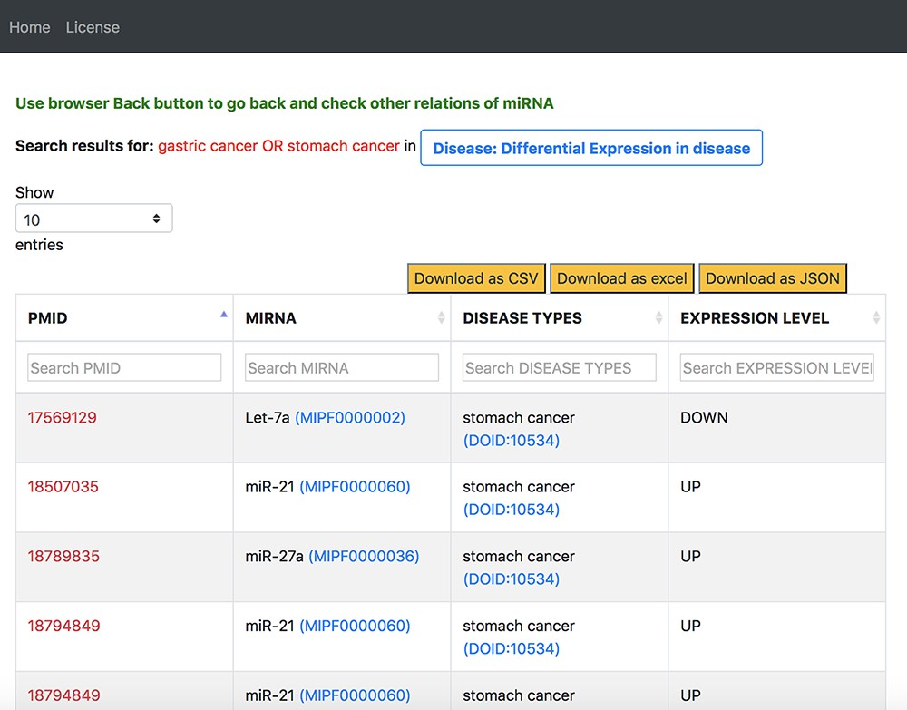
Figure 12. Output response page of ‘Differential Expression in Disease’ tab for ‘gastric cancer OR stomach cancer’ query ...
Notes:
Figure 12. Output response page of ‘Differential Expression in Disease’ tab for ‘gastric cancer OR stomach cancer’ query in general keyword-centric search mode.
Unless provided in the caption above, the following copyright applies to the content of this slide: © The Author(s) 2021. Published by Oxford University Press.This is an Open Access article distributed under the terms of the Creative Commons Attribution License (http://creativecommons.org/licenses/by/4.0/), which permits unrestricted reuse, distribution, and reproduction in any medium, provided the original work is properly cited.

