Slide 1
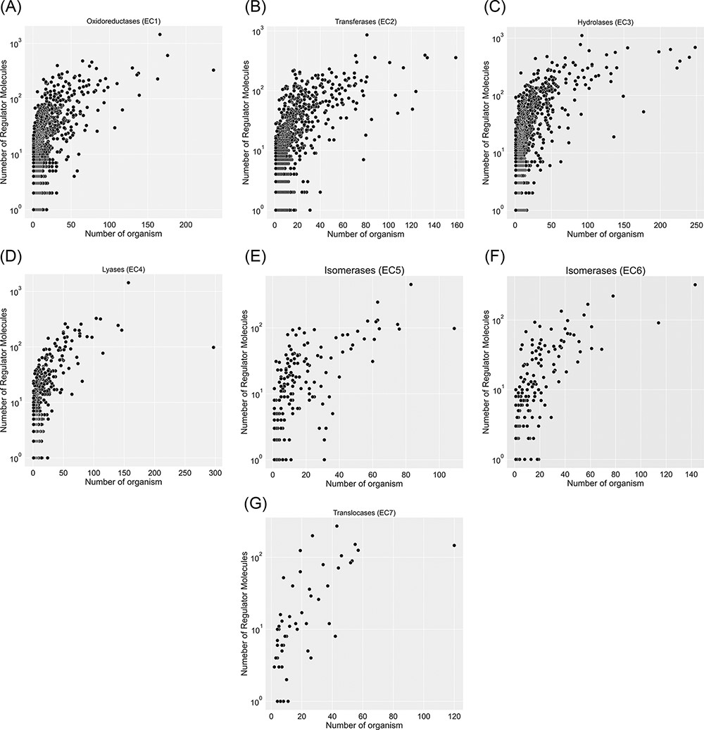
Figure 4. Visualization of seven EC classes based on the number of regulators interacting with each EC number and the ...
Notes:
Figure 4. Visualization of seven EC classes based on the number of regulators interacting with each EC number and the number of specific organisms that inherit them in metabolism. EC(1) represents the highest number of regulated enzymes among the seven categories.
Unless provided in the caption above, the following copyright applies to the content of this slide: © The Author(s) 2022. Published by Oxford University Press.This is an Open Access article distributed under the terms of the Creative Commons Attribution-NonCommercial License (https://creativecommons.org/licenses/by-nc/4.0/), which permits non-commercial re-use, distribution, and reproduction in any medium, provided the original work is properly cited. For commercial re-use, please contact journals.permissions@oup.com

