Slide 1
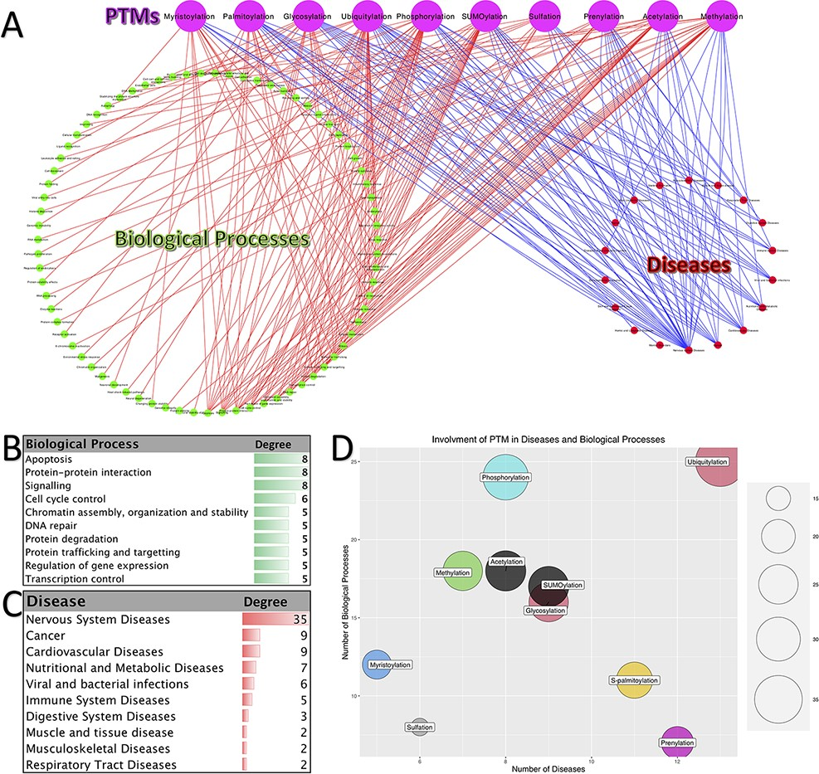
Figure 4. Involvement of PTMs in diseases and biological processes. (A). Tripartite network of PTM involvement in ...
Notes:
Figure 4. Involvement of PTMs in diseases and biological processes. (A). Tripartite network of PTM involvement in diseases and biological processes for the 10 major PTMs. (B) The degree of the biological processes with degree ≥3 in the tripartite network. (C) The degree of the diseases with degree ≥2 in the tripartite network. (D) Involvement of PTMs in disease and biological processes.
Unless provided in the caption above, the following copyright applies to the content of this slide: © The Author(s) 2021. Published by Oxford University Press. All rights reserved. For permissions, please e-mail: journals.permissions@oup.comThis article is published and distributed under the terms of the Oxford University Press, Standard Journals Publication Model (https://academic.oup.com/journals/pages/open_access/funder_policies/chorus/standard_publication_model)

