Slide 1
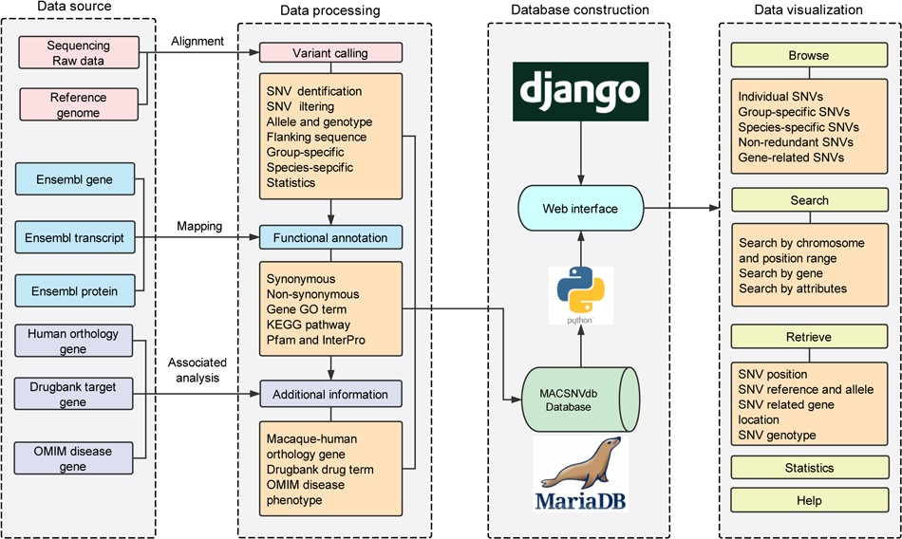
Figure 1 Database construction overview and the functionality of MACSNVdb.
Notes:
Figure 1 Database construction overview and the functionality of MACSNVdb.
Unless provided in the caption above, the following copyright applies to the content of this slide: © The Author(s) 2020. Published by Oxford University Press.This is an Open Access article distributed under the terms of the Creative Commons Attribution License (http://creativecommons.org/licenses/by/4.0/), which permits unrestricted reuse, distribution, and reproduction in any medium, provided the original work is properly cited.

Slide 2
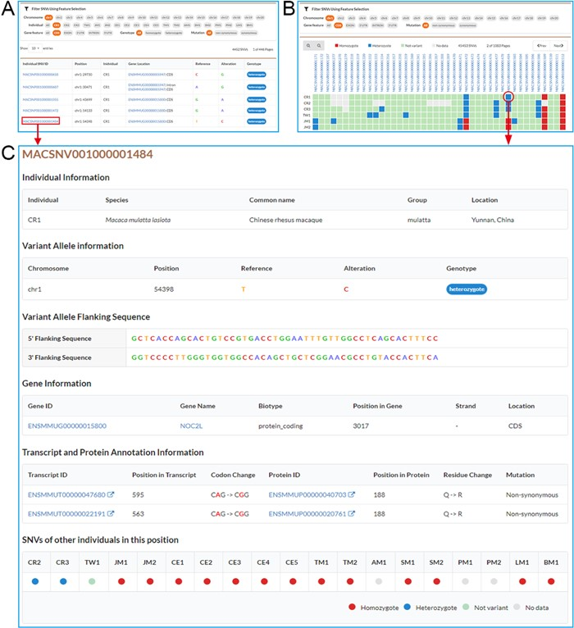
Figure 2 Screenshots of SNV browse pages. A. Individual SNVs’ browse page contains the filtration pane with the SNV ...
Notes:
Figure 2 Screenshots of SNV browse pages. A. Individual SNVs’ browse page contains the filtration pane with the SNV result table below. By using the filtration pane, users can filter SNV data and get a list of relevant SNVs. B. Non-redundant SNVs’ browse page. Comparative map of genotypes in each individual is indicated by colored and filled circles in SNV result table. C. Detailed information for an SNV.
Unless provided in the caption above, the following copyright applies to the content of this slide: © The Author(s) 2020. Published by Oxford University Press.This is an Open Access article distributed under the terms of the Creative Commons Attribution License (http://creativecommons.org/licenses/by/4.0/), which permits unrestricted reuse, distribution, and reproduction in any medium, provided the original work is properly cited.

Slide 3
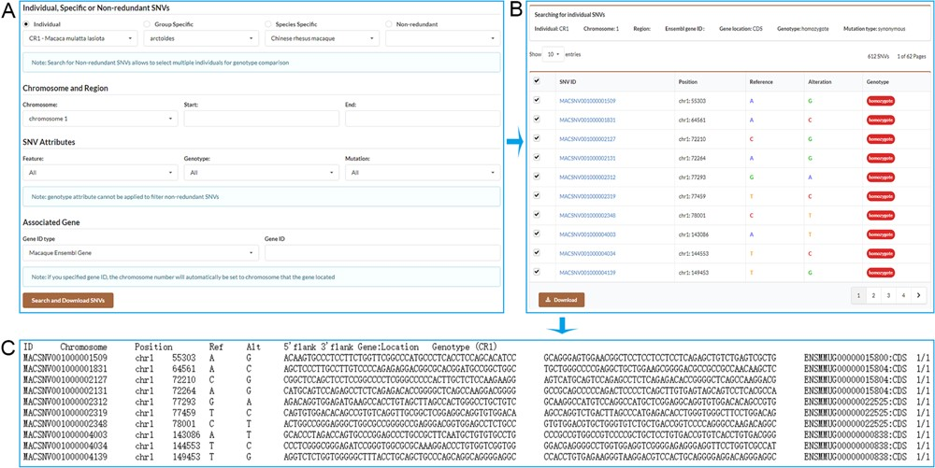
Figure 3 Screenshots of the search result pages. A. Search for individual SNVs, specific SNVs or non-redundant SNVs by ...
Notes:
Figure 3 Screenshots of the search result pages. A. Search for individual SNVs, specific SNVs or non-redundant SNVs by specifying chromosome and position range or associated gene. B. Search result table allows users to select desired SNVs to download. C. SNV list with detailed information obtained by downloading.
Unless provided in the caption above, the following copyright applies to the content of this slide: © The Author(s) 2020. Published by Oxford University Press.This is an Open Access article distributed under the terms of the Creative Commons Attribution License (http://creativecommons.org/licenses/by/4.0/), which permits unrestricted reuse, distribution, and reproduction in any medium, provided the original work is properly cited.

