Slide 1
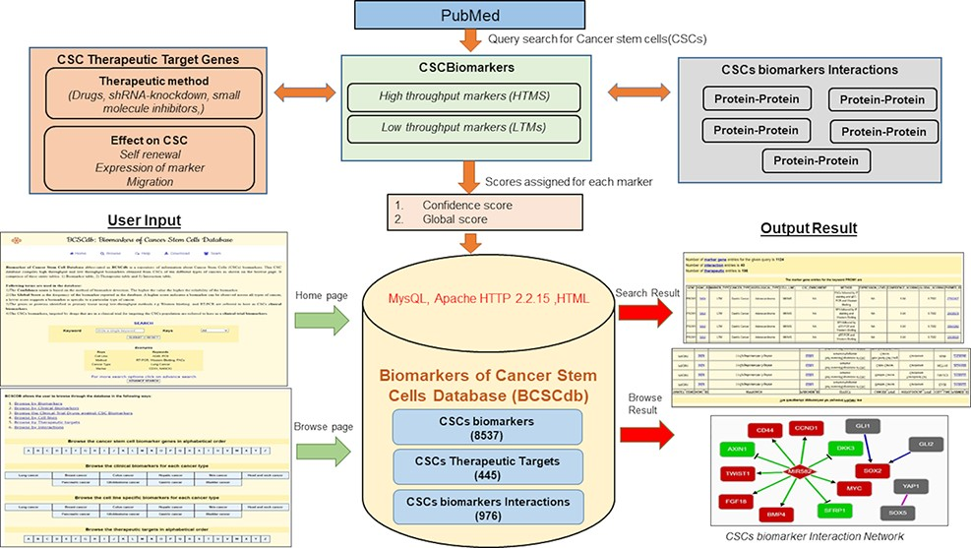
Figure 1. Schematic representation of the workflow of BCSCdb online database and summary of data statistics.
Notes:
Figure 1. Schematic representation of the workflow of BCSCdb online database and summary of data statistics.
Unless provided in the caption above, the following copyright applies to the content of this slide: © The Author(s) 2022. Published by Oxford University Press.This is an Open Access article distributed under the terms of the Creative Commons Attribution-NonCommercial License (https://creativecommons.org/licenses/by-nc/4.0/), which permits non-commercial re-use, distribution, and reproduction in any medium, provided the original work is properly cited. For commercial re-use, please contact journals.permissions@oup.com

Slide 2
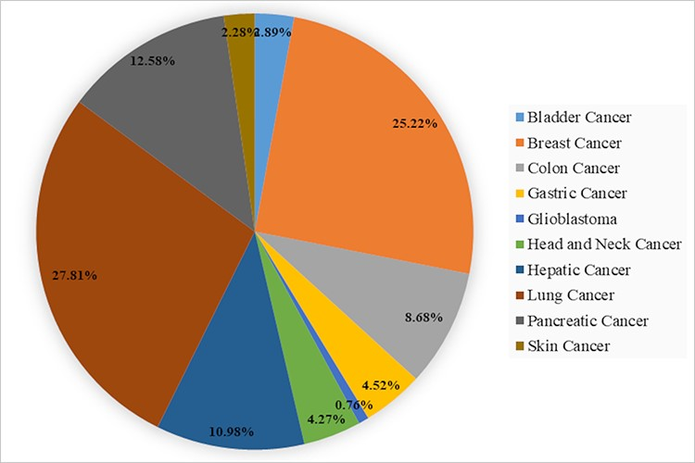
Figure 2. A pie chart showing the percentage of CSCs biomarkers in 10 different types of cancer present in BCSCdb.
Notes:
Figure 2. A pie chart showing the percentage of CSCs biomarkers in 10 different types of cancer present in BCSCdb.
Unless provided in the caption above, the following copyright applies to the content of this slide: © The Author(s) 2022. Published by Oxford University Press.This is an Open Access article distributed under the terms of the Creative Commons Attribution-NonCommercial License (https://creativecommons.org/licenses/by-nc/4.0/), which permits non-commercial re-use, distribution, and reproduction in any medium, provided the original work is properly cited. For commercial re-use, please contact journals.permissions@oup.com

Slide 3
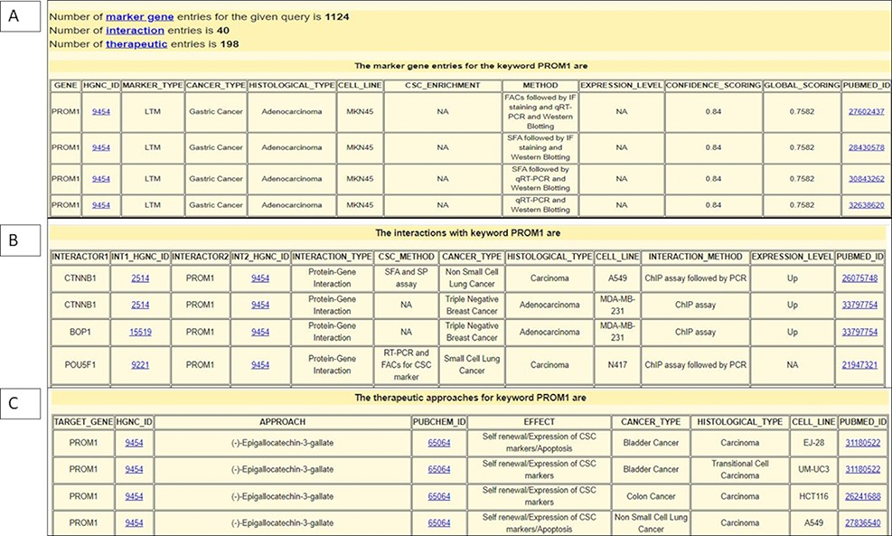
Figure 3. Snapshot of output page of BCSCdb showing the result of three tables (A) CSC biomarker, (B) CSC biomarker ...
Notes:
Figure 3. Snapshot of output page of BCSCdb showing the result of three tables (A) CSC biomarker, (B) CSC biomarker interaction and (C) CSC therapeutics, respectively, of query search ‘PROM1’.
Unless provided in the caption above, the following copyright applies to the content of this slide: © The Author(s) 2022. Published by Oxford University Press.This is an Open Access article distributed under the terms of the Creative Commons Attribution-NonCommercial License (https://creativecommons.org/licenses/by-nc/4.0/), which permits non-commercial re-use, distribution, and reproduction in any medium, provided the original work is properly cited. For commercial re-use, please contact journals.permissions@oup.com

Slide 4
Figure 4. (A) Interaction network showing MIR582 regulation in the A549 NSCLC cell line. (B) Interaction network ...
Notes:
Figure 4. (A) Interaction network showing MIR582 regulation in the A549 NSCLC cell line. (B) Interaction network showing MIR582 regulation in the H1975 NSCLC cell line.
Unless provided in the caption above, the following copyright applies to the content of this slide: © The Author(s) 2022. Published by Oxford University Press.This is an Open Access article distributed under the terms of the Creative Commons Attribution-NonCommercial License (https://creativecommons.org/licenses/by-nc/4.0/), which permits non-commercial re-use, distribution, and reproduction in any medium, provided the original work is properly cited. For commercial re-use, please contact journals.permissions@oup.com

