Slide 1
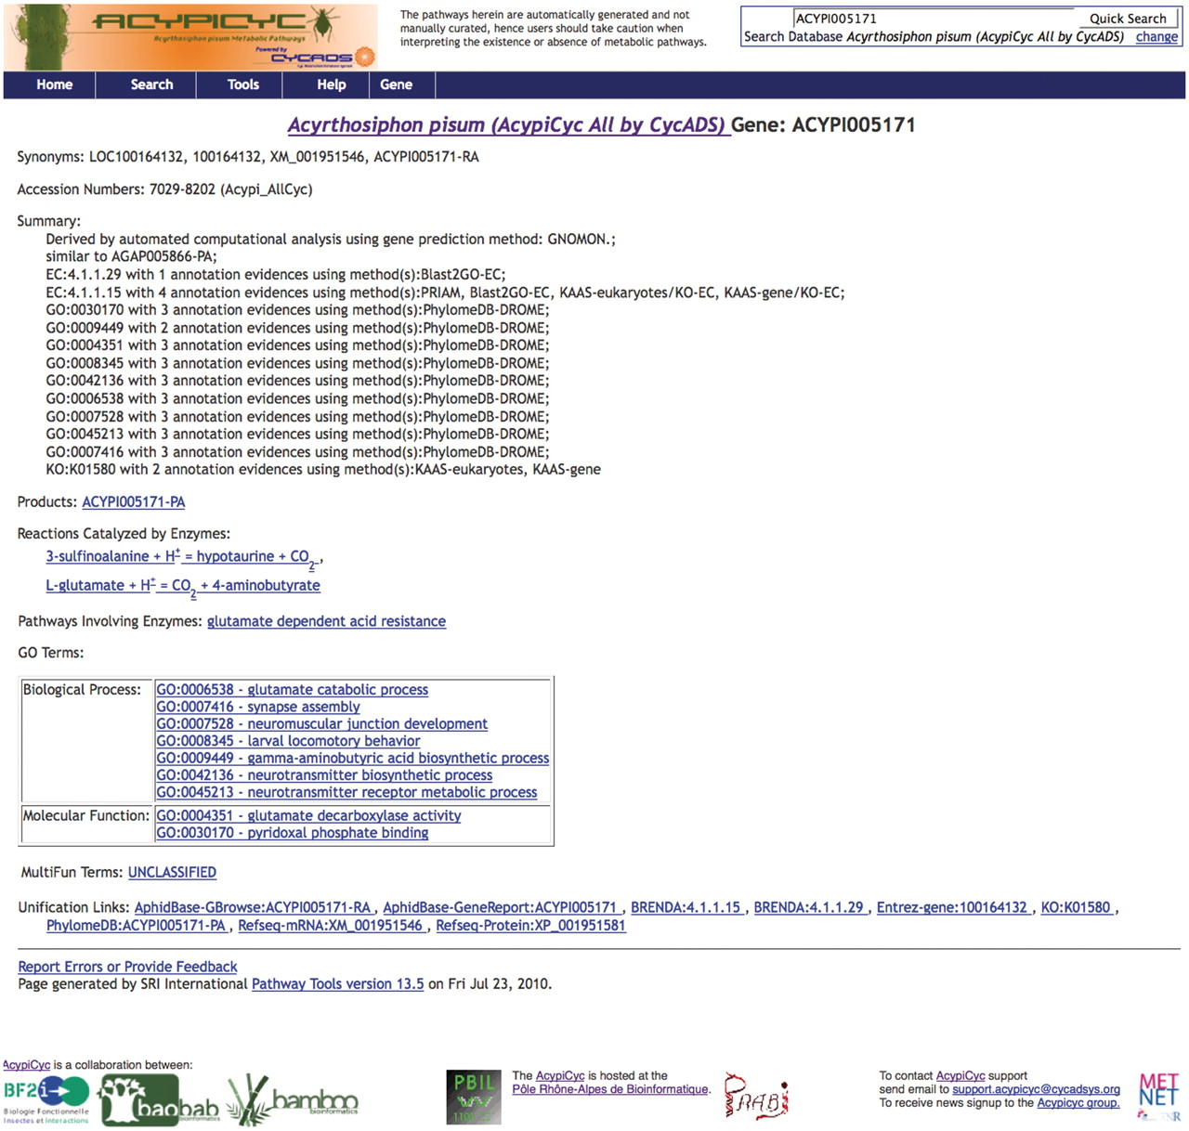
Figure 2. Screenshots of a BioCyc database generated by CycADS. An example page from AcypiCyc showing the enrichment of ...
Notes:
Figure 2. Screenshots of a BioCyc database generated by CycADS. An example page from AcypiCyc showing the enrichment of a BioCyc gene page with complementary information about the annotation source included in the ‘Summary’ and extra hyperlinks (‘Unification Links’) to important resources.
Unless provided in the caption above, the following copyright applies to the content of this slide: © The Author(s) 2011. Published by Oxford University Press.This is Open Access article distributed under the terms of the Creative Commons Attribution Non-Commercial License (http://creativecommons.org/licenses/by-nc/2.5), which permits unrestricted non-commercial use, distribution, and reproduction in any medium, provided the original work is properly cited.

