Slide 1
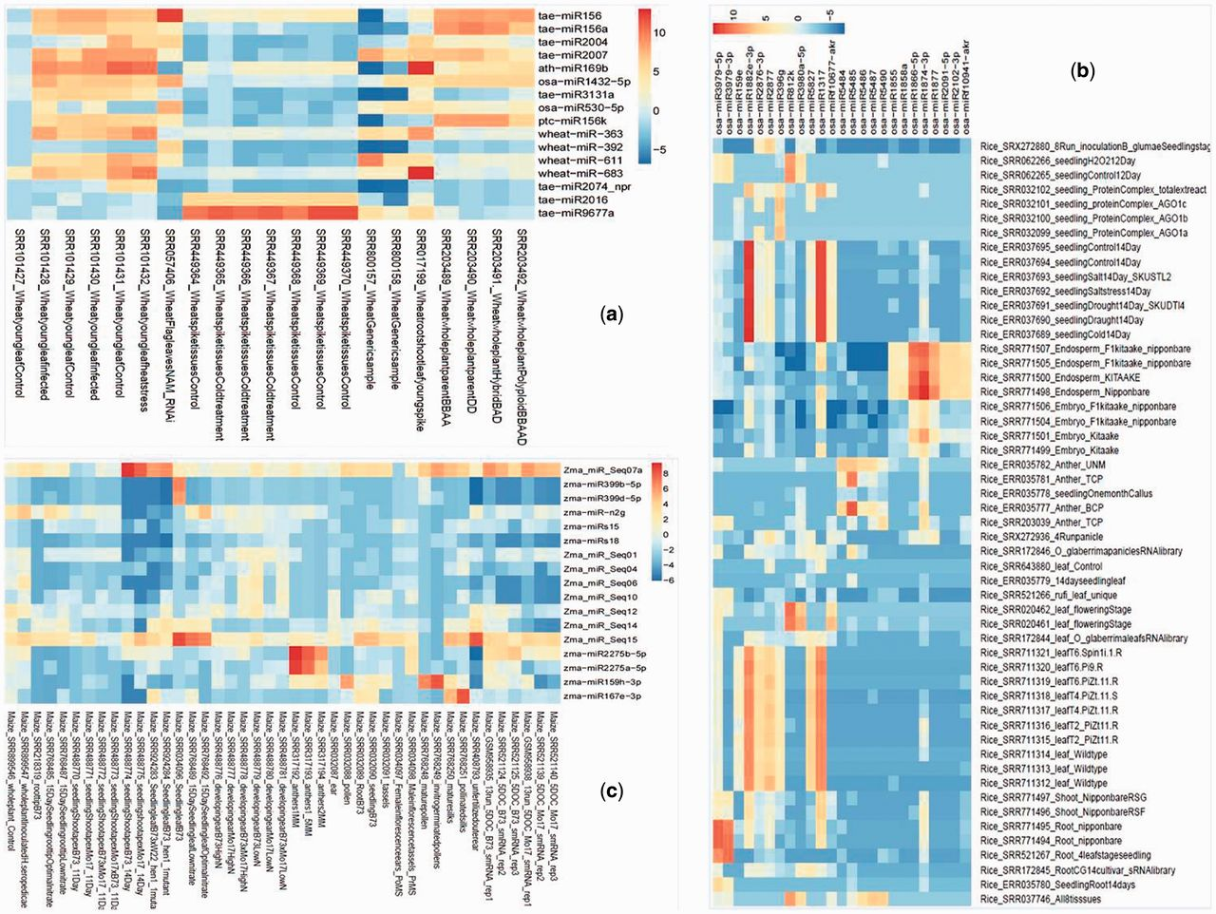
Figure 2. Tissue preferential expression heatmap of wheat (A), rice (B) and maize (C). The tissue preferential miRNA ...
Notes:
Figure 2. Tissue preferential expression heatmap of wheat (A), rice (B) and maize (C). The tissue preferential miRNA were filtered on the basis of fold change (above 80-fold) expression as compared with other miRNA expression and the fold change values were calculated by cumulative TPM values of one tissue versus average of cumulative TPM of other tissues.
Unless provided in the caption above, the following copyright applies to the content of this slide: © The Author(s) 2016. Published by Oxford University Press.This is an Open Access article distributed under the terms of the Creative Commons Attribution License (http://creativecommons.org/licenses/by/4.0/), which permits unrestricted reuse, distribution, and reproduction in any medium, provided the original work is properly cited.

