Slide 1
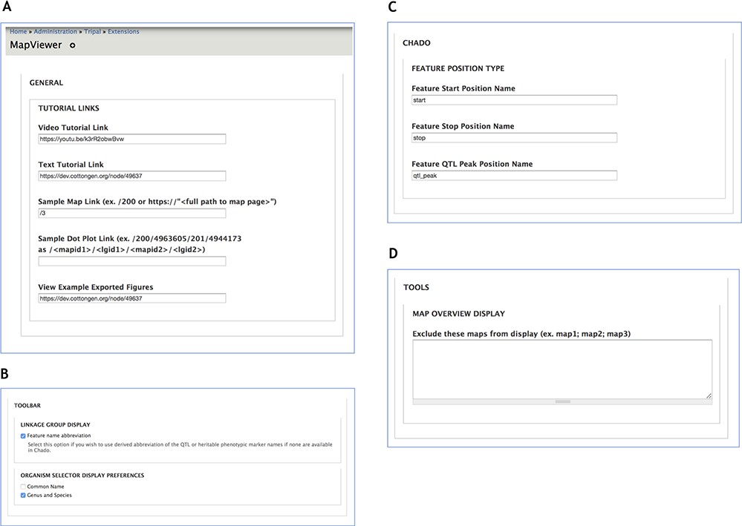
Figure 10 Administration page providing configuration options for MapViewer displays. A. The General section interface ...
Notes:
Figure 10 Administration page providing configuration options for MapViewer displays. A. The General section interface to configure links for tutorials and usage examples. B. Toolbar settings to specify feature name format. C. The Chado section provides way to customize Chado terminology for feature position names. D. Maps to be excluded from display by the MapViewer can be listed in the Tools section.
Unless provided in the caption above, the following copyright applies to the content of this slide: © The Author(s) 2019. Published by Oxford University Press.This work is written by US Government employees and is in the public domain in the US.

