Slide 1
Figure 1 Structure of a BEL statement. This example of a BEL statement describes that an abundance of the chemical ...
Notes:
Figure 1 Structure of a BEL statement. This example of a BEL statement describes that an abundance of the chemical corticosteroid reduces the biological process Oxidative Stress . For the identification and disambiguation of domain-specific terms and concepts in BEL pre-defined namespaces, in this example, CHEBI and MESHPP are used. The namespaces CHEBI contains chemical entities from the resource ChEBI ( http://www.ebi.ac.uk/chebi/ ) and MESHPP contains various biological processes from MeSH ( http://www.nlm.nih.gov/mesh/ ) Phenomena and Processes [G] branch.
Unless provided in the caption above, the following copyright applies to the content of this slide: © The Author(s) 2016. Published by Oxford University Press. All rights reserved. For permissions, please e-mail: journals.permissions@oup.com This is an Open Access article distributed under the terms of the Creative Commons Attribution License ( http://creativecommons.org/licenses/by/4.0/ ), which permits unrestricted reuse, distribution, and reproduction in any medium, provided the original work is properly cited.

Slide 2
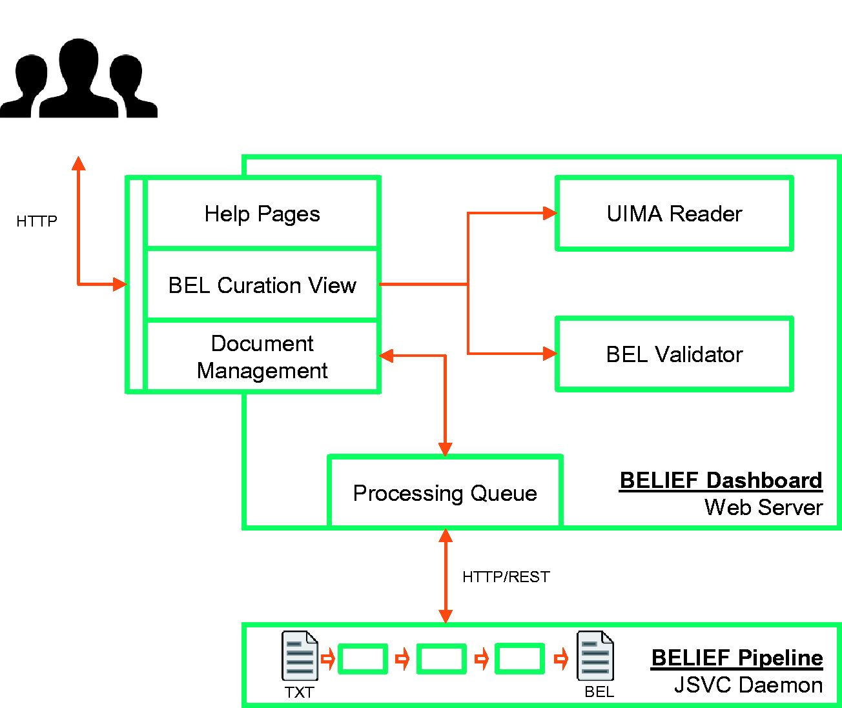
Figure 2 Architecture of semiautomatic information extraction workflow BELIEF. The workflow consists of a text mining ...
Notes:
Figure 2 Architecture of semiautomatic information extraction workflow BELIEF. The workflow consists of a text mining pipeline (BELIEF Pipeline) and a web-based biocuration tool (BELIEF Dashboard). ( Note : UIMA: Unstructured Information Management Architecture. UIMA Reader: A reader component to parse and extr act information from UIMA XCAS documents. JSVC Daemon: A Java library that allows applications to run as daemons.).
Unless provided in the caption above, the following copyright applies to the content of this slide: © The Author(s) 2016. Published by Oxford University Press. All rights reserved. For permissions, please e-mail: journals.permissions@oup.com This is an Open Access article distributed under the terms of the Creative Commons Attribution License ( http://creativecommons.org/licenses/by/4.0/ ), which permits unrestricted reuse, distribution, and reproduction in any medium, provided the original work is properly cited.

Slide 3
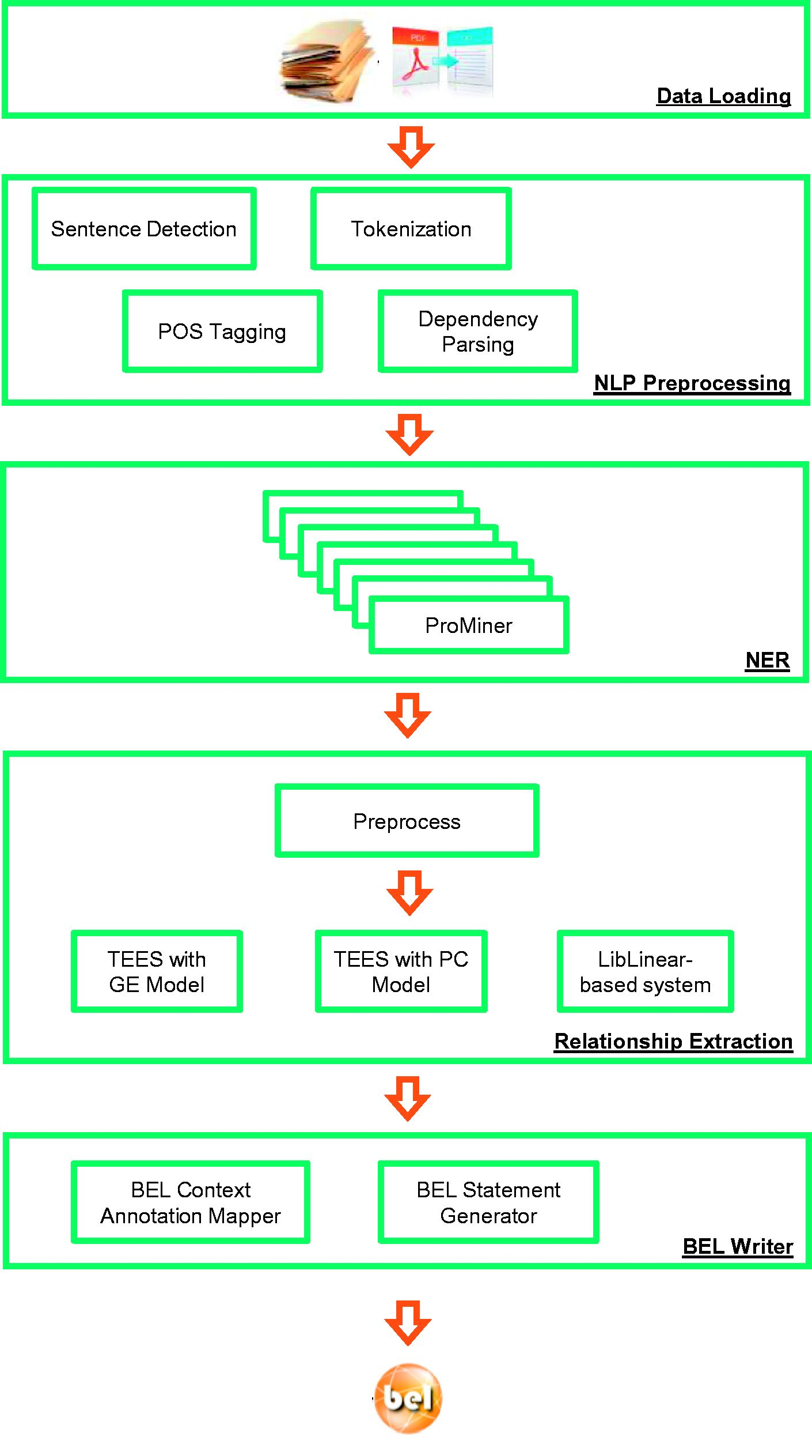
Figure 3 Architecture of the BELIEF text mining pipeline. ( Note : POS Tagging: Part of Speech Tagging. NLP: Natural ...
Notes:
Figure 3 Architecture of the BELIEF text mining pipeline. ( Note : POS Tagging: Part of Speech Tagging. NLP: Natural Language Processing. TEES: Turku Event Extraction System, a state-of-the-art relation extraction system. GE: Genia Event Extraction for NFkB knowledgebase, a BioNLP Shared Task. PC: Pathway Curation, a BioNLP Shared Task.).
Unless provided in the caption above, the following copyright applies to the content of this slide: © The Author(s) 2016. Published by Oxford University Press. All rights reserved. For permissions, please e-mail: journals.permissions@oup.com This is an Open Access article distributed under the terms of the Creative Commons Attribution License ( http://creativecommons.org/licenses/by/4.0/ ), which permits unrestricted reuse, distribution, and reproduction in any medium, provided the original work is properly cited.

Slide 4
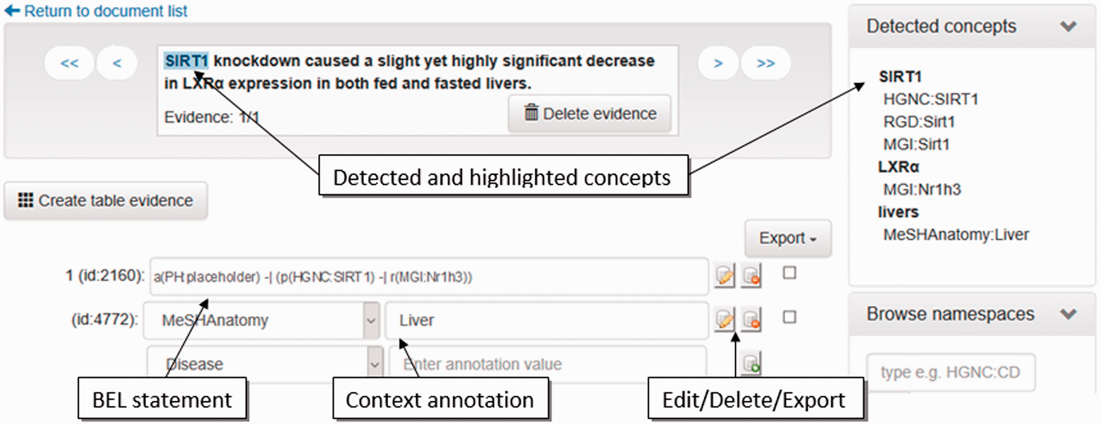
Figure 4 Screenshot of the evidence-centric curation view. In the upper left, the evidence text is visualized. ...
Notes:
Figure 4 Screenshot of the evidence-centric curation view. In the upper left, the evidence text is visualized. Detected concepts in the current evidence text are shown in the upper right. In the bottom left, the curation of BEL statements and their context annotations can be performed.
Unless provided in the caption above, the following copyright applies to the content of this slide: © The Author(s) 2016. Published by Oxford University Press. All rights reserved. For permissions, please e-mail: journals.permissions@oup.com This is an Open Access article distributed under the terms of the Creative Commons Attribution License ( http://creativecommons.org/licenses/by/4.0/ ), which permits unrestricted reuse, distribution, and reproduction in any medium, provided the original work is properly cited.

Slide 5
Figure 5 Screenshot of the document management system listing documents for project ‘Demoversion’.
Notes:
Figure 5 Screenshot of the document management system listing documents for project ‘Demoversion’.
Unless provided in the caption above, the following copyright applies to the content of this slide: © The Author(s) 2016. Published by Oxford University Press. All rights reserved. For permissions, please e-mail: journals.permissions@oup.com This is an Open Access article distributed under the terms of the Creative Commons Attribution License ( http://creativecommons.org/licenses/by/4.0/ ), which permits unrestricted reuse, distribution, and reproduction in any medium, provided the original work is properly cited.

Slide 6
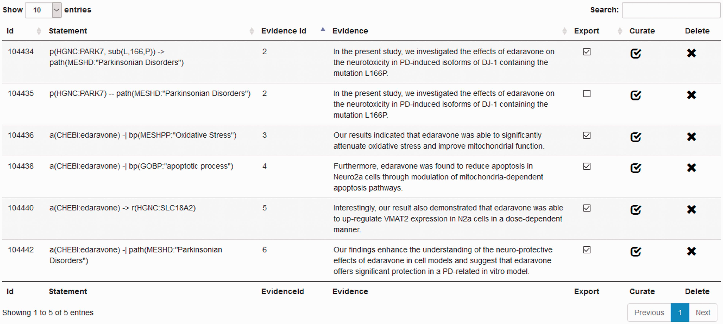
Figure 6 Screenshot of the statement-centric curation view in the BELIEF Dashboard.
Notes:
Figure 6 Screenshot of the statement-centric curation view in the BELIEF Dashboard.
Unless provided in the caption above, the following copyright applies to the content of this slide: © The Author(s) 2016. Published by Oxford University Press. All rights reserved. For permissions, please e-mail: journals.permissions@oup.com This is an Open Access article distributed under the terms of the Creative Commons Attribution License ( http://creativecommons.org/licenses/by/4.0/ ), which permits unrestricted reuse, distribution, and reproduction in any medium, provided the original work is properly cited.

Slide 7
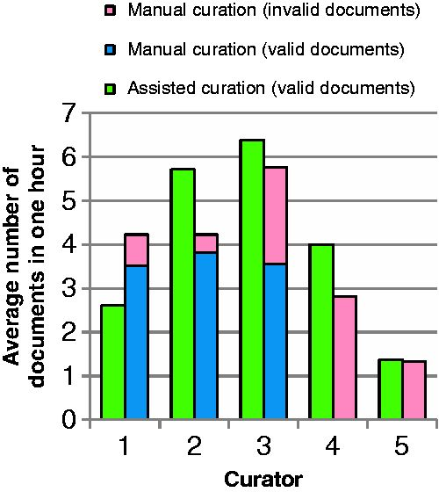
Figure 7 Average number of documents curated by curators in 1 h through assited curation using BELIEF Dashboard and ...
Notes:
Figure 7 Average number of documents curated by curators in 1 h through assited curation using BELIEF Dashboard and through manual curation. The documents with BEL syntax errors are shown here as invalid. The curators are ordered according to their experience of BEL curation.
Unless provided in the caption above, the following copyright applies to the content of this slide: © The Author(s) 2016. Published by Oxford University Press. All rights reserved. For permissions, please e-mail: journals.permissions@oup.com This is an Open Access article distributed under the terms of the Creative Commons Attribution License ( http://creativecommons.org/licenses/by/4.0/ ), which permits unrestricted reuse, distribution, and reproduction in any medium, provided the original work is properly cited.

Slide 8
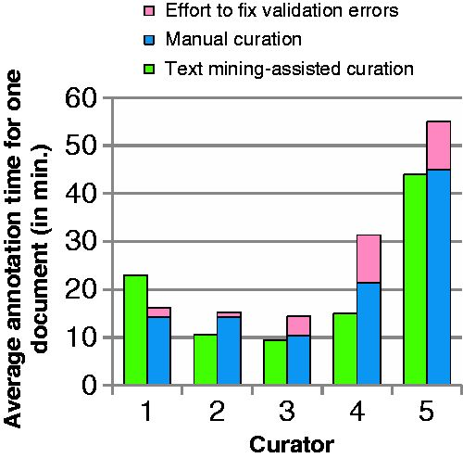
Figure 8 Time usage by curators and curation type.
Notes:
Figure 8 Time usage by curators and curation type.
Unless provided in the caption above, the following copyright applies to the content of this slide: © The Author(s) 2016. Published by Oxford University Press. All rights reserved. For permissions, please e-mail: journals.permissions@oup.com This is an Open Access article distributed under the terms of the Creative Commons Attribution License ( http://creativecommons.org/licenses/by/4.0/ ), which permits unrestricted reuse, distribution, and reproduction in any medium, provided the original work is properly cited.

