Slide 1
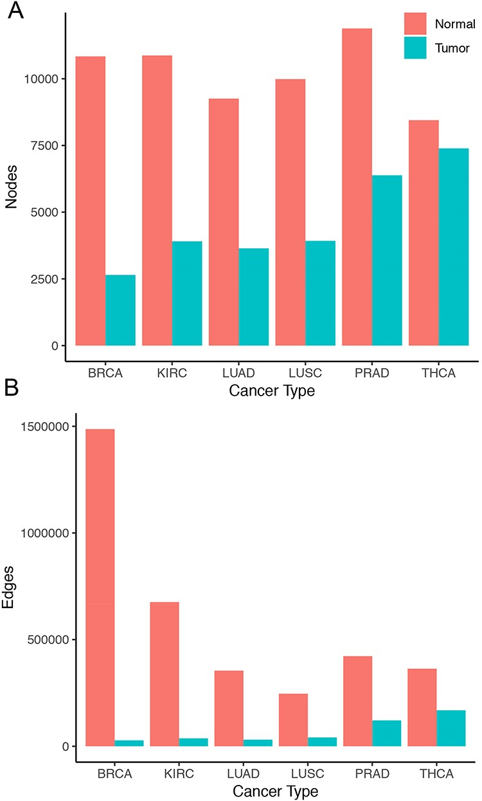
Figure 1. Size of co-expression networks. The bar charts show the total number of (A) nodes and (B) edges in the normal ...
Notes:
Figure 1. Size of co-expression networks. The bar charts show the total number of (A) nodes and (B) edges in the normal (red) and tumor (blue) co-expression graphs.
Unless provided in the caption above, the following copyright applies to the content of this slide: © The Author(s) 2020. Published by Oxford University Press.This is an Open Access article distributed under the terms of the Creative Commons Attribution License (http://creativecommons.org/licenses/by/4.0/), which permits unrestricted reuse, distribution, and reproduction in any medium, provided the original work is properly cited.

Slide 2
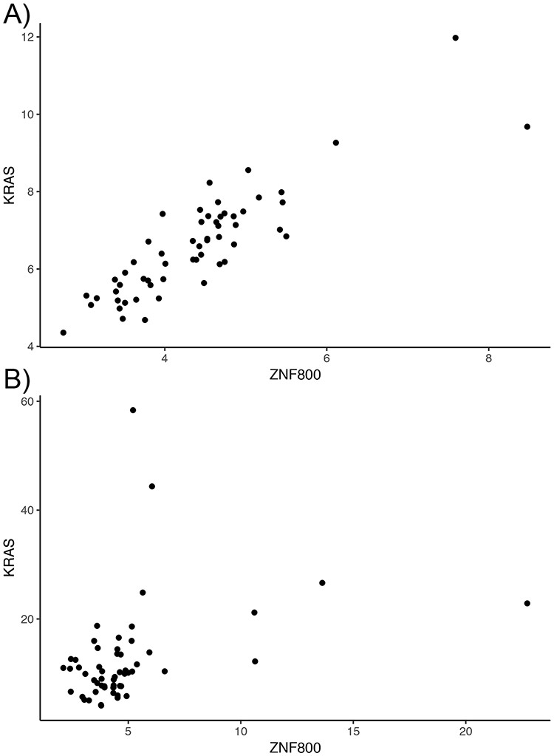
Figure 2. Lost co-expression in tumors. The dot plots illustrate the expression (measured as FPKM) of KRAS and ZNF800 ...
Notes:
Figure 2. Lost co-expression in tumors. The dot plots illustrate the expression (measured as FPKM) of KRAS and ZNF800 in (A) healthy lungs and (B) lung adenocarcinoma. Each dot reflects the expression of the two genes in one sample.
Unless provided in the caption above, the following copyright applies to the content of this slide: © The Author(s) 2020. Published by Oxford University Press.This is an Open Access article distributed under the terms of the Creative Commons Attribution License (http://creativecommons.org/licenses/by/4.0/), which permits unrestricted reuse, distribution, and reproduction in any medium, provided the original work is properly cited.

Slide 3
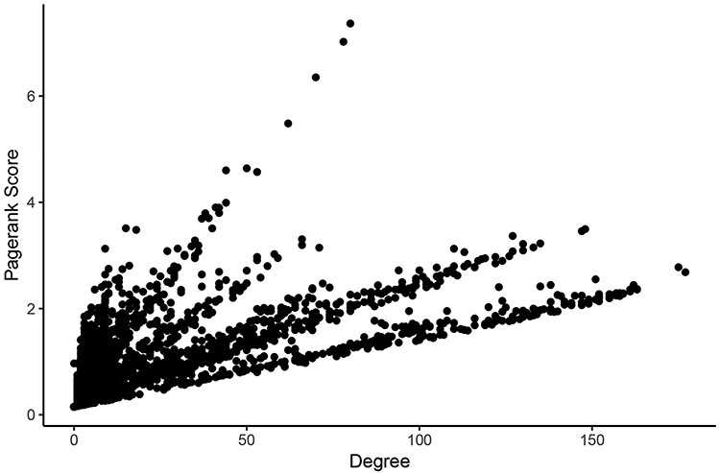
Figure 3. Comparison of measures of centrality in the LUAD tumor network. In the normal lung co-expression network, ...
Notes:
Figure 3. Comparison of measures of centrality in the LUAD tumor network. In the normal lung co-expression network, seven of the 10 nodes with the highest Pagerank scores were zinc finger transcription factors (Table 1). The other three genes encode trinucleotide repeat-containing gene 6A protein (TNRC6A), transmembrane protein-encoding gene KIAA1109 and nuclear mitotic apparatus protein 1 (NuMA-1).
Unless provided in the caption above, the following copyright applies to the content of this slide: © The Author(s) 2020. Published by Oxford University Press.This is an Open Access article distributed under the terms of the Creative Commons Attribution License (http://creativecommons.org/licenses/by/4.0/), which permits unrestricted reuse, distribution, and reproduction in any medium, provided the original work is properly cited.

Slide 4
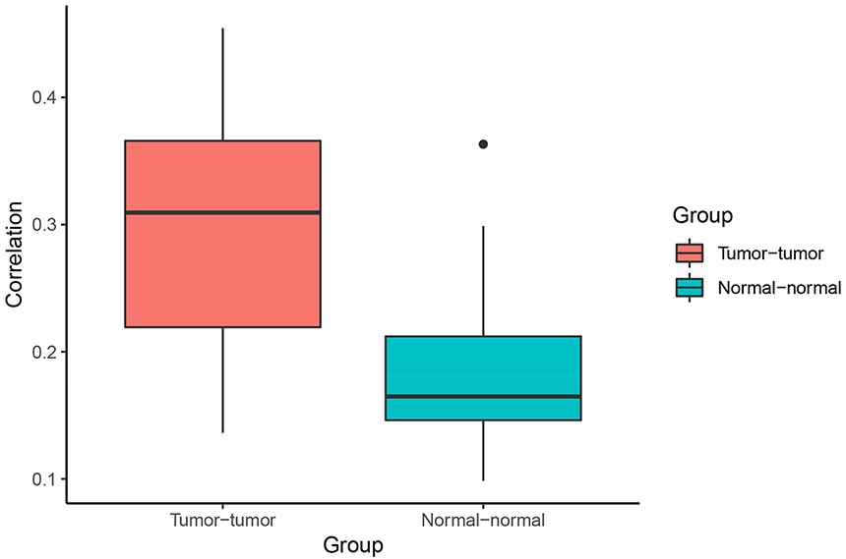
Figure 4. Correlation of Pagerank scores between tumor networks (red) and normal networks (blue). On average, the ...
Notes:
Figure 4. Correlation of Pagerank scores between tumor networks (red) and normal networks (blue). On average, the correlation between Pagerank scores in tumor networks was higher than the correlation between Pagerank scores in normal networks (excluding the two normal lung tissue networks). Higher PageRank scores indicate higher centrality in the network.
Unless provided in the caption above, the following copyright applies to the content of this slide: © The Author(s) 2020. Published by Oxford University Press.This is an Open Access article distributed under the terms of the Creative Commons Attribution License (http://creativecommons.org/licenses/by/4.0/), which permits unrestricted reuse, distribution, and reproduction in any medium, provided the original work is properly cited.

Slide 5
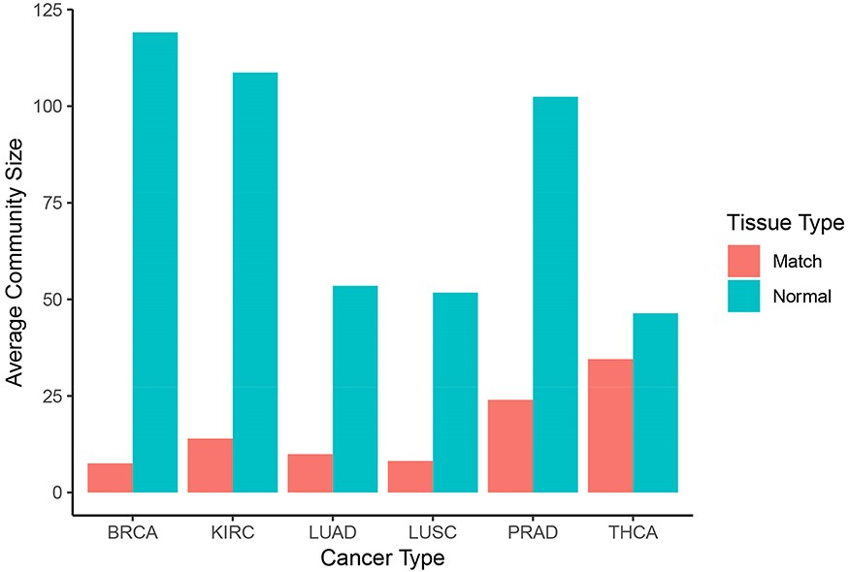
Figure 5. Community sizes across cancer and tissue types. Number of genes per community resulting from applying the ...
Notes:
Figure 5. Community sizes across cancer and tissue types. Number of genes per community resulting from applying the Louvain algorithm on each graph in Neo4j (blue: normal, red: matched tumor).
Unless provided in the caption above, the following copyright applies to the content of this slide: © The Author(s) 2020. Published by Oxford University Press.This is an Open Access article distributed under the terms of the Creative Commons Attribution License (http://creativecommons.org/licenses/by/4.0/), which permits unrestricted reuse, distribution, and reproduction in any medium, provided the original work is properly cited.

Slide 6
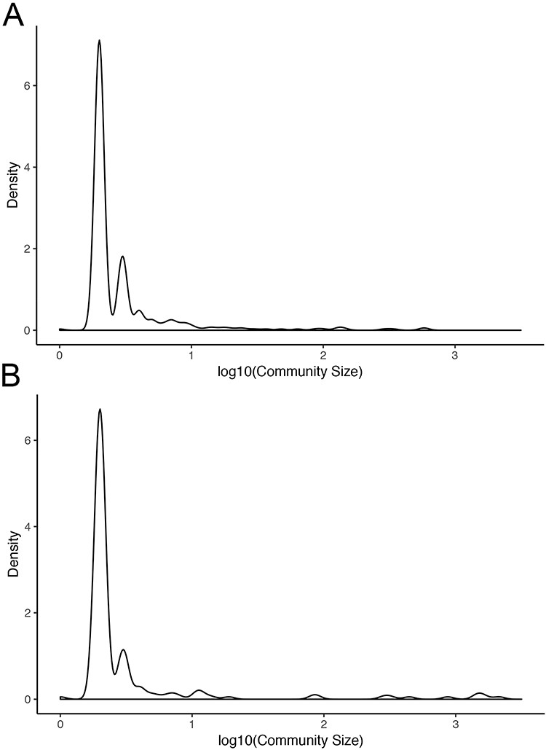
Figure 6. Community sizes in LUAD networks. Density plots of community size in LUAD (A) tumor and (B) normal graphs.
Notes:
Figure 6. Community sizes in LUAD networks. Density plots of community size in LUAD (A) tumor and (B) normal graphs.
Unless provided in the caption above, the following copyright applies to the content of this slide: © The Author(s) 2020. Published by Oxford University Press.This is an Open Access article distributed under the terms of the Creative Commons Attribution License (http://creativecommons.org/licenses/by/4.0/), which permits unrestricted reuse, distribution, and reproduction in any medium, provided the original work is properly cited.

Slide 7
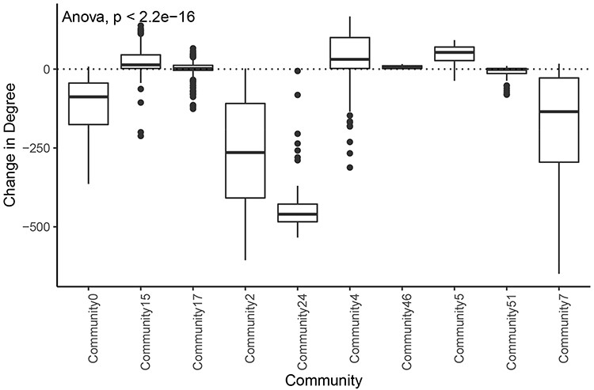
Figure 7. Change in degree across large communities in LUAD. Difference of degree between tumor and normal samples for ...
Notes:
Figure 7. Change in degree across large communities in LUAD. Difference of degree between tumor and normal samples for each tumor community larger than 50 genes.
Unless provided in the caption above, the following copyright applies to the content of this slide: © The Author(s) 2020. Published by Oxford University Press.This is an Open Access article distributed under the terms of the Creative Commons Attribution License (http://creativecommons.org/licenses/by/4.0/), which permits unrestricted reuse, distribution, and reproduction in any medium, provided the original work is properly cited.

Slide 8
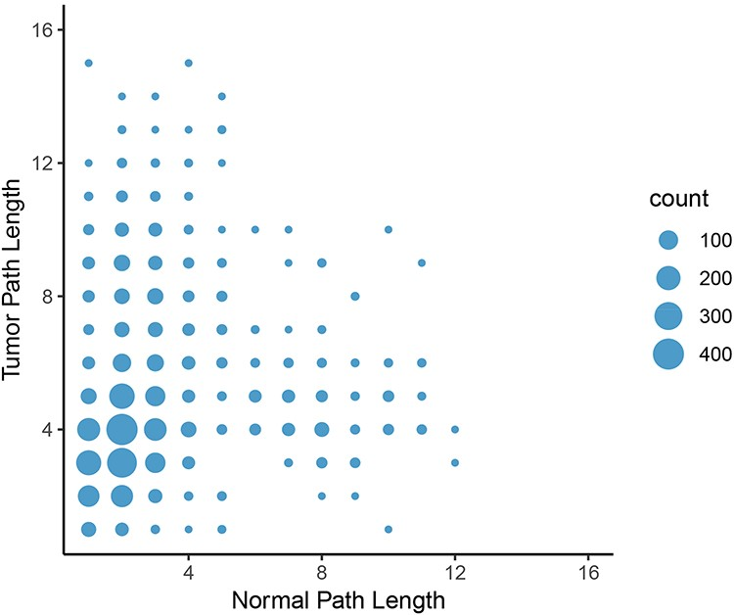
Figure 8. Change in path length between LUAD normal and tumor networks. On average, the path length between an ...
Notes:
Figure 8. Change in path length between LUAD normal and tumor networks. On average, the path length between an epigenetic regulator and an oncogene increased from the normal graph to the tumor graph, with the most common change in path length from two to four genes.
Unless provided in the caption above, the following copyright applies to the content of this slide: © The Author(s) 2020. Published by Oxford University Press.This is an Open Access article distributed under the terms of the Creative Commons Attribution License (http://creativecommons.org/licenses/by/4.0/), which permits unrestricted reuse, distribution, and reproduction in any medium, provided the original work is properly cited.

