Slide 1
Figure 2. Representative PYK structures. Left: the homotetramer of hLPYK (PDB4IMA); three monomers are in gray, and the ...
Notes:
Figure 2. Representative PYK structures. Left: the homotetramer of hLPYK (PDB4IMA); three monomers are in gray, and the fourth is colored by a domain. Middle: the ribbon of the hLPYK monomer is colored by domains (A, B, C and N). The catalytic site is in black space-filling, the inhibitory alanine binding site is in blue space-filling and the enhancing Fru-1,6-BP binding site is in pink space-filling. Right: alternative domain structures observed throughout the PYK family. Domain colors match those of the middle panel.
Unless provided in the caption above, the following copyright applies to the content of this slide: © The Author(s) 2023. Published by Oxford University Press.This is an Open Access article distributed under the terms of the Creative Commons Attribution License (https://creativecommons.org/licenses/by/4.0/), which permits unrestricted reuse, distribution, and reproduction in any medium, provided the original work is properly cited.

Slide 2
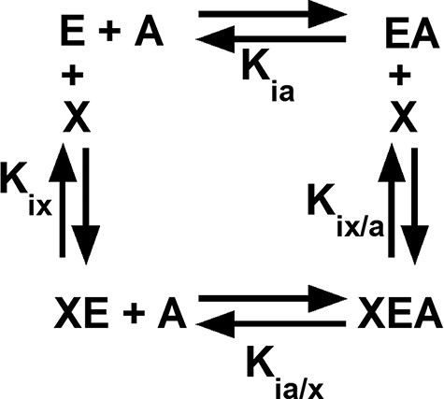
Figure 1. An allosteric energy cycle in which an enzyme (E) binds one substrate (A) and one allosteric effector (X). ...
Notes:
Figure 1. An allosteric energy cycle in which an enzyme (E) binds one substrate (A) and one allosteric effector (X). Kia is the binding of the substrate to the enzyme in the absence of the effector; when initial data are derived from kinetic measurements, this parameter is designated as Ka. Kia/x is the binding of the substrate to the enzyme in the presence of saturating concentrations of the effector. Kix is the binding of the effector to the enzyme when the substrate is absent. Kix/a is the binding of the effector to the enzyme in the presence of saturating concentrations of the substrate. Allosteric coupling is defined as Qax = Ka/Ka/x = Kix/Kix/a (34, 36, 37, 223). A description of hLPYK’s allosteric regulation requires two such functional cycles—one for activation by Fru-1,6-BP and one for inhibition by alanine.
Unless provided in the caption above, the following copyright applies to the content of this slide: © The Author(s) 2023. Published by Oxford University Press.This is an Open Access article distributed under the terms of the Creative Commons Attribution License (https://creativecommons.org/licenses/by/4.0/), which permits unrestricted reuse, distribution, and reproduction in any medium, provided the original work is properly cited.

Slide 3
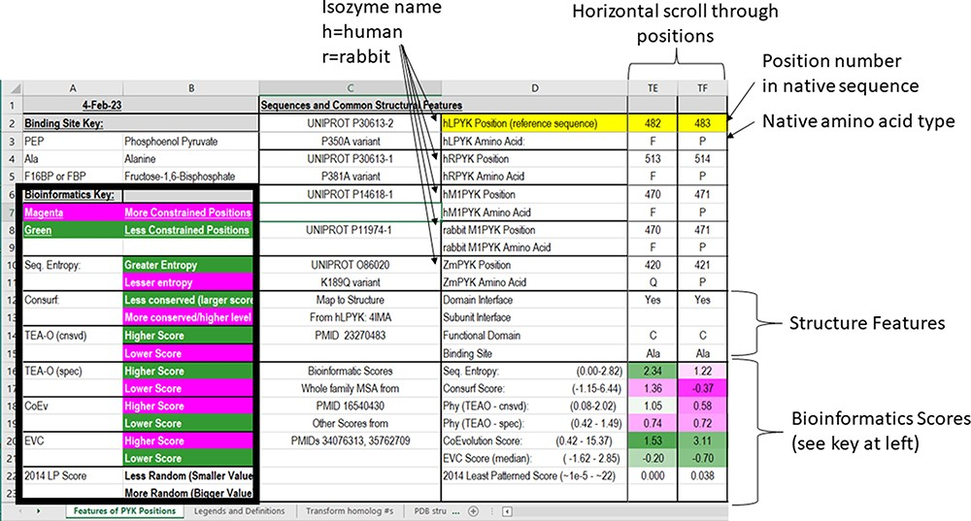
Figure 3. The top two sections of the ‘Features of PYK Positions’ page from PYK-SubstitutionOME. The left-most rows ...
Notes:
Figure 3. The top two sections of the ‘Features of PYK Positions’ page from PYK-SubstitutionOME. The left-most rows contain reference information and abbreviations. The top rows (1–11) contain the position numbers and wild-type amino acids for hLPYK, hRPYK, hM1PYK, rM1PYK and ZmPYK. Note that Columns A–D are locked, allowing the position columns to be scrolled. The next section’s rows (12–23) include notes on the structural locations for each position and evolutionary scores derived from the MSAs in Unit 2 (9, 17, 136). Each evolutionary score type has a different range, which is indicated in parentheses by the score names. To aid interpretation, the scores for each position are colored to show where it falls in the range, with magenta indicating stronger constraint/more prevalent pattern and green indicating less (see the legend highlighted with the black box on the left of this figure) .
Unless provided in the caption above, the following copyright applies to the content of this slide: © The Author(s) 2023. Published by Oxford University Press.This is an Open Access article distributed under the terms of the Creative Commons Attribution License (https://creativecommons.org/licenses/by/4.0/), which permits unrestricted reuse, distribution, and reproduction in any medium, provided the original work is properly cited.

Slide 4
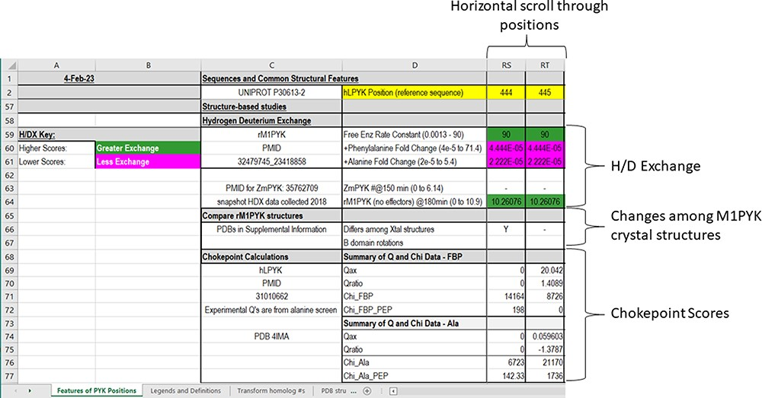
Figure 6. The bottom section of the ‘Features of PYK Positions’ worksheet in the PYK-SubstitutionOME workbook. Again, ...
Notes:
Figure 6. The bottom section of the ‘Features of PYK Positions’ worksheet in the PYK-SubstitutionOME workbook. Again, Rows 1 and 2 and Columns A–D are anchored to provide reference points. This section contains structural information, including H/DX data from both rM1PYK and ZmPYK, structural comparisons for M1PYK and chokepoint calculations for hLPYK. H/DX scores are color-coded to aid visual interpretation; color legends are in the left-most columns.
Unless provided in the caption above, the following copyright applies to the content of this slide: © The Author(s) 2023. Published by Oxford University Press.This is an Open Access article distributed under the terms of the Creative Commons Attribution License (https://creativecommons.org/licenses/by/4.0/), which permits unrestricted reuse, distribution, and reproduction in any medium, provided the original work is properly cited.

Slide 5
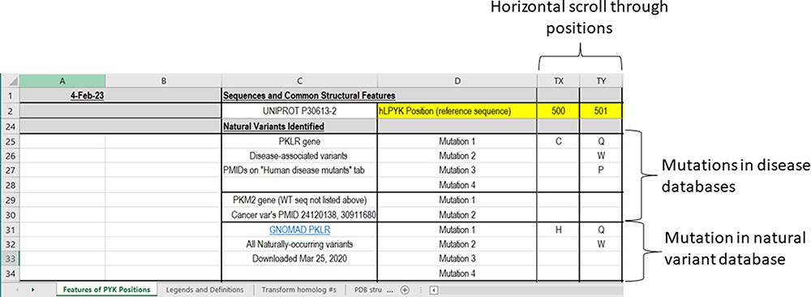
Figure 4. The third section of the ‘Features of PYK Positions’ worksheet in the PYK-SubstitutionOME workbook. Rows 1 ...
Notes:
Figure 4. The third section of the ‘Features of PYK Positions’ worksheet in the PYK-SubstitutionOME workbook. Rows 1 and 2 are anchored to provide position reference points, as are Columns A–D. This third section contains substitutions associated with PKD and other substitutions identified in the human population; the latter are not necessarily associated with disease.
Unless provided in the caption above, the following copyright applies to the content of this slide: © The Author(s) 2023. Published by Oxford University Press.This is an Open Access article distributed under the terms of the Creative Commons Attribution License (https://creativecommons.org/licenses/by/4.0/), which permits unrestricted reuse, distribution, and reproduction in any medium, provided the original work is properly cited.

Slide 6
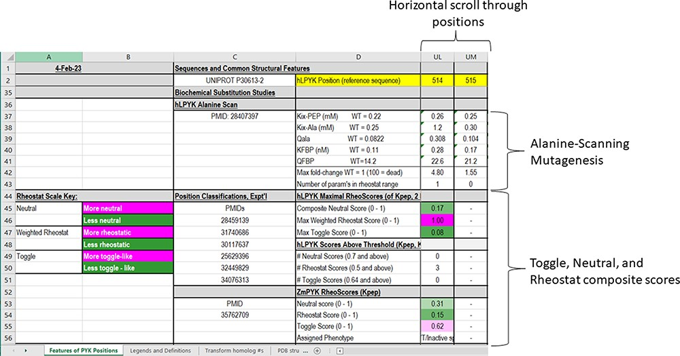
Figure 5. The fourth section of the ‘Features of PYK Positions’ worksheet in the PYK-SubstitutionOME workbook. Again, ...
Notes:
Figure 5. The fourth section of the ‘Features of PYK Positions’ worksheet in the PYK-SubstitutionOME workbook. Again, Rows 1 and 2 and Columns A–D are anchored to provide reference points; the K and Q values for wild-type hLPYK measured under the same experimental conditions (‘WT = [value]’) are included for reference. This section contains information from in vitro biochemical characterizations of purified [and partially purified (19)] PYK variants. Both information from a whole-protein, alanine-scanning mutagenesis study and RheoScale scores from semi-SM (i.e. toggle, neutral and rheostat scores) are entered here for each position. Each RheoScale score ranges from 0 to 1; the significant ranges are indicated in parentheses, and their corresponding color legends that aid visual interpretation are noted at left. Experimentally determined parameters for >1000 substituted hLPYK proteins are included in supporting worksheets.
Unless provided in the caption above, the following copyright applies to the content of this slide: © The Author(s) 2023. Published by Oxford University Press.This is an Open Access article distributed under the terms of the Creative Commons Attribution License (https://creativecommons.org/licenses/by/4.0/), which permits unrestricted reuse, distribution, and reproduction in any medium, provided the original work is properly cited.

Slide 7
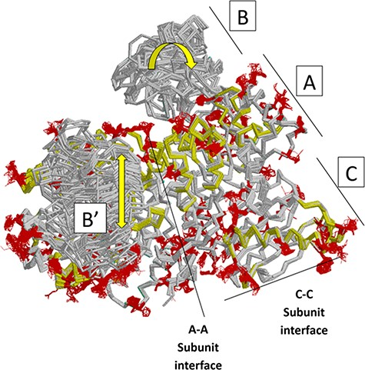
Figure 7. Locations of changes in the domains A and C were detected by comparing monomeric structures of rM1PYK. To ...
Notes:
Figure 7. Locations of changes in the domains A and C were detected by comparing monomeric structures of rM1PYK. To highlight the many changes located at the A–A subunit interface, representative dimers were extracted and superimposed from each PDB; note that the perspective of the left-most monomer is looking down at the top of its B domain (B’). The other two monomers of the rM1PYK homotetramer are not shown. The locations of the largest backbone shifts are shown in light yellow (>3.3 Å; most >10 Å); and the locations of the largest side-chain differences are in dark red (>3.3 Å; most >10 Å). Since the entire B domains experience change (yellow arrows), they are not individually highlighted.
Unless provided in the caption above, the following copyright applies to the content of this slide: © The Author(s) 2023. Published by Oxford University Press.This is an Open Access article distributed under the terms of the Creative Commons Attribution License (https://creativecommons.org/licenses/by/4.0/), which permits unrestricted reuse, distribution, and reproduction in any medium, provided the original work is properly cited.

