Slide 1
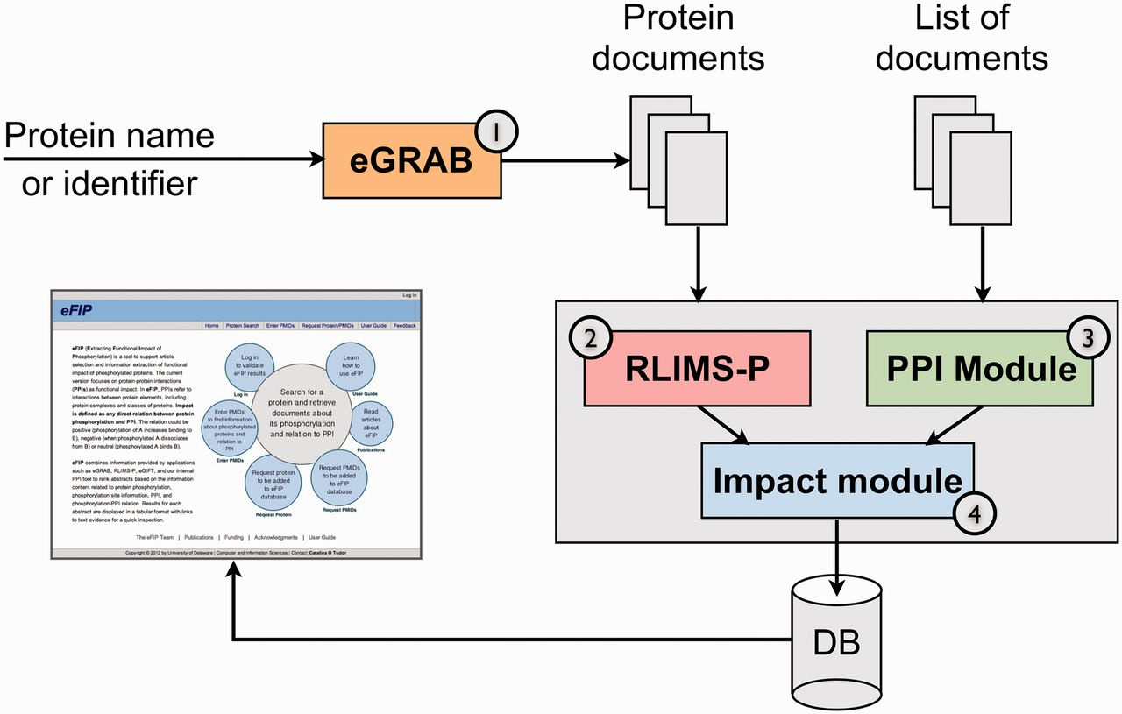
Figure 1 The eFIP text mining system overview. The pipeline consists of four components to process: (1) retrieval of ...
Notes:
Figure 1 The eFIP text mining system overview. The pipeline consists of four components to process: (1) retrieval of all documents relevant to a given protein (eGRAB), (2) extraction of phosphorylation mentions (kinase, substrate and site) in these documents (RLIMS-P), (3) extraction of PPI mentions (protein interactants and type of interaction) (PPI module) and (4) detection of phosphorylation-interaction relations (impact module).
Unless provided in the caption above, the following copyright applies to the content of this slide: © The Author(s) 2012. Published by Oxford University Press.This is an Open Access article distributed under the terms of the Creative Commons Attribution License (http://creativecommons.org/licenses/by-nc/3.0/), which permits non-commercial reuse, distribution, and reproduction in any medium, provided the original work is properly cited. For commercial re-use, please contact journals.permissions@oup.com.

Slide 2
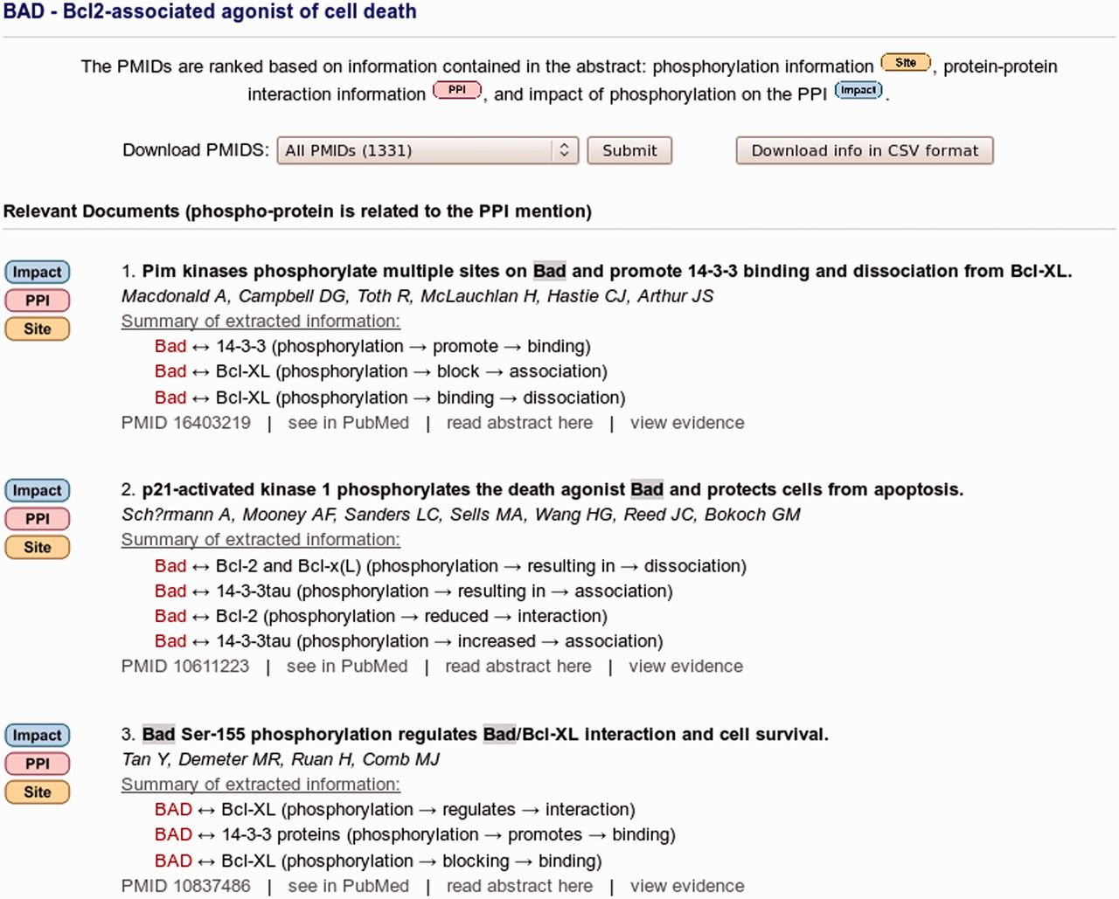
Figure 2 eFIP ranking and result summary of abstracts for protein BAD. A total of 1331 abstracts are linked to protein ...
Notes:
Figure 2 eFIP ranking and result summary of abstracts for protein BAD. A total of 1331 abstracts are linked to protein BAD as determined by eGRAB, among which 369 mention phosphorylation information (ranked and partially shown). The ‘Impact’, ‘PPI’ and ‘Site’ images on the left point to the type of information are found in the abstract. The title, authors and a summary of the interactions involving the phosphorylated forms of BAD are displayed. A spreadsheet summary file can be downloaded by clicking on the ‘Download info in CSV format’ button.
Unless provided in the caption above, the following copyright applies to the content of this slide: © The Author(s) 2012. Published by Oxford University Press.This is an Open Access article distributed under the terms of the Creative Commons Attribution License (http://creativecommons.org/licenses/by-nc/3.0/), which permits non-commercial reuse, distribution, and reproduction in any medium, provided the original work is properly cited. For commercial re-use, please contact journals.permissions@oup.com.

Slide 3
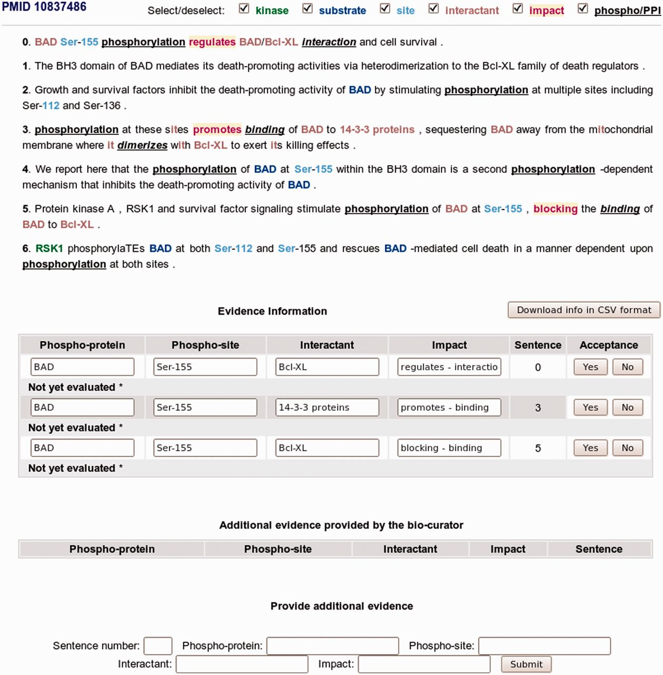
Figure 3 eFIP annotation interface with sentence evidence attribution of phosphorylated protein and interaction events ...
Notes:
Figure 3 eFIP annotation interface with sentence evidence attribution of phosphorylated protein and interaction events in PMID 10837486.
Unless provided in the caption above, the following copyright applies to the content of this slide: © The Author(s) 2012. Published by Oxford University Press.This is an Open Access article distributed under the terms of the Creative Commons Attribution License (http://creativecommons.org/licenses/by-nc/3.0/), which permits non-commercial reuse, distribution, and reproduction in any medium, provided the original work is properly cited. For commercial re-use, please contact journals.permissions@oup.com.

