Slide 1
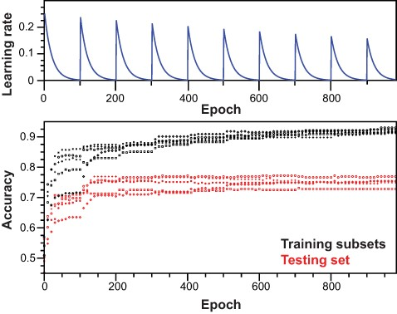
Figure 4. Training of the neural network. Top panel: scheme for learning rate cycling during training of independent ...
Notes:
Figure 4. Training of the neural network. Top panel: scheme for learning rate cycling during training of independent models. Bottom panel: for each independent model, accuracy was monitored along training epochs for training subsets and testing set.
Unless provided in the caption above, the following copyright applies to the content of this slide: © The Author(s) 2021. Published by Oxford University Press.This is an Open Access article distributed under the terms of the Creative Commons Attribution License (http://creativecommons.org/licenses/by/4.0/), which permits unrestricted reuse, distribution, and reproduction in any medium, provided the original work is properly cited.

