Slide 1
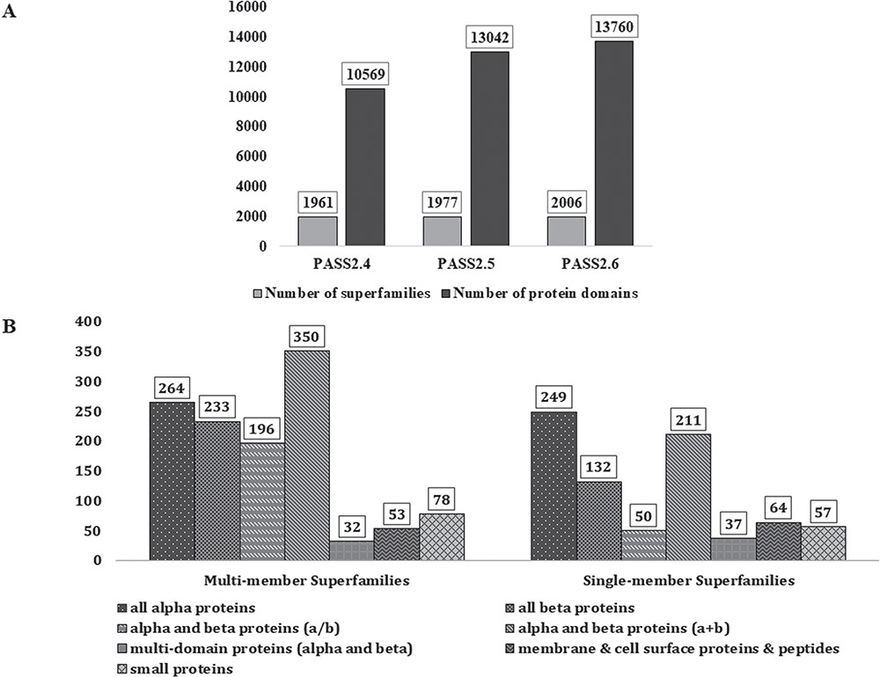
Figure 1 PASS2 statistics. (A) Statistics and comparison of current update with two earlier versions of PASS2, in ...
Notes:
Figure 1 PASS2 statistics. (A) Statistics and comparison of current update with two earlier versions of PASS2, in terms of number of superfamilies (light grey) and number of protein domains included (dark grey). (B) Distribution of SCOPe structural classes (all α, all β, α/β and so on) in single and MMS considered for alignment in PASS2.6.
Unless provided in the caption above, the following copyright applies to the content of this slide: © The Author(s) 2019. Published by Oxford University Press.This is an Open Access article distributed under the terms of the Creative Commons Attribution License (http://creativecommons.org/licenses/by/4.0/), which permits unrestricted reuse, distribution, and reproduction in any medium, provided the original work is properly cited.

Slide 2
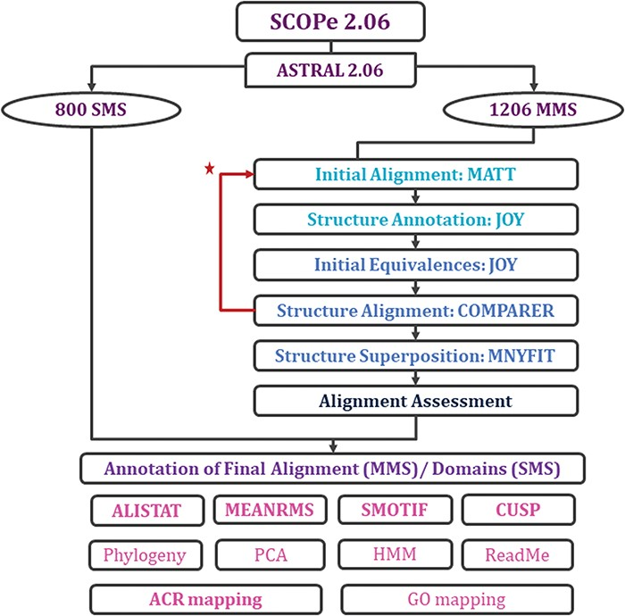
Figure 2 Workflow for rigorous structure-based sequence alignment of protein domains with less than 40% sequence ...
Notes:
Figure 2 Workflow for rigorous structure-based sequence alignment of protein domains with less than 40% sequence identity belonging to SCOPe superfamilies. The initial alignment, final alignment and alignment assessment phases are coloured in cyan, blue and indigo. Features that were generated for the alignments (for MMS) and domains (for SMS) are listed, with in-house features in bold. Extreme structural outliers were removed from superfamilies if required and the remaining members were realigned (marked by red star).
Unless provided in the caption above, the following copyright applies to the content of this slide: © The Author(s) 2019. Published by Oxford University Press.This is an Open Access article distributed under the terms of the Creative Commons Attribution License (http://creativecommons.org/licenses/by/4.0/), which permits unrestricted reuse, distribution, and reproduction in any medium, provided the original work is properly cited.

Slide 3
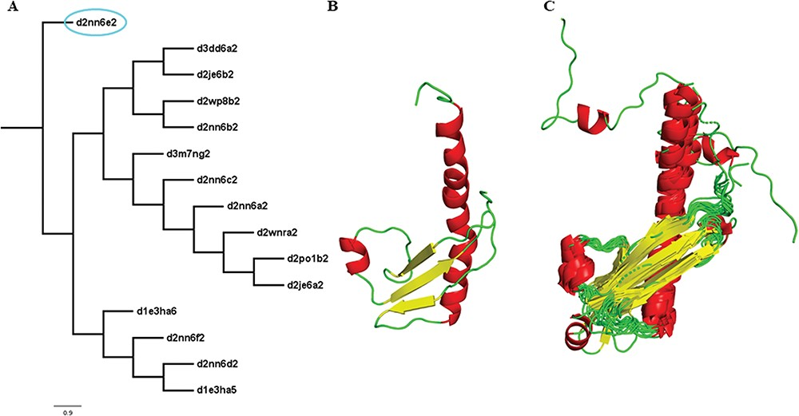
Figure 3 Illustration of a PASS2 superfamily with an extreme structural outlier domain. (A) Structural phylogeny of ...
Notes:
Figure 3 Illustration of a PASS2 superfamily with an extreme structural outlier domain. (A) Structural phylogeny of the members of the Ribonuclease PH domain 2-like superfamily (SCOPe superfamily ID: 55666) showing extreme structural outlier (d2nn6e2, circled in cyan). (B) Structure of the extreme structural outlier, d2nn6e2, and (C) the final superposed structure of remaining members after removal of extreme structural outlier.
Unless provided in the caption above, the following copyright applies to the content of this slide: © The Author(s) 2019. Published by Oxford University Press.This is an Open Access article distributed under the terms of the Creative Commons Attribution License (http://creativecommons.org/licenses/by/4.0/), which permits unrestricted reuse, distribution, and reproduction in any medium, provided the original work is properly cited.

