Slide 1
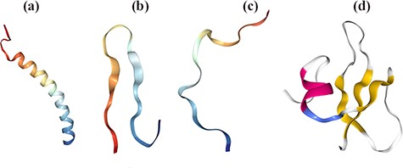
Figure 1. Structural diversity of AMPs based on their secondary conformations using Protein Data Bank (PDB). [(a) 2K6O: ...
Notes:
Figure 1. Structural diversity of AMPs based on their secondary conformations using Protein Data Bank (PDB). [(a) 2K6O: Antimicrobial Peptide, the α-helical structure of cathelicidin LL-37 in Homo sapiens. (b) 1RKK: Antimicrobial Peptide, β-sheeted polyphemusin in Limulus polyphemus. (c) 1G89: Antimicrobial Peptide, extended indolicidin in Bos taurus. (d) 1FQQ: Antimicrobial Peptide, Antibiotic and mixed structures like human β- defensin-2 in Homo sapiens].
Unless provided in the caption above, the following copyright applies to the content of this slide: © The Author(s) 2022. Published by Oxford University Press.This is an Open Access article distributed under the terms of the Creative Commons Attribution License (https://creativecommons.org/licenses/by/4.0/), which permits unrestricted reuse, distribution, and reproduction in any medium, provided the original work is properly cited.

