Slide 1
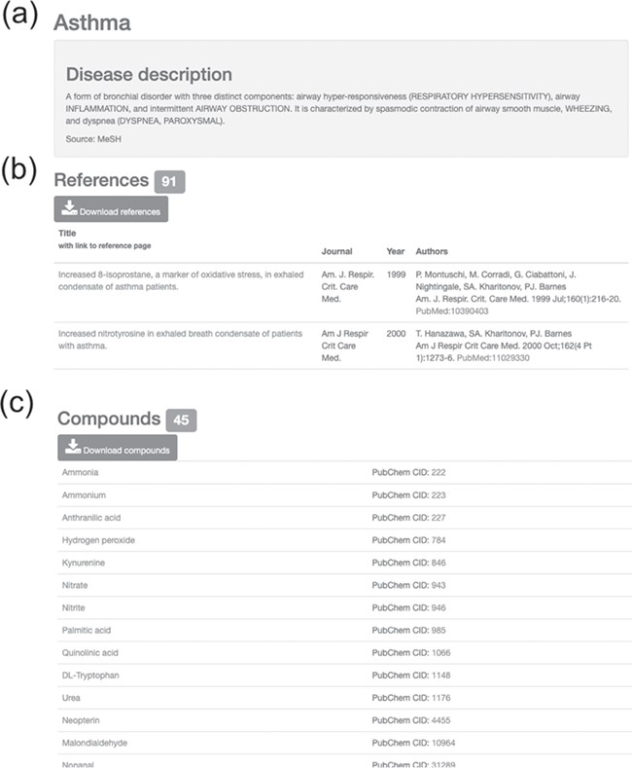
Figure 4 Information on asthma with associated references and compounds. (a) Disease description. (b) Downloadable ...
Notes:
Figure 4 Information on asthma with associated references and compounds. (a) Disease description. (b) Downloadable list of associated references for asthma. (c) Downloadable list of associated compounds for asthma.
Unless provided in the caption above, the following copyright applies to the content of this slide: © The Author(s) 2020. Published by Oxford University Press.This is an Open Access article distributed under the terms of the Creative Commons Attribution License (http://creativecommons.org/licenses/by/4.0/), which permits unrestricted reuse, distribution, and reproduction in any medium, provided the original work is properly cited.

