Slide 1
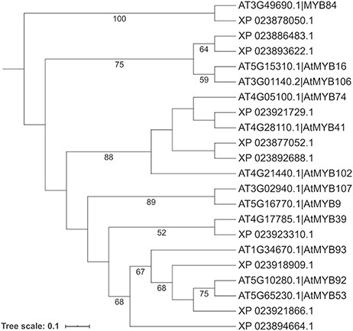
Figure 10. Phylogenetic analysis of selected cork oak and Arabidopsis MYBs TFs related to AtMYB39 and AtMYB92. Amino ...
Notes:
Figure 10. Phylogenetic analysis of selected cork oak and Arabidopsis MYBs TFs related to AtMYB39 and AtMYB92. Amino acid sequences were retrieved from CorkOakDB and TAIR, and multiple alignment of conserved MYB domains was performed using MAFFT v7. Phylogenetic inference was obtained using the Maximum Likelihood method with RAxML v8.2.12. Branch support was obtained by bootstrap analysis (1000 replications) and indicated for specific nodes (bootstrap value >50%).
Unless provided in the caption above, the following copyright applies to the content of this slide: © The Author(s) 2020. Published by Oxford University Press.This is an Open Access article distributed under the terms of the Creative Commons Attribution License (http://creativecommons.org/licenses/by/4.0/), which permits unrestricted reuse, distribution, and reproduction in any medium, provided the original work is properly cited.

