Slide 1
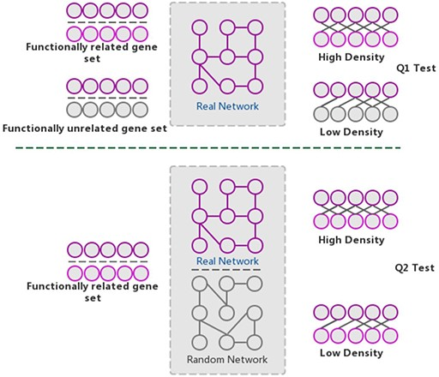
Figure 4. The GSLA algorithm. GSLA uses two hypothesis tests to identify biologically significant functional ...
Notes:
Figure 4. The GSLA algorithm. GSLA uses two hypothesis tests to identify biologically significant functional associations between gene sets. Q1 evaluates whether the intergene-set interaction density between two gene sets is higher than that between random gene pairs. Q2 evaluates whether the dense functional interactions between gene sets can only be observed within the correct network, rather than random interactomes.
Unless provided in the caption above, the following copyright applies to the content of this slide: © The Author(s) 2020. Published by Oxford University Press.This is an Open Access article distributed under the terms of the Creative Commons Attribution License (http://creativecommons.org/licenses/by/4.0/), which permits unrestricted reuse, distribution, and reproduction in any medium, provided the original work is properly cited.

