Slide 1
Figure 1. Comparisons of biological characteristics of the three breast tissues by means of GESs. The first row ...
Notes:
Figure 1. Comparisons of biological characteristics of the three breast tissues by means of GESs. The first row presents the three types of breast tissues. The other rows, from top to bottom, present significant GES scores in function of tissue type (green: low score; red and green checkerboard pattern: intermediate score; red: high score). This figure is an illustration of Supplementary Table S3.
Unless provided in the caption above, the following copyright applies to the content of this slide: © The Author(s) 2021. Published by Oxford University Press.This is an Open Access article distributed under the terms of the Creative Commons Attribution License (http://creativecommons.org/licenses/by/4.0/), which permits unrestricted reuse, distribution, and reproduction in any medium, provided the original work is properly cited.

Slide 2
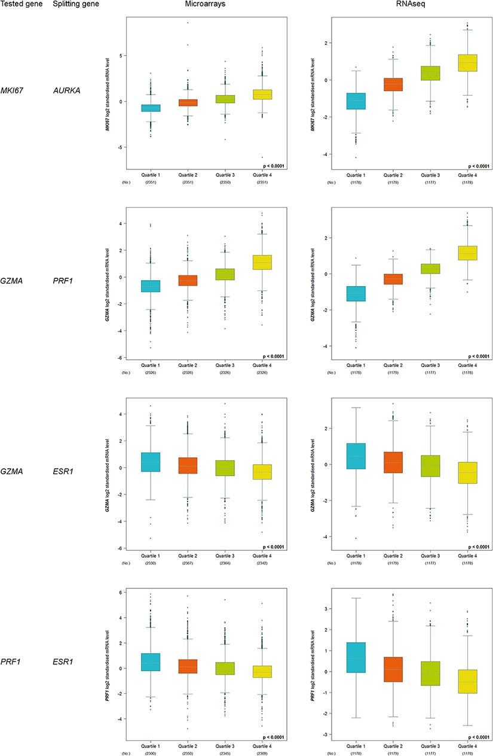
Figure 3. Customized expression analysis results of four demonstrative gene pairs (tested gene, splitting gene/quartile ...
Notes:
Figure 3. Customized expression analysis results of four demonstrative gene pairs (tested gene, splitting gene/quartile criterion): (MKI67, AURKA); (GZMA, PRF1); (GZMA, ESR1) and (PRF1, ESR1).
Unless provided in the caption above, the following copyright applies to the content of this slide: © The Author(s) 2021. Published by Oxford University Press.This is an Open Access article distributed under the terms of the Creative Commons Attribution License (http://creativecommons.org/licenses/by/4.0/), which permits unrestricted reuse, distribution, and reproduction in any medium, provided the original work is properly cited.

Slide 3
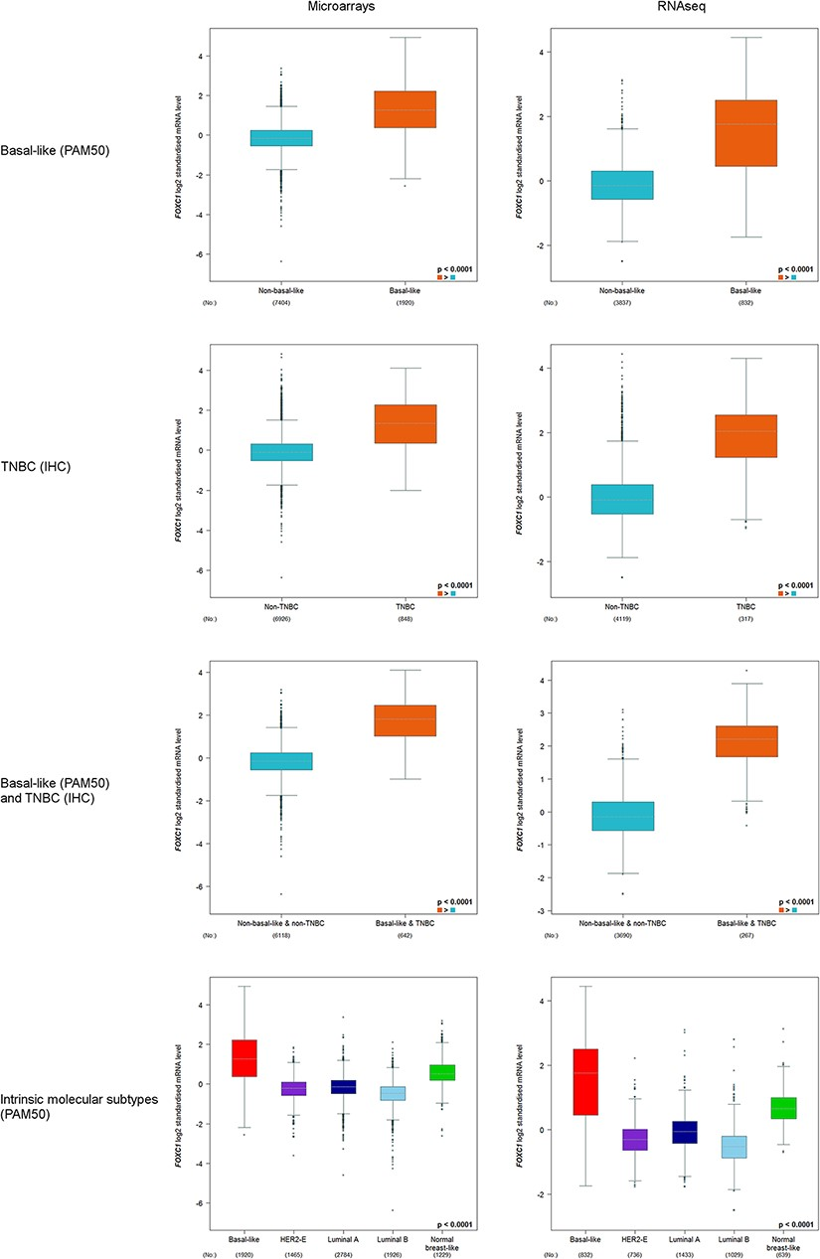
Figure 2. FOXC1 gene expression analysis in basal-like (PAM50) and/or TNBC (IHC), and intrinsic molecular subtypes ...
Notes:
Figure 2. FOXC1 gene expression analysis in basal-like (PAM50) and/or TNBC (IHC), and intrinsic molecular subtypes (PAM50).
Unless provided in the caption above, the following copyright applies to the content of this slide: © The Author(s) 2021. Published by Oxford University Press.This is an Open Access article distributed under the terms of the Creative Commons Attribution License (http://creativecommons.org/licenses/by/4.0/), which permits unrestricted reuse, distribution, and reproduction in any medium, provided the original work is properly cited.

