Slide 1
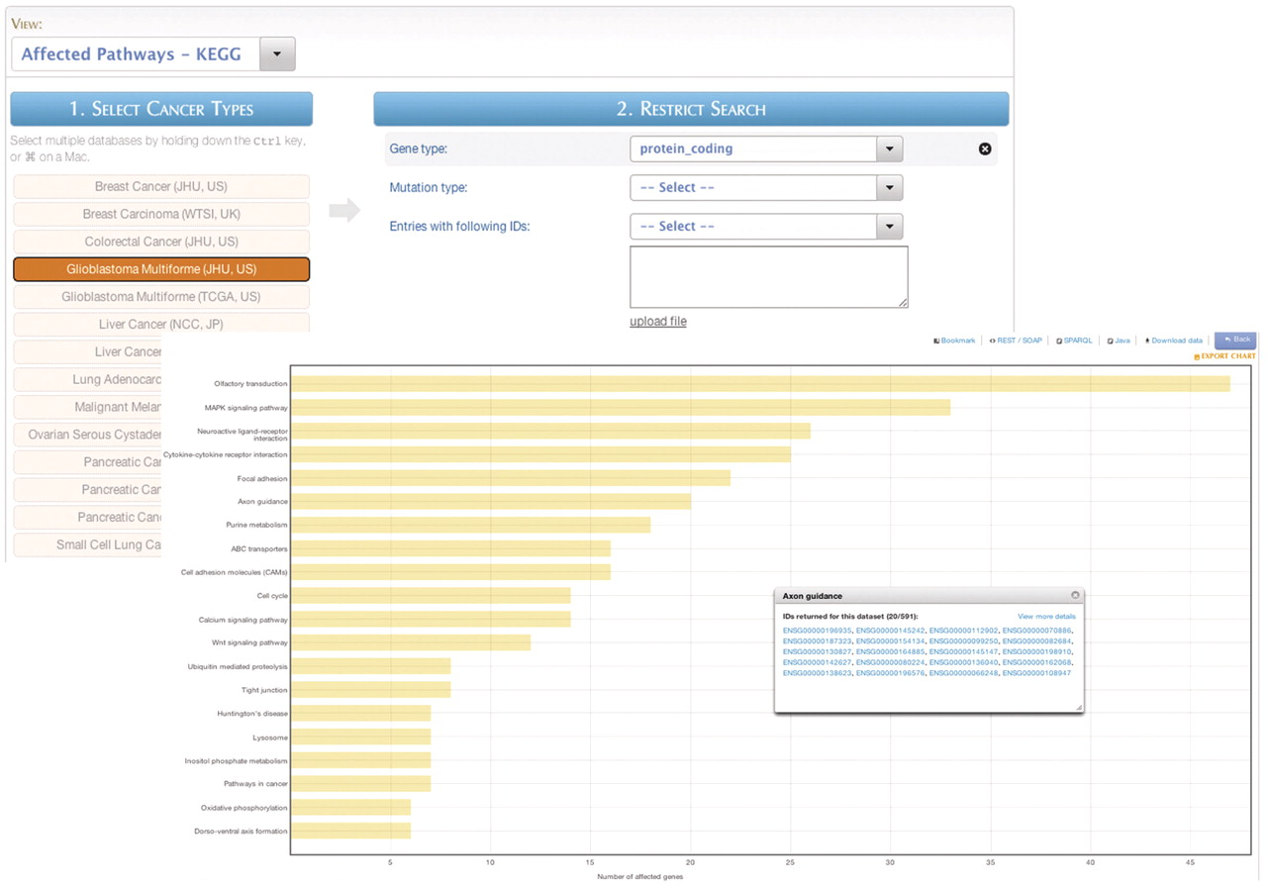
Figure 10. MartAnalysis. ‘MartAnalysis’ presents the user with a choice of data sets in a column on the left and a list ...
Notes:
Figure 10. MartAnalysis. ‘MartAnalysis’ presents the user with a choice of data sets in a column on the left and a list of filters in a column on the right. The attributes are determined in advance by the administrator and cannot be changed by the user. As such, the ‘MartAnalysis’ interface is best suited for quick querying of commonly used attributes. In this example, the query result is processed to produce a histogram presentation of the most frequently affected pathways.
Unless provided in the caption above, the following copyright applies to the content of this slide: © The Author(s) 2011. Published by Oxford University Press.This is Open Access article distributed under the terms of the Creative Commons Attribution Non-Commercial License (http://creativecommons.org/licenses/by-nc/2.5), which permits unrestricted non-commercial use, distribution, and reproduction in any medium, provided the original work is properly cited.

