Slide 1
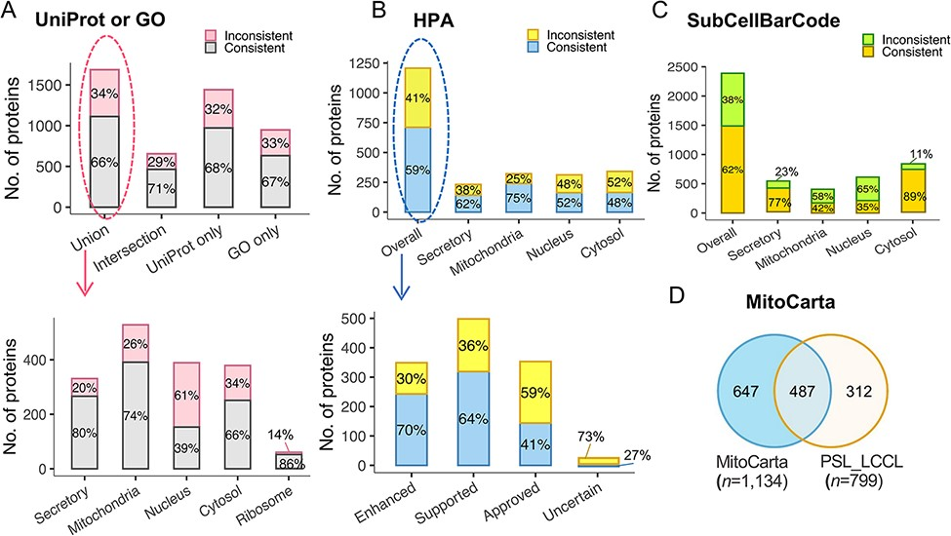
Figure 5. The evaluation of subcellular protein localization in PSL-LCCL against the public databases. (A) An agreement ...
Notes:
Figure 5. The evaluation of subcellular protein localization in PSL-LCCL against the public databases. (A) An agreement of neighborhood-based classification of proteins in PSL-LCC with proteins having unique localization annotated in UniProt or GO (upper). An agreement between PSL-LCC classifications and UniProt and GO single-location proteins of each neighborhood (below). Union, the union of UniProt and GO; Intersection, the overlap proteins in UniProt and GO. (B) An agreement of the neighborhood-based classifications in PSL-LCCL and proteins having unique localization annotated in Human Cell Atlas (upper) and their corresponding reliability score (below). (C) An agreement of the neighborhood-based classification in PSL-LCCL and proteins localized in SubCellBarCode Orre et al. (8). (D) An agreement of proteins localized in mitochondria in PSL-LCCL with MitoCarta Rath et al. (28).
Unless provided in the caption above, the following copyright applies to the content of this slide: © The Author(s) 2022. Published by Oxford University Press.This is an Open Access article distributed under the terms of the Creative Commons Attribution License (https://creativecommons.org/licenses/by/4.0/), which permits unrestricted reuse, distribution, and reproduction in any medium, provided the original work is properly cited.

