Slide 1
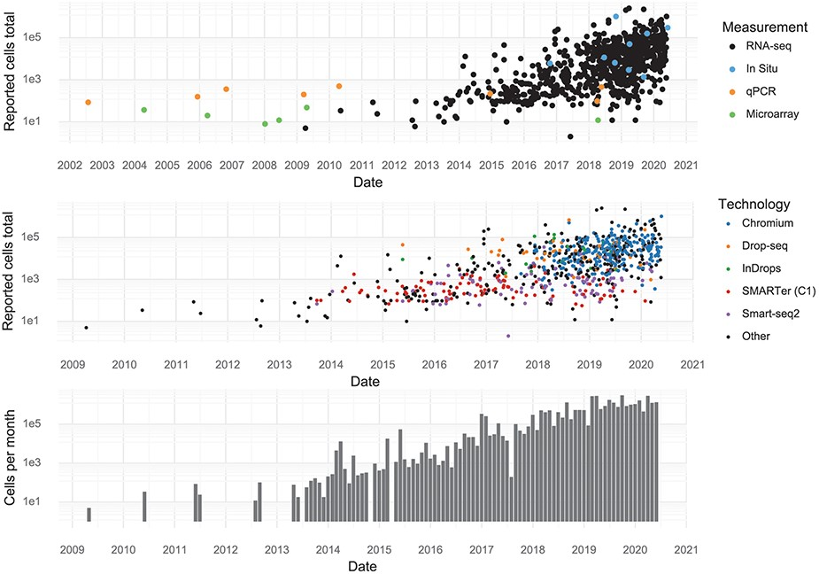
Figure 2. Scale of experiments and data over time. (Upper): The number of cells measured in a study, stratified by the ...
Notes:
Figure 2. Scale of experiments and data over time. (Upper): The number of cells measured in a study, stratified by the measurement method. (Middle): The number of cells measured in scRNA-seq experiments, stratified by scRNA-seq protocol. (Lower): The aggregate number of cells measured per month.
Unless provided in the caption above, the following copyright applies to the content of this slide: © The Author(s) 2020. Published by Oxford University Press.This is an Open Access article distributed under the terms of the Creative Commons Attribution License (http://creativecommons.org/licenses/by/4.0/), which permits unrestricted reuse, distribution, and reproduction in any medium, provided the original work is properly cited.

