Slide 1
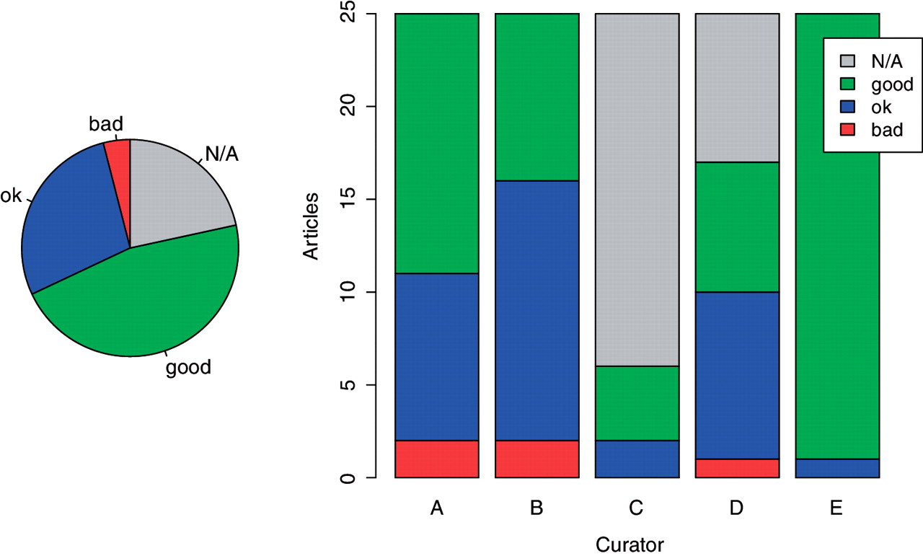
Figure 7. Distribution of concept identification judgments.
Notes:
Figure 7. Distribution of concept identification judgments.
Unless provided in the caption above, the following copyright applies to the content of this slide: © The Author(s) 2012. Published by Oxford University Press.This is an Open Access article distributed under the terms of the Creative Commons Attribution Non-Commercial License (http://creativecommons.org/licenses/by-nc/3.0), which permits unrestricted non-commercial use, distribution, and reproduction in any medium, provided the original work is properly cited.

Slide 2
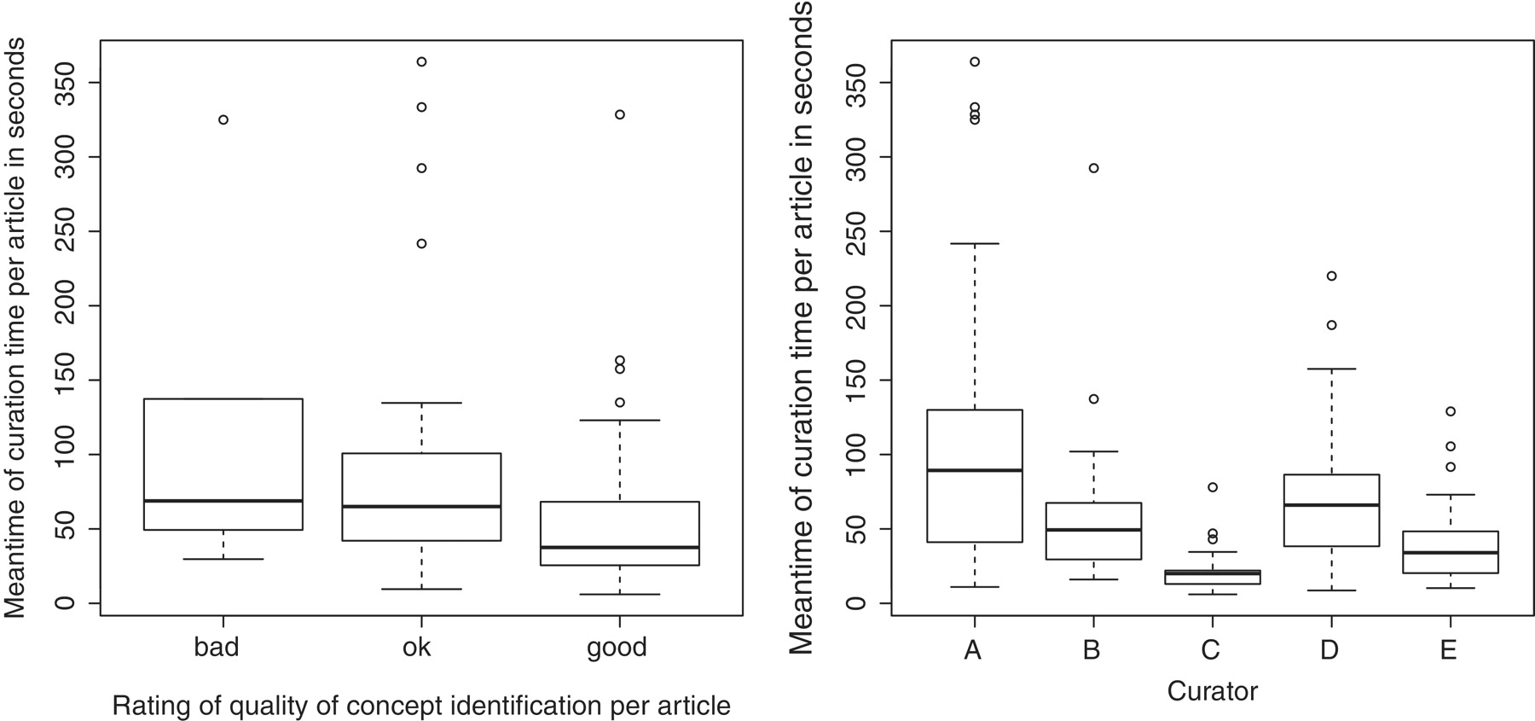
Figure 8. Box-and-whisker plots illustrating curation time (on the left according to the decision taken, on the right ...
Notes:
Figure 8. Box-and-whisker plots illustrating curation time (on the left according to the decision taken, on the right per curator).
Unless provided in the caption above, the following copyright applies to the content of this slide: © The Author(s) 2012. Published by Oxford University Press.This is an Open Access article distributed under the terms of the Creative Commons Attribution Non-Commercial License (http://creativecommons.org/licenses/by-nc/3.0), which permits unrestricted non-commercial use, distribution, and reproduction in any medium, provided the original work is properly cited.

Slide 3
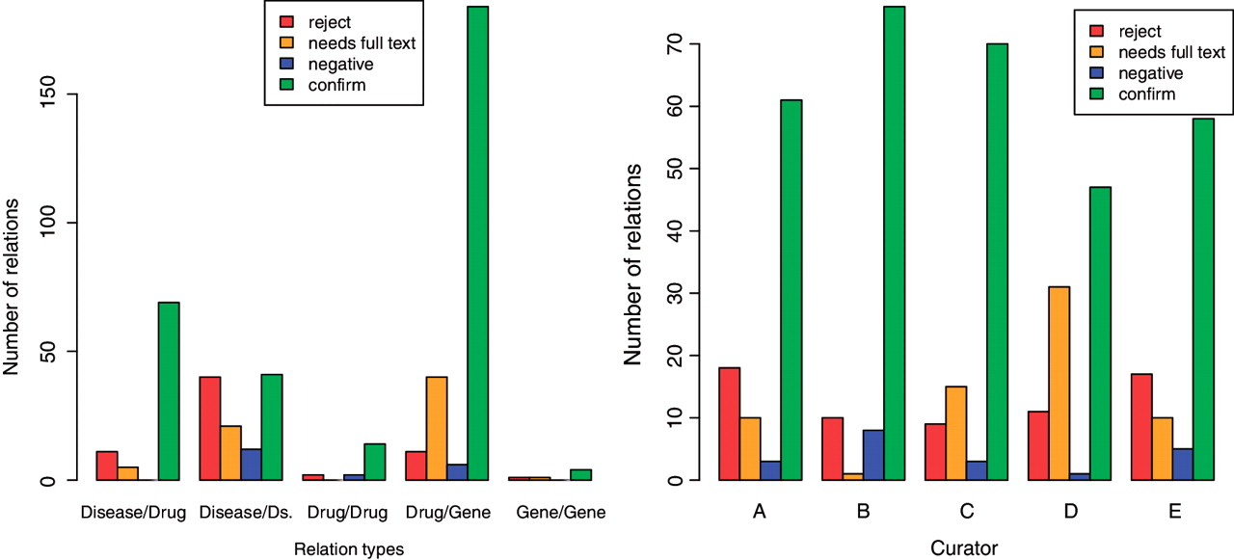
Figure 6. Validation decisions by category and by curator.
Notes:
Figure 6. Validation decisions by category and by curator.
Unless provided in the caption above, the following copyright applies to the content of this slide: © The Author(s) 2012. Published by Oxford University Press.This is an Open Access article distributed under the terms of the Creative Commons Attribution Non-Commercial License (http://creativecommons.org/licenses/by-nc/3.0), which permits unrestricted non-commercial use, distribution, and reproduction in any medium, provided the original work is properly cited.

Slide 4
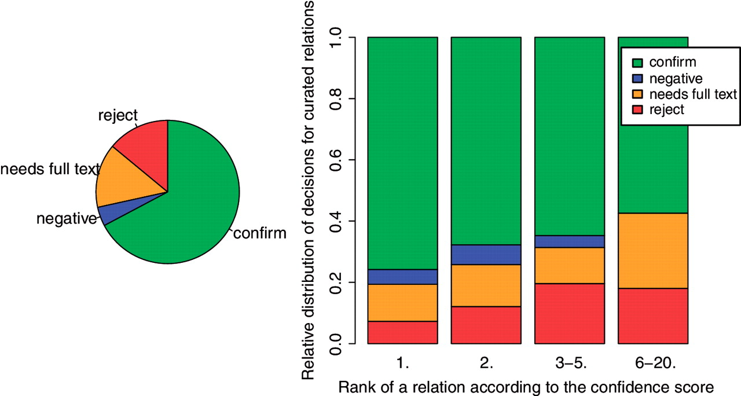
Figure 5. Distribution of validation decisions taken by curators.
Notes:
Figure 5. Distribution of validation decisions taken by curators.
Unless provided in the caption above, the following copyright applies to the content of this slide: © The Author(s) 2012. Published by Oxford University Press.This is an Open Access article distributed under the terms of the Creative Commons Attribution Non-Commercial License (http://creativecommons.org/licenses/by-nc/3.0), which permits unrestricted non-commercial use, distribution, and reproduction in any medium, provided the original work is properly cited.

Slide 5
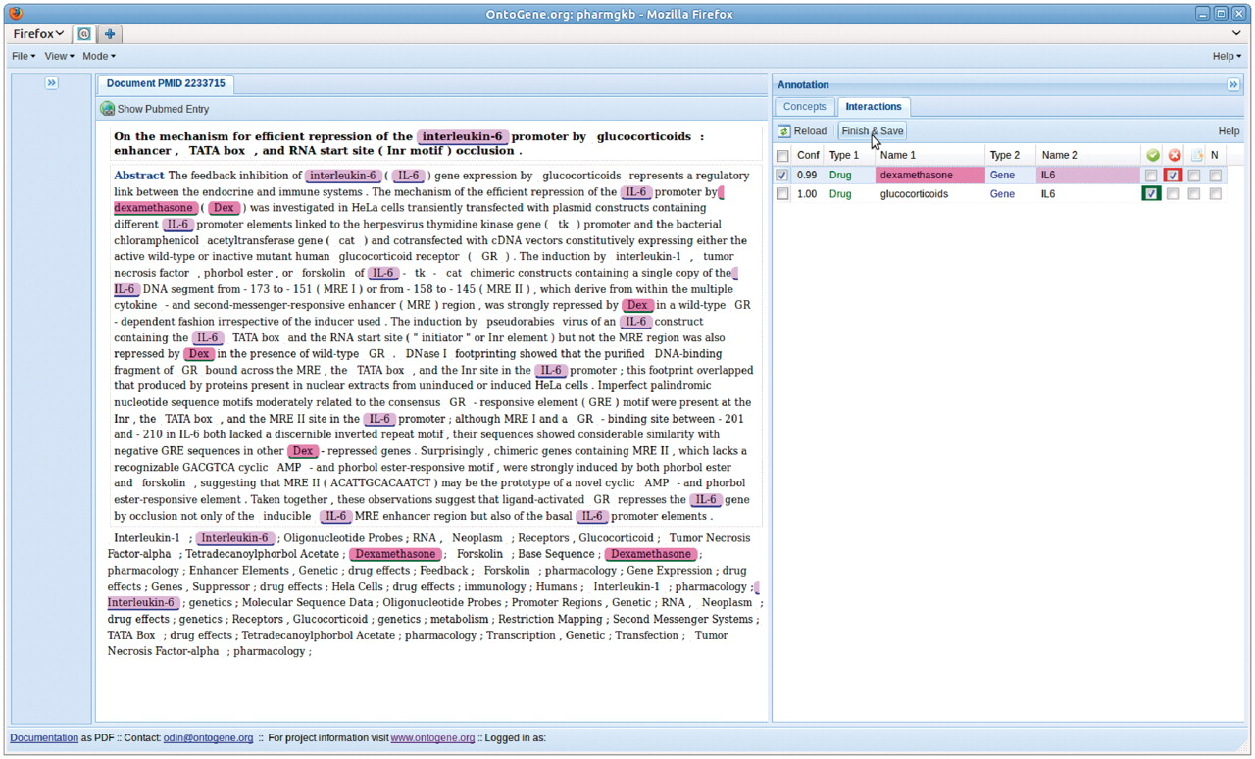
Figure 4. Entities which participate in the selected interaction are highlighted in the document panel.
Notes:
Figure 4. Entities which participate in the selected interaction are highlighted in the document panel.
Unless provided in the caption above, the following copyright applies to the content of this slide: © The Author(s) 2012. Published by Oxford University Press.This is an Open Access article distributed under the terms of the Creative Commons Attribution Non-Commercial License (http://creativecommons.org/licenses/by-nc/3.0), which permits unrestricted non-commercial use, distribution, and reproduction in any medium, provided the original work is properly cited.

Slide 6
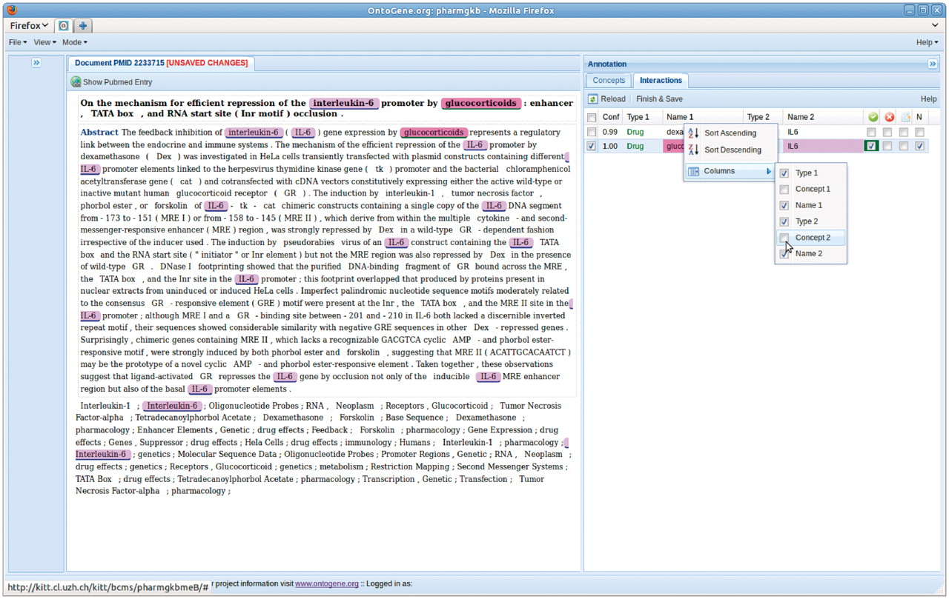
Figure 3. Modifying the presentation of the interactions.
Notes:
Figure 3. Modifying the presentation of the interactions.
Unless provided in the caption above, the following copyright applies to the content of this slide: © The Author(s) 2012. Published by Oxford University Press.This is an Open Access article distributed under the terms of the Creative Commons Attribution Non-Commercial License (http://creativecommons.org/licenses/by-nc/3.0), which permits unrestricted non-commercial use, distribution, and reproduction in any medium, provided the original work is properly cited.

Slide 7
Figure 2. Log of user actions as stored on the OntoGene server.
Notes:
Figure 2. Log of user actions as stored on the OntoGene server.
Unless provided in the caption above, the following copyright applies to the content of this slide: © The Author(s) 2012. Published by Oxford University Press.This is an Open Access article distributed under the terms of the Creative Commons Attribution Non-Commercial License (http://creativecommons.org/licenses/by-nc/3.0), which permits unrestricted non-commercial use, distribution, and reproduction in any medium, provided the original work is properly cited.

Slide 8
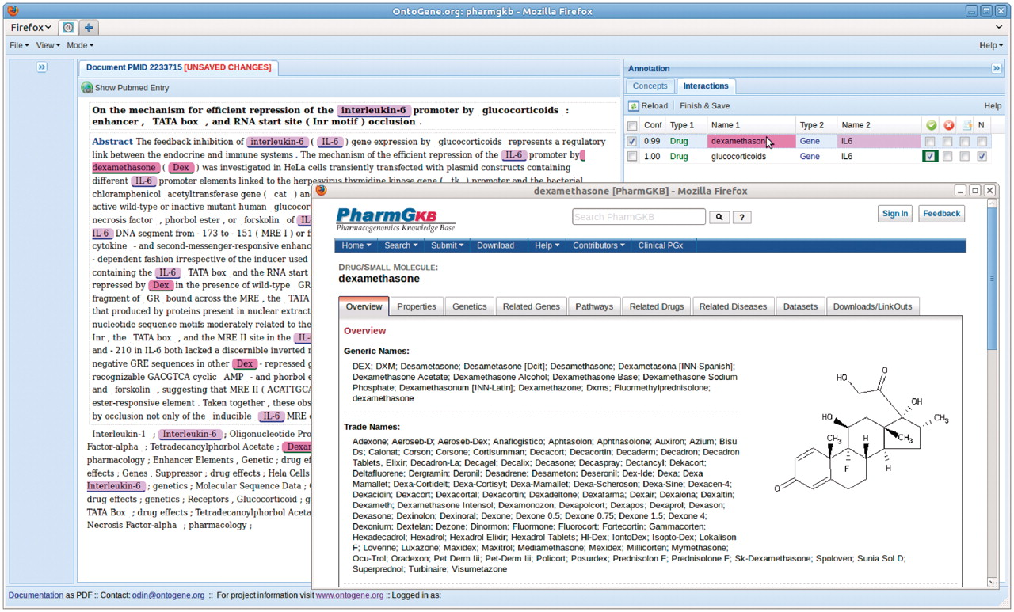
Figure 1. Inspection of PharmGKB entry associated with a given entity.
Notes:
Figure 1. Inspection of PharmGKB entry associated with a given entity.
Unless provided in the caption above, the following copyright applies to the content of this slide: © The Author(s) 2012. Published by Oxford University Press.This is an Open Access article distributed under the terms of the Creative Commons Attribution Non-Commercial License (http://creativecommons.org/licenses/by-nc/3.0), which permits unrestricted non-commercial use, distribution, and reproduction in any medium, provided the original work is properly cited.

