Slide 1
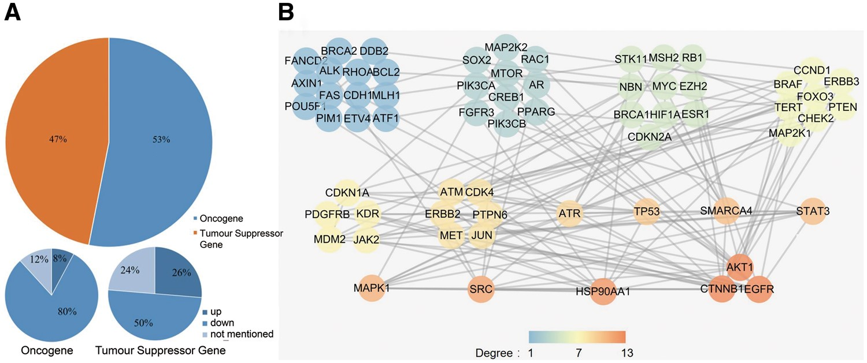
Figure 4. (A) The cancer-related genes that were classified as oncogenes and TSGs. (B) The PPI network of the collected ...
Notes:
Figure 4. (A) The cancer-related genes that were classified as oncogenes and TSGs. (B) The PPI network of the collected cancer genes. All genes were sorted by their degree in the network, and all genes with the same degree were clustered together. The degree represents the prominence of the node, which is equal to the number of edges connected to it. The node colour means each gene’s degree.
Unless provided in the caption above, the following copyright applies to the content of this slide: © The Author(s) 2018. Published by Oxford University Press.This is an Open Access article distributed under the terms of the Creative Commons Attribution License (http://creativecommons.org/licenses/by/4.0/), which permits unrestricted reuse, distribution, and reproduction in any medium, provided the original work is properly cited.

