Slide 1
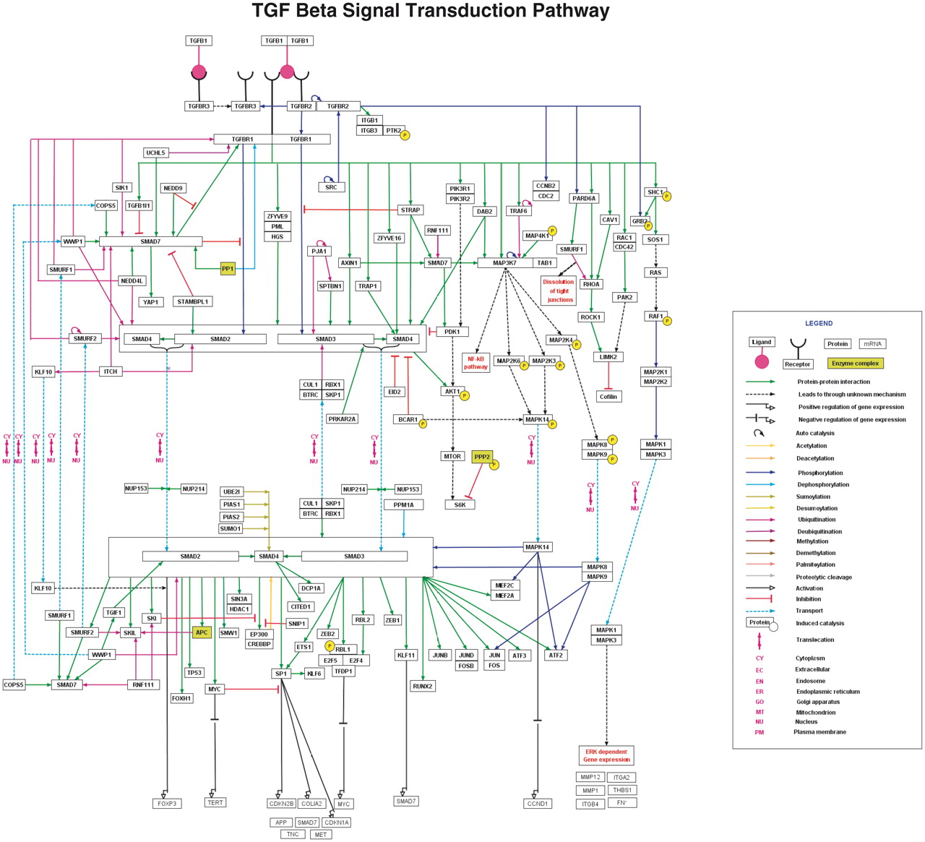
Figure 3. TGF-β pathway in NetSlim. The TGF-β pathway map represents the molecular reactions induced by the binding of ...
Notes:
Figure 3. TGF-β pathway in NetSlim. The TGF-β pathway map represents the molecular reactions induced by the binding of TGF-β 1 to TGF-β receptor complex. The annotated NetSlim pathway for TGF-β possesses 121 proteins involved in 252 reactions with 173 molecular associations, 60 enzyme catalysis reactions and 19 translocation events. The nodes and edges represent the molecules and their reactions, respectively. A key for the various symbols, colors and abbreviations used in the pathway diagram is provided.
Unless provided in the caption above, the following copyright applies to the content of this slide: © The Author(s) 2011. Published by Oxford University Press.This is Open Access article distributed under the terms of the Creative Commons Attribution Non-Commercial License (http://creativecommons.org/licenses/by-nc/2.5), which permits unrestricted non-commercial use, distribution, and reproduction in any medium, provided the original work is properly cited.

