Slide 1
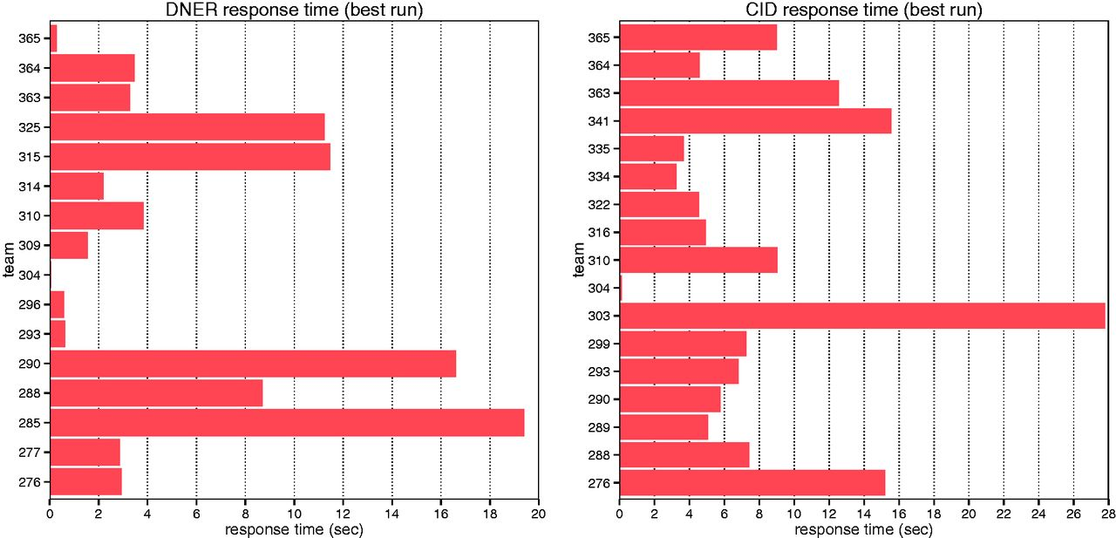
Figure 4. Average response time of each individual team for DNER and CID tasks.
Notes:
Figure 4. Average response time of each individual team for DNER and CID tasks.
Unless provided in the caption above, the following copyright applies to the content of this slide: Published by Oxford University Press 2016. This work is written by US Government employees and is in the public domain in the US.

