Slide 1
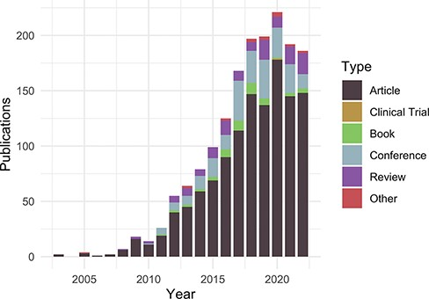
Figure 1. Publications citing the DO each year from PubMed and Scopus organized by publication type ...
Notes:
Figure 1. Publications citing the DO each year from PubMed and Scopus organized by publication type (https://disease-ontology.org/about/pubs_by_year). ‘Other’ publications include a small number of preprints indexed in PubMed and Scopus. The slight downward trend from 2020 to 2022 reflects a spike in publications due to COVID (2020) and incomplete publication information (2022). In November 2022, there were 1659 total unique citations to one or more of DO’s official publications.
Unless provided in the caption above, the following copyright applies to the content of this slide: © The Author(s) 2023. Published by Oxford University Press.This is an Open Access article distributed under the terms of the Creative Commons Attribution License (https://creativecommons.org/licenses/by/4.0/), which permits unrestricted reuse, distribution, and reproduction in any medium, provided the original work is properly cited.

