Slide 1
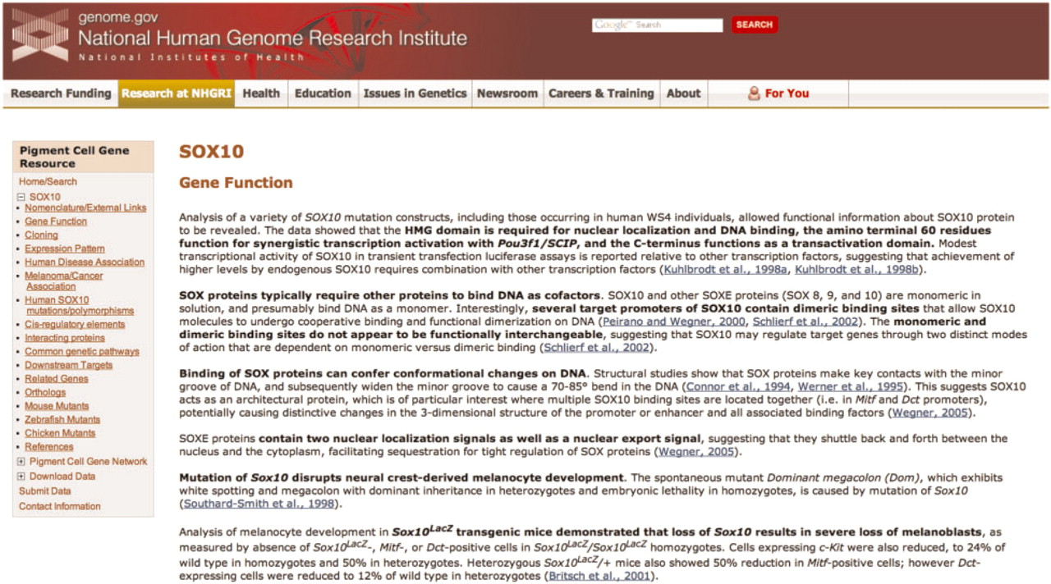
Figure 1. A representative page from the annotated literature section for SOX10 of the Pigment Cell Gene Resource. The ...
Notes:
Figure 1. A representative page from the annotated literature section for SOX10 of the Pigment Cell Gene Resource. The navigation sidebar at left includes the 17 literature summary subcategories; each of these categories is located on a separate page. Links to PubMed abstracts for each summarized article are in blue, and bold text indicates the main points of the summary. The navigation sidebar also contains links to access the Pigment Cell Gene Network, to submit data directly and to download data.
Unless provided in the caption above, the following copyright applies to the content of this slide: Published by Oxford University Press 2010.This is Open Access article distributed under the terms of the Creative Commons Attribution Non-Commercial License (http://creativecommons.org/licenses/by-nc/2.5), which permits unrestricted non-commercial use, distribution, and reproduction in any medium, provided the original work is properly cited.

