Slide 1
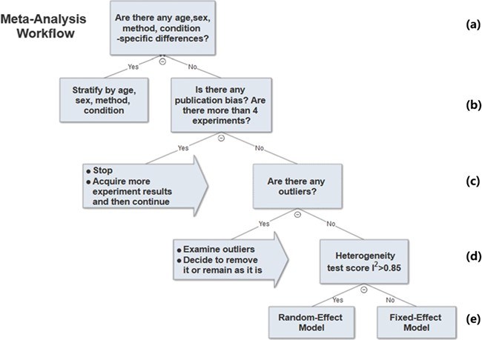
Figure 6 Meta-analysis workflow. In summary, our workflow is composed of the following key steps: (a) Preliminary ...
Notes:
Figure 6 Meta-analysis workflow. In summary, our workflow is composed of the following key steps: (a) Preliminary stratification by age, sex, method and experimental condition. (b) Perform exploratory analysis to examine publication bias and total number of experiments. (c) Perform exploratory analysis to determine inclusion/exclusion of individual study/observation in the meta-analysis. (d) Examination of heterogeneity using Cochrane’s Q, a statistic based on the χ2 test and the I2 statistic. (e) The fixed-effect and random-effect model choice threshold is set to I2 = 0.85, which is considered the optimal threshold to distinguish heterogeneity caused by a limited number of records or true inter-study variance. (f) All the summary values for the phenotype under analysis are displayed in a summary forest plot.
Unless provided in the caption above, the following copyright applies to the content of this slide: © The Author(s) 2019. Published by Oxford University Press.This is an Open Access article distributed under the terms of the Creative Commons Attribution License (http://creativecommons.org/licenses/by/4.0/), which permits unrestricted reuse, distribution, and reproduction in any medium, provided the original work is properly cited.

