Slide 1
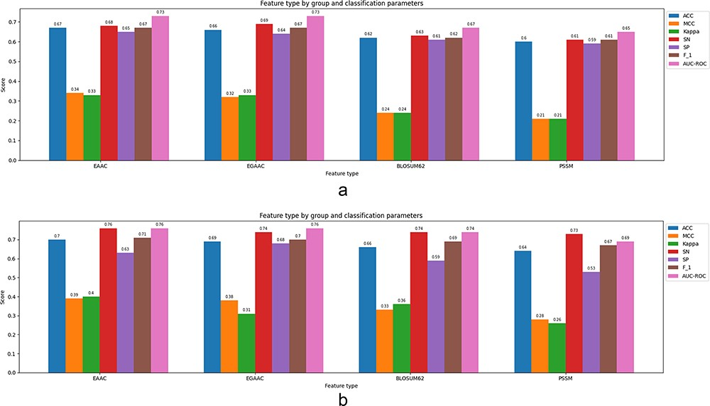
Figure 5. Classification parameters corresponding to the best-performing classification model (XGBoost) fed by the ...
Notes:
Figure 5. Classification parameters corresponding to the best-performing classification model (XGBoost) fed by the single feature of window size 35 for both cases: 5-fold cross-validation and independent test: (a) results corresponding to a 5-fold CV, (b) results corresponding to an independent test.
Unless provided in the caption above, the following copyright applies to the content of this slide: © The Author(s) 2024. Published by Oxford University Press.This is an Open Access article distributed under the terms of the Creative Commons Attribution License (https://creativecommons.org/licenses/by/4.0/), which permits unrestricted reuse, distribution, and reproduction in any medium, provided the original work is properly cited.

