Slide 1
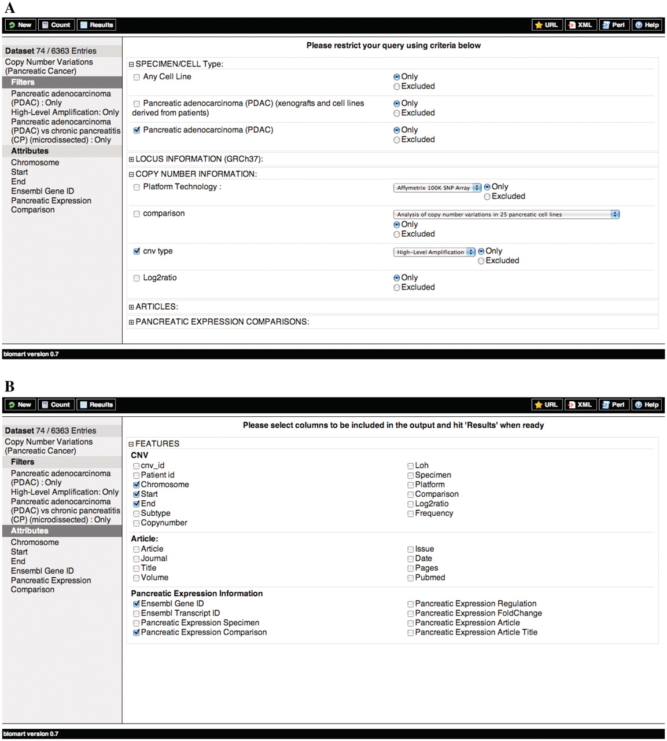
Figure 1. Schematic representation of the querying process for the PED CNV data sets. (A) Filters and (B) Attributes.
Notes:
Figure 1. Schematic representation of the querying process for the PED CNV data sets. (A) Filters and (B) Attributes.
Unless provided in the caption above, the following copyright applies to the content of this slide: © The Author(s) 2011. Published by Oxford University Press.This is Open Access article distributed under the terms of the Creative Commons Attribution Non-Commercial License (http://creativecommons.org/licenses/by-nc/2.5), which permits unrestricted non-commercial use, distribution, and reproduction in any medium, provided the original work is properly cited.

Slide 2
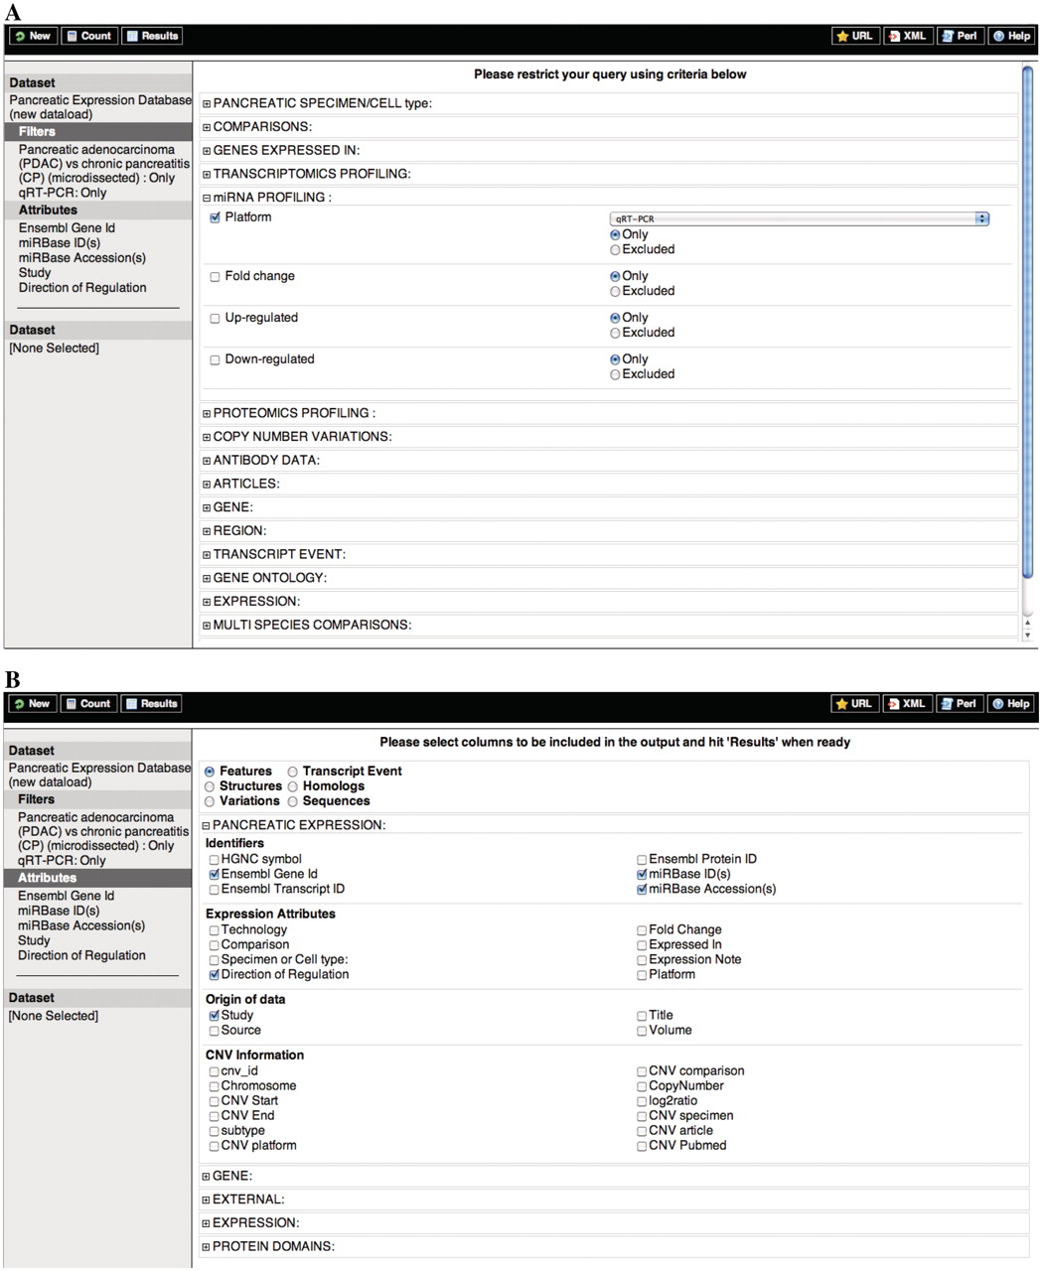
Figure 2. Schematic representation of the querying process for the PED expression data set. (A) Filters and (B) ...
Notes:
Figure 2. Schematic representation of the querying process for the PED expression data set. (A) Filters and (B) Attributes.
Unless provided in the caption above, the following copyright applies to the content of this slide: © The Author(s) 2011. Published by Oxford University Press.This is Open Access article distributed under the terms of the Creative Commons Attribution Non-Commercial License (http://creativecommons.org/licenses/by-nc/2.5), which permits unrestricted non-commercial use, distribution, and reproduction in any medium, provided the original work is properly cited.

