Slide 1
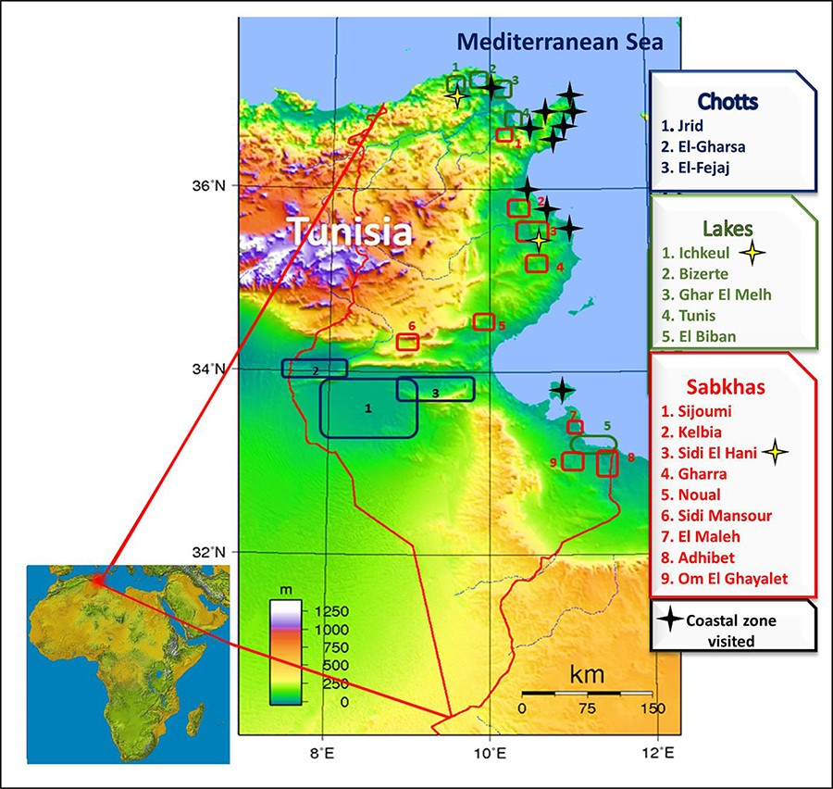
Figure 1. Strategic geographical location of Tunisia in the Mediterranean basin and map of the main potential halophyte ...
Notes:
Figure 1. Strategic geographical location of Tunisia in the Mediterranean basin and map of the main potential halophyte locations in Tunisia (Chotts, lakes, Sabkhas and coastal zones).
Unless provided in the caption above, the following copyright applies to the content of this slide: © The Author(s) 2022. Published by Oxford University Press.This is an Open Access article distributed under the terms of the Creative Commons Attribution License (https://creativecommons.org/licenses/by/4.0/), which permits unrestricted reuse, distribution, and reproduction in any medium, provided the original work is properly cited.

Slide 2
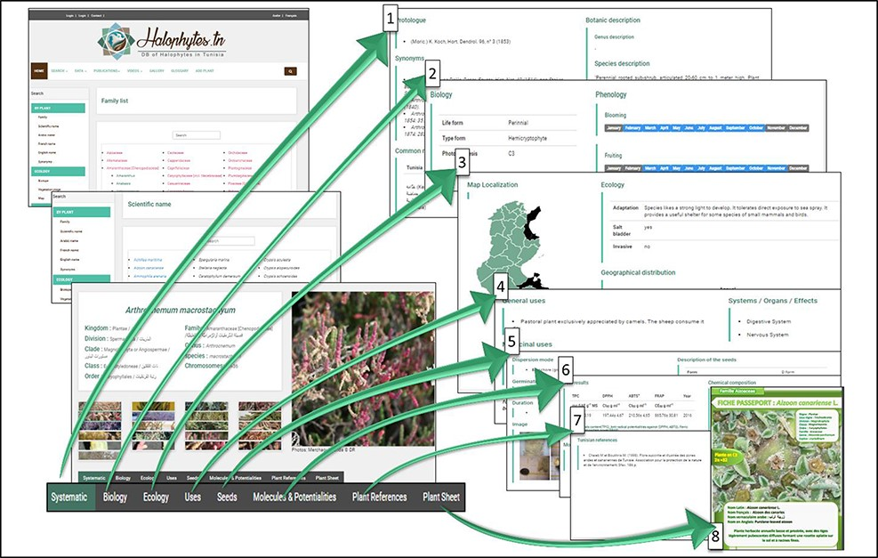
Figure 9. Organization of the different webpages related to each species: 1: systematic information and botanic ...
Notes:
Figure 9. Organization of the different webpages related to each species: 1: systematic information and botanic description; 2: biological data and phenology; 3: ecological data and geographical distribution; 4: general and medicinal uses; 5: seeds data; 6: molecules and potentialities; 7: references; 8: plant sheet.
Unless provided in the caption above, the following copyright applies to the content of this slide: © The Author(s) 2022. Published by Oxford University Press.This is an Open Access article distributed under the terms of the Creative Commons Attribution License (https://creativecommons.org/licenses/by/4.0/), which permits unrestricted reuse, distribution, and reproduction in any medium, provided the original work is properly cited.

Slide 3
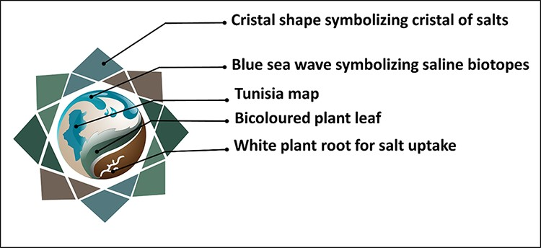
Figure 5. Logotype meaning of the Halophytes.rnrt.tn database.
Notes:
Figure 5. Logotype meaning of the Halophytes.rnrt.tn database.
Unless provided in the caption above, the following copyright applies to the content of this slide: © The Author(s) 2022. Published by Oxford University Press.This is an Open Access article distributed under the terms of the Creative Commons Attribution License (https://creativecommons.org/licenses/by/4.0/), which permits unrestricted reuse, distribution, and reproduction in any medium, provided the original work is properly cited.

Slide 4
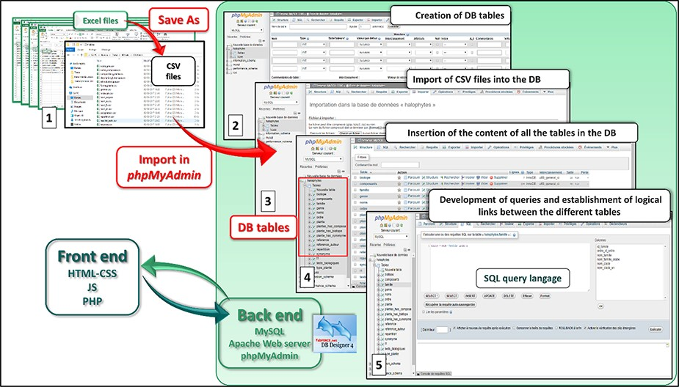
Figure 4. Web development strategy of Halophytes.rnrt.tn database.
Notes:
Figure 4. Web development strategy of Halophytes.rnrt.tn database.
Unless provided in the caption above, the following copyright applies to the content of this slide: © The Author(s) 2022. Published by Oxford University Press.This is an Open Access article distributed under the terms of the Creative Commons Attribution License (https://creativecommons.org/licenses/by/4.0/), which permits unrestricted reuse, distribution, and reproduction in any medium, provided the original work is properly cited.

Slide 5
Figure 3. The four global steps that led to the Halophytes.rnrt.tn database conception.
Notes:
Figure 3. The four global steps that led to the Halophytes.rnrt.tn database conception.
Unless provided in the caption above, the following copyright applies to the content of this slide: © The Author(s) 2022. Published by Oxford University Press.This is an Open Access article distributed under the terms of the Creative Commons Attribution License (https://creativecommons.org/licenses/by/4.0/), which permits unrestricted reuse, distribution, and reproduction in any medium, provided the original work is properly cited.

Slide 6
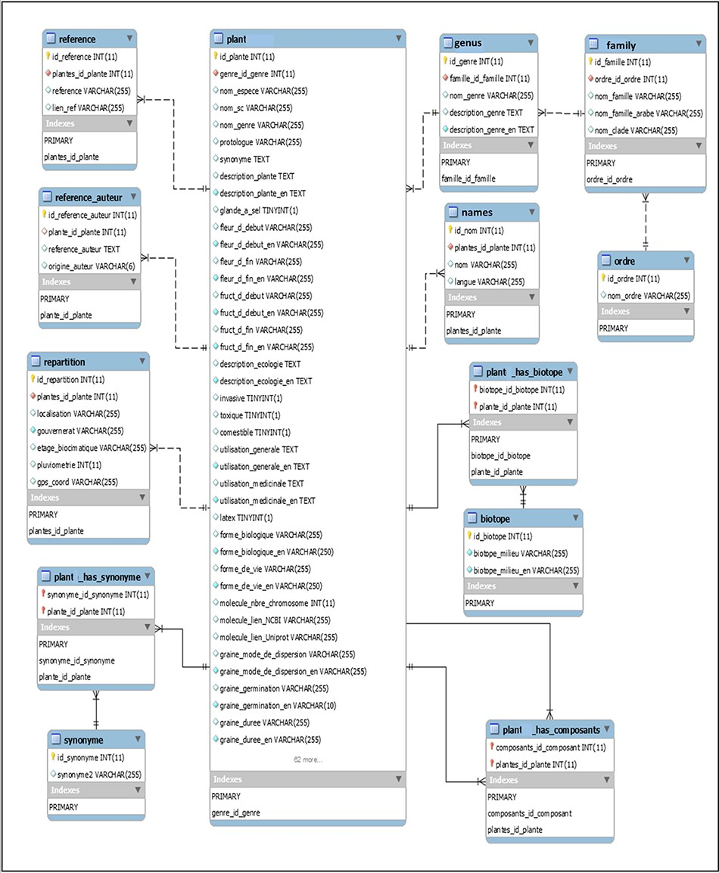
Figure 2. Database structure: main tables and their relationships (mysql-workbench-community-6.3.10-winx64).
Notes:
Figure 2. Database structure: main tables and their relationships (mysql-workbench-community-6.3.10-winx64).
Unless provided in the caption above, the following copyright applies to the content of this slide: © The Author(s) 2022. Published by Oxford University Press.This is an Open Access article distributed under the terms of the Creative Commons Attribution License (https://creativecommons.org/licenses/by/4.0/), which permits unrestricted reuse, distribution, and reproduction in any medium, provided the original work is properly cited.

Slide 7
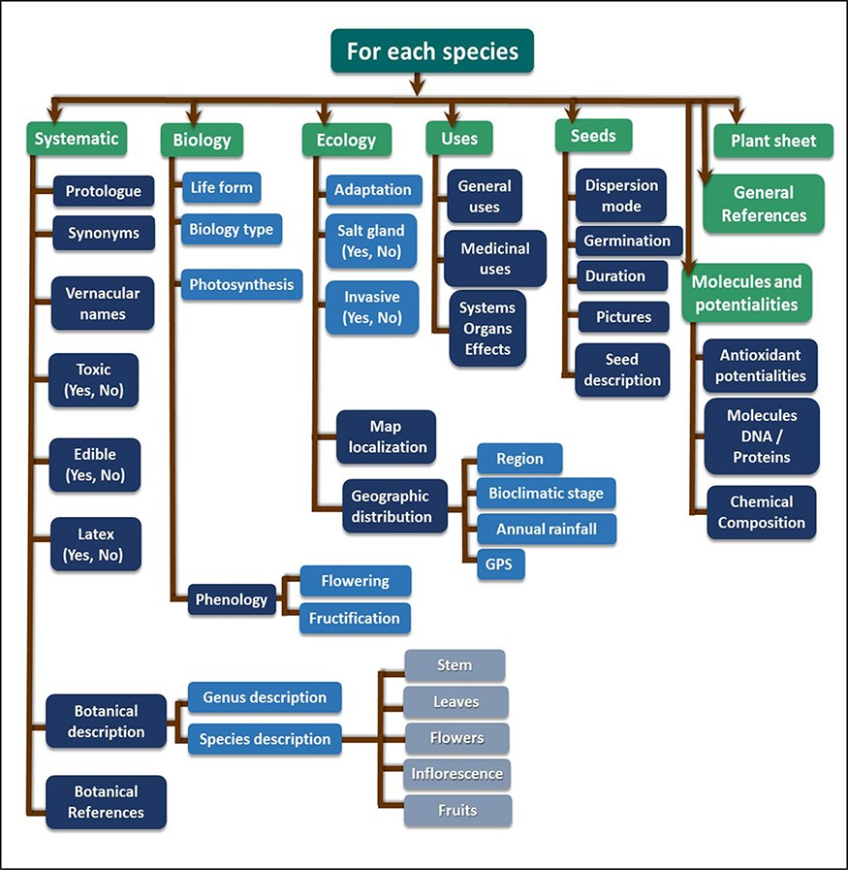
Figure 8. Framework of several search criteria for each species.
Notes:
Figure 8. Framework of several search criteria for each species.
Unless provided in the caption above, the following copyright applies to the content of this slide: © The Author(s) 2022. Published by Oxford University Press.This is an Open Access article distributed under the terms of the Creative Commons Attribution License (https://creativecommons.org/licenses/by/4.0/), which permits unrestricted reuse, distribution, and reproduction in any medium, provided the original work is properly cited.

Slide 8
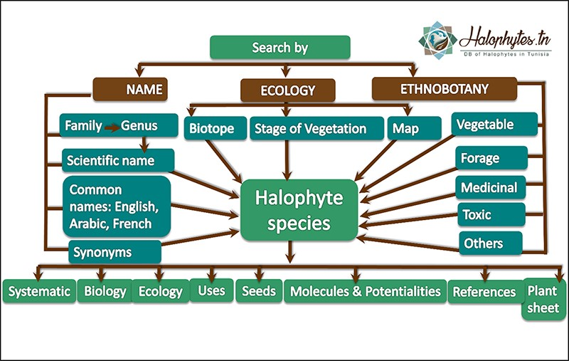
Figure 7. Framework of the Halophytes.rnrt.tn database showing the different search criteria in the homepage.
Notes:
Figure 7. Framework of the Halophytes.rnrt.tn database showing the different search criteria in the homepage.
Unless provided in the caption above, the following copyright applies to the content of this slide: © The Author(s) 2022. Published by Oxford University Press.This is an Open Access article distributed under the terms of the Creative Commons Attribution License (https://creativecommons.org/licenses/by/4.0/), which permits unrestricted reuse, distribution, and reproduction in any medium, provided the original work is properly cited.

Slide 9
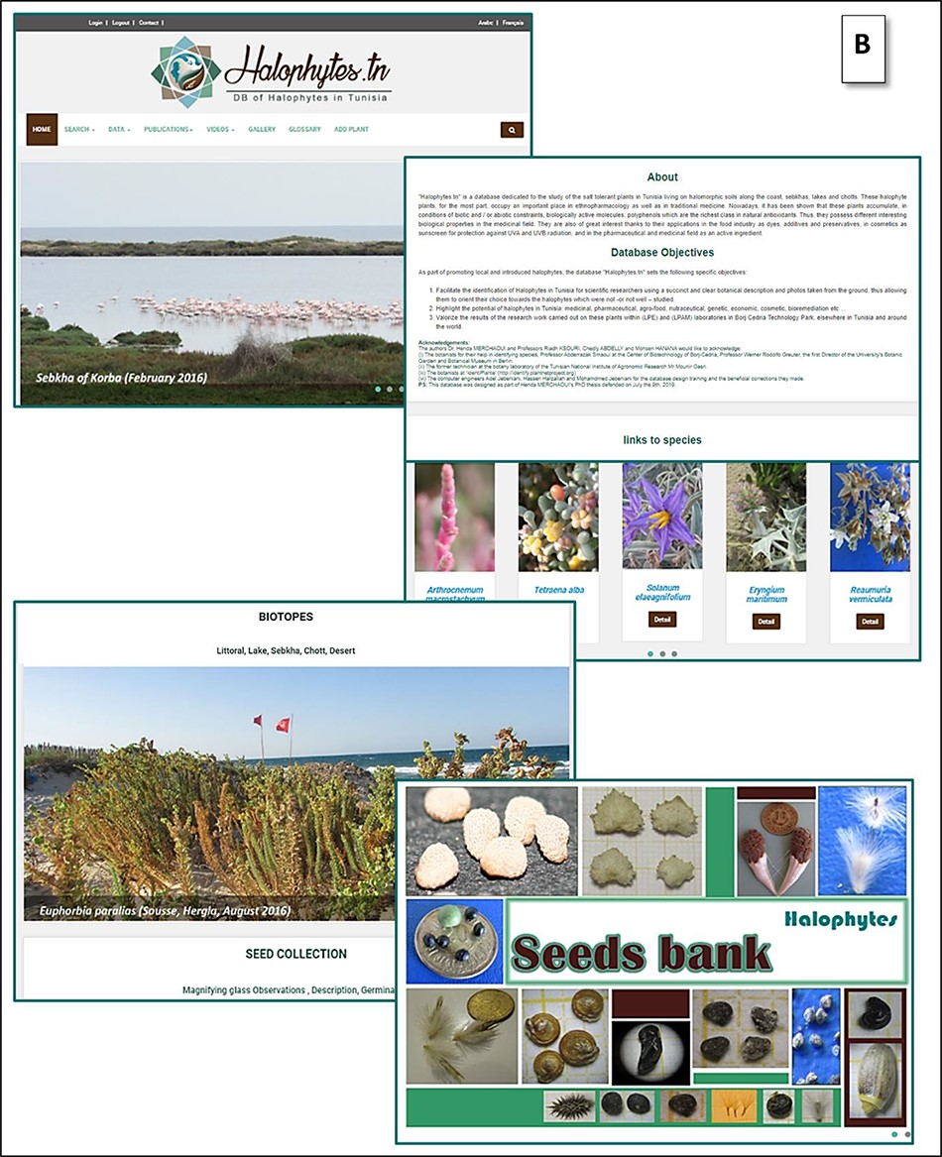
Figure 6. (B) Other topics and links of the home page.
Notes:
Figure 6. (B) Other topics and links of the home page.
Unless provided in the caption above, the following copyright applies to the content of this slide: © The Author(s) 2022. Published by Oxford University Press.This is an Open Access article distributed under the terms of the Creative Commons Attribution License (https://creativecommons.org/licenses/by/4.0/), which permits unrestricted reuse, distribution, and reproduction in any medium, provided the original work is properly cited.

Slide 10
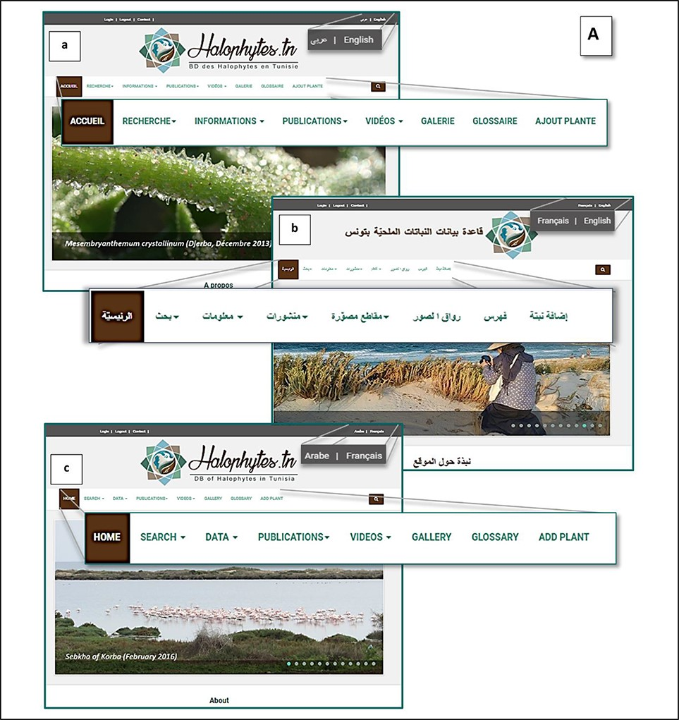
Figure 6. (A) Home page of the Halophytes.rnrt.tn website available in three languages: a: French, b: Arabic, c: ...
Notes:
Figure 6. (A) Home page of the Halophytes.rnrt.tn website available in three languages: a: French, b: Arabic, c: English.
Unless provided in the caption above, the following copyright applies to the content of this slide: © The Author(s) 2022. Published by Oxford University Press.This is an Open Access article distributed under the terms of the Creative Commons Attribution License (https://creativecommons.org/licenses/by/4.0/), which permits unrestricted reuse, distribution, and reproduction in any medium, provided the original work is properly cited.

