Slide 1
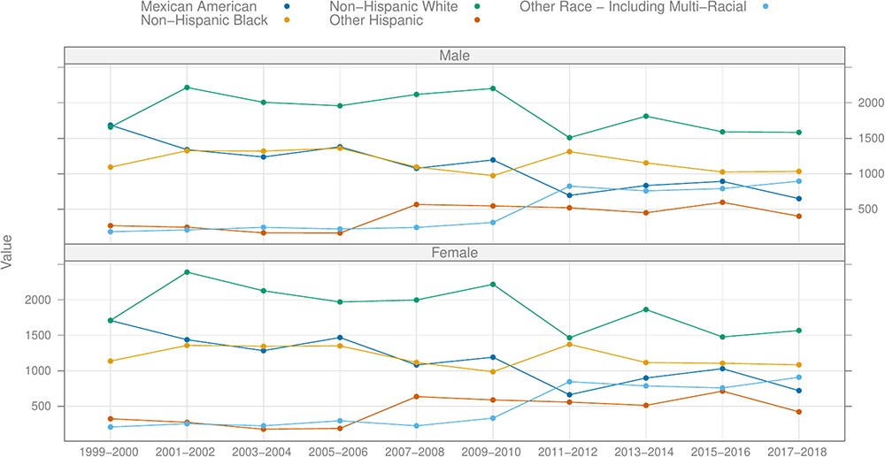
Figure 1. Number of participants by recorded ethnicity and gender by cycle, excluding the pre-pandemic (2017–March ...
Notes:
Figure 1. Number of participants by recorded ethnicity and gender by cycle, excluding the pre-pandemic (2017–March 2020) cycle.
Unless provided in the caption above, the following copyright applies to the content of this slide: © The Author(s) 2024. Published by Oxford University Press.This is an Open Access article distributed under the terms of the Creative Commons Attribution License (https://creativecommons.org/licenses/by/4.0/), which permits unrestricted reuse, distribution, and reproduction in any medium, provided the original work is properly cited.

Slide 2
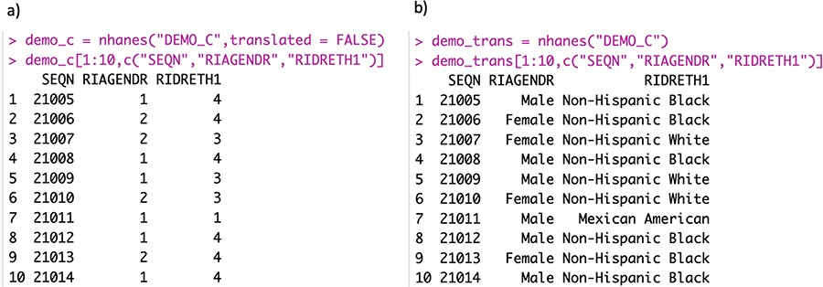
Figure 2. Panel (a) shows the raw data, where both gender and ethnicity are encoded as integers. Panel (b) shows the ...
Notes:
Figure 2. Panel (a) shows the raw data, where both gender and ethnicity are encoded as integers. Panel (b) shows the translated data.
Unless provided in the caption above, the following copyright applies to the content of this slide: © The Author(s) 2024. Published by Oxford University Press.This is an Open Access article distributed under the terms of the Creative Commons Attribution License (https://creativecommons.org/licenses/by/4.0/), which permits unrestricted reuse, distribution, and reproduction in any medium, provided the original work is properly cited.

Slide 3
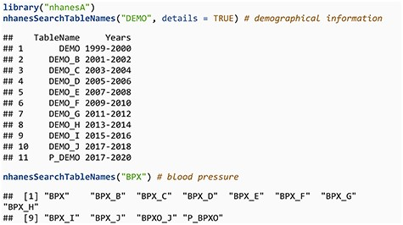
Notes:
Unless provided in the caption above, the following copyright applies to the content of this slide: © The Author(s) 2024. Published by Oxford University Press.This is an Open Access article distributed under the terms of the Creative Commons Attribution License (https://creativecommons.org/licenses/by/4.0/), which permits unrestricted reuse, distribution, and reproduction in any medium, provided the original work is properly cited.

Slide 4
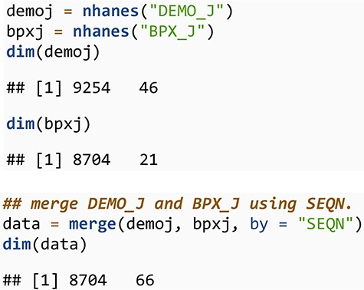
Notes:
Unless provided in the caption above, the following copyright applies to the content of this slide: © The Author(s) 2024. Published by Oxford University Press.This is an Open Access article distributed under the terms of the Creative Commons Attribution License (https://creativecommons.org/licenses/by/4.0/), which permits unrestricted reuse, distribution, and reproduction in any medium, provided the original work is properly cited.

Slide 5
Notes:
Unless provided in the caption above, the following copyright applies to the content of this slide: © The Author(s) 2024. Published by Oxford University Press.This is an Open Access article distributed under the terms of the Creative Commons Attribution License (https://creativecommons.org/licenses/by/4.0/), which permits unrestricted reuse, distribution, and reproduction in any medium, provided the original work is properly cited.

Slide 6
Notes:
Unless provided in the caption above, the following copyright applies to the content of this slide: © The Author(s) 2024. Published by Oxford University Press.This is an Open Access article distributed under the terms of the Creative Commons Attribution License (https://creativecommons.org/licenses/by/4.0/), which permits unrestricted reuse, distribution, and reproduction in any medium, provided the original work is properly cited.

Slide 7
Notes:
Unless provided in the caption above, the following copyright applies to the content of this slide: © The Author(s) 2024. Published by Oxford University Press.This is an Open Access article distributed under the terms of the Creative Commons Attribution License (https://creativecommons.org/licenses/by/4.0/), which permits unrestricted reuse, distribution, and reproduction in any medium, provided the original work is properly cited.

Slide 8
Notes:
Unless provided in the caption above, the following copyright applies to the content of this slide: © The Author(s) 2024. Published by Oxford University Press.This is an Open Access article distributed under the terms of the Creative Commons Attribution License (https://creativecommons.org/licenses/by/4.0/), which permits unrestricted reuse, distribution, and reproduction in any medium, provided the original work is properly cited.

Slide 9
Notes:
Unless provided in the caption above, the following copyright applies to the content of this slide: © The Author(s) 2024. Published by Oxford University Press.This is an Open Access article distributed under the terms of the Creative Commons Attribution License (https://creativecommons.org/licenses/by/4.0/), which permits unrestricted reuse, distribution, and reproduction in any medium, provided the original work is properly cited.

Slide 10
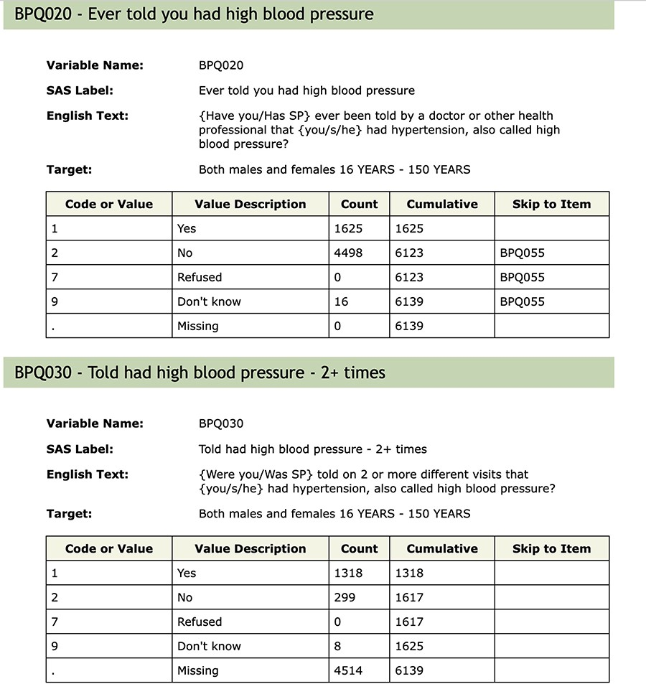
Figure 3. Questions BPQ_020 and BPQ_030 from table BPQ_D.
Notes:
Figure 3. Questions BPQ_020 and BPQ_030 from table BPQ_D.
Unless provided in the caption above, the following copyright applies to the content of this slide: © The Author(s) 2024. Published by Oxford University Press.This is an Open Access article distributed under the terms of the Creative Commons Attribution License (https://creativecommons.org/licenses/by/4.0/), which permits unrestricted reuse, distribution, and reproduction in any medium, provided the original work is properly cited.

Slide 11
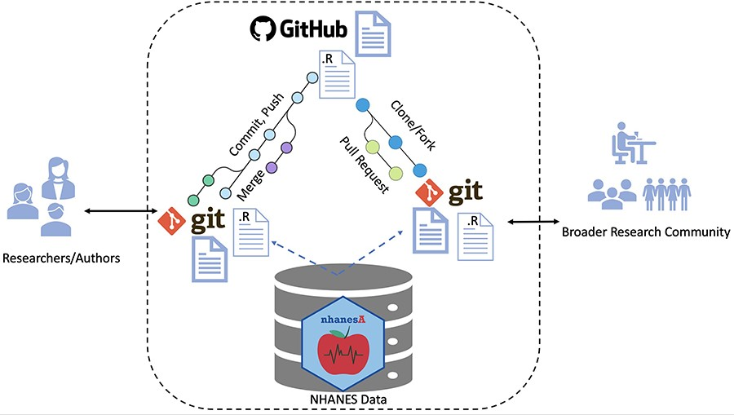
Figure 4. Workflow for ensuring transparent and reproducible research: (i) authors use Rmarkdown and R files, managed ...
Notes:
Figure 4. Workflow for ensuring transparent and reproducible research: (i) authors use Rmarkdown and R files, managed with Git version control for organization and collaboration. The nhanesA package facilitates NHANES access. Git and GitHub facilitate this by archiving and source code control. (ii) Work is committed, pushed and made public on GitHub in the form of Rmarkdown and R files. (iii) Anyone who wants to reproduce the work can fork or clone the repository to reproduce or expand upon the work. External users can access the NHANES database in the same way as the original authors. Contributions or extensions can be integrated via pull requests and subsequent merging.
Unless provided in the caption above, the following copyright applies to the content of this slide: © The Author(s) 2024. Published by Oxford University Press.This is an Open Access article distributed under the terms of the Creative Commons Attribution License (https://creativecommons.org/licenses/by/4.0/), which permits unrestricted reuse, distribution, and reproduction in any medium, provided the original work is properly cited.

