Slide 1
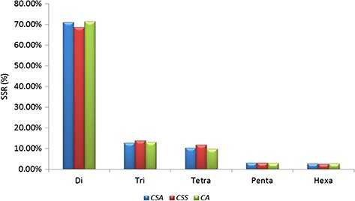
Figure 1 Comparative analysis of SSR in nuclear genomes of Camellia species. Frequency of di- to hexa-nucleotide ...
Notes:
Figure 1 Comparative analysis of SSR in nuclear genomes of Camellia species. Frequency of di- to hexa-nucleotide repeat motifs detected in the three Camellia species, namely CSA, CSS and CA.
Unless provided in the caption above, the following copyright applies to the content of this slide: © The Author(s) 2020. Published by Oxford University Press.This is an Open Access article distributed under the terms of the Creative Commons Attribution License (http://creativecommons.org/licenses/by/4.0/), which permits unrestricted reuse, distribution, and reproduction in any medium, provided the original work is properly cited.

Slide 2
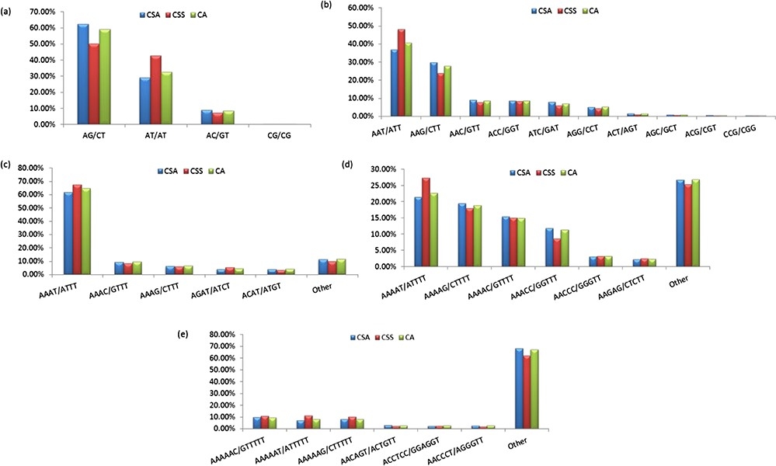
Figure 2 Frequency of identified motifs and their complementary sequences in the nuclear genomes of Camellia species. ...
Notes:
Figure 2 Frequency of identified motifs and their complementary sequences in the nuclear genomes of Camellia species. Figure 2(a–e) represent the frequency of di- to hexa-nucleotide repeat motifs and their complementary sequences in CSA, CSS and CA, respectively.
Unless provided in the caption above, the following copyright applies to the content of this slide: © The Author(s) 2020. Published by Oxford University Press.This is an Open Access article distributed under the terms of the Creative Commons Attribution License (http://creativecommons.org/licenses/by/4.0/), which permits unrestricted reuse, distribution, and reproduction in any medium, provided the original work is properly cited.

Slide 3
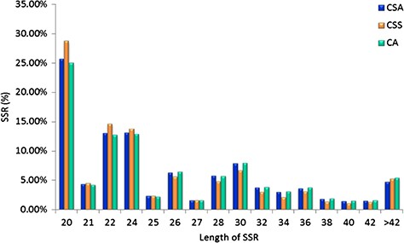
Figure 3 Length distribution of SSRs identified in the nuclear genomes of Camellia species, CSA, CSS and CA.
Notes:
Figure 3 Length distribution of SSRs identified in the nuclear genomes of Camellia species, CSA, CSS and CA.
Unless provided in the caption above, the following copyright applies to the content of this slide: © The Author(s) 2020. Published by Oxford University Press.This is an Open Access article distributed under the terms of the Creative Commons Attribution License (http://creativecommons.org/licenses/by/4.0/), which permits unrestricted reuse, distribution, and reproduction in any medium, provided the original work is properly cited.

Slide 4
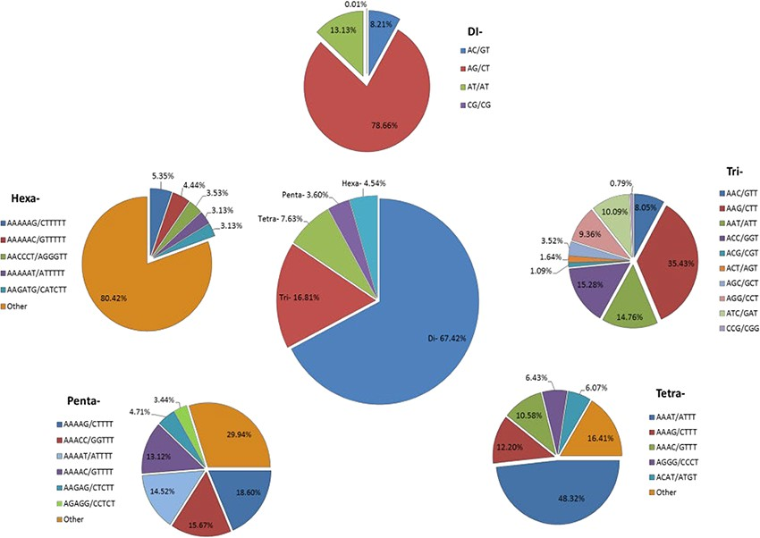
Figure 4 Identification of SSRs in the Transcriptome Shotgun Assembly of SRA data. Frequency of di- to hexa-nucleotide ...
Notes:
Figure 4 Identification of SSRs in the Transcriptome Shotgun Assembly of SRA data. Frequency of di- to hexa-nucleotide repeats in the central, large pie chart and small peripheral pie charts represent the motifs and their complementary sequences of identified di- to hexa-nucleotide repeats, respectively.
Unless provided in the caption above, the following copyright applies to the content of this slide: © The Author(s) 2020. Published by Oxford University Press.This is an Open Access article distributed under the terms of the Creative Commons Attribution License (http://creativecommons.org/licenses/by/4.0/), which permits unrestricted reuse, distribution, and reproduction in any medium, provided the original work is properly cited.

Slide 5
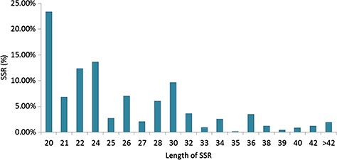
Figure 5 Length distribution of SSRs identified in the Transcriptome Shotgun Assembly of Camellia.
Notes:
Figure 5 Length distribution of SSRs identified in the Transcriptome Shotgun Assembly of Camellia.
Unless provided in the caption above, the following copyright applies to the content of this slide: © The Author(s) 2020. Published by Oxford University Press.This is an Open Access article distributed under the terms of the Creative Commons Attribution License (http://creativecommons.org/licenses/by/4.0/), which permits unrestricted reuse, distribution, and reproduction in any medium, provided the original work is properly cited.

Slide 6
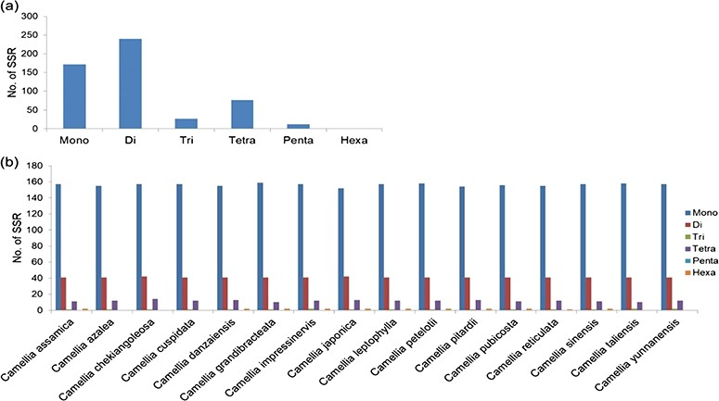
Figure 6 Identification of SSRs in organelle genomes of Camellia: (a) frequency of SSRs identified in mitochondria and ...
Notes:
Figure 6 Identification of SSRs in organelle genomes of Camellia: (a) frequency of SSRs identified in mitochondria and (b) chloroplast genomes of 16 Camellia species.
Unless provided in the caption above, the following copyright applies to the content of this slide: © The Author(s) 2020. Published by Oxford University Press.This is an Open Access article distributed under the terms of the Creative Commons Attribution License (http://creativecommons.org/licenses/by/4.0/), which permits unrestricted reuse, distribution, and reproduction in any medium, provided the original work is properly cited.

Slide 7
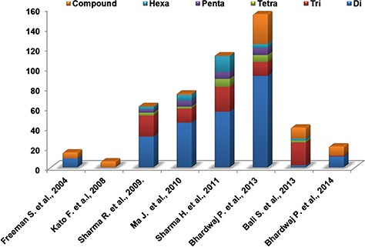
Figure 7 Distribution of different experimentally validated SSR in tea.
Notes:
Figure 7 Distribution of different experimentally validated SSR in tea.
Unless provided in the caption above, the following copyright applies to the content of this slide: © The Author(s) 2020. Published by Oxford University Press.This is an Open Access article distributed under the terms of the Creative Commons Attribution License (http://creativecommons.org/licenses/by/4.0/), which permits unrestricted reuse, distribution, and reproduction in any medium, provided the original work is properly cited.

Slide 8
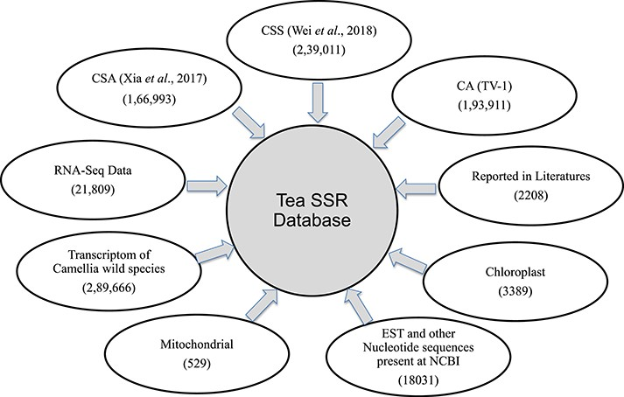
Figure 8 Summary of SSR database. Numbers of SSR identified and their sources used for database development.
Notes:
Figure 8 Summary of SSR database. Numbers of SSR identified and their sources used for database development.
Unless provided in the caption above, the following copyright applies to the content of this slide: © The Author(s) 2020. Published by Oxford University Press.This is an Open Access article distributed under the terms of the Creative Commons Attribution License (http://creativecommons.org/licenses/by/4.0/), which permits unrestricted reuse, distribution, and reproduction in any medium, provided the original work is properly cited.

Slide 9
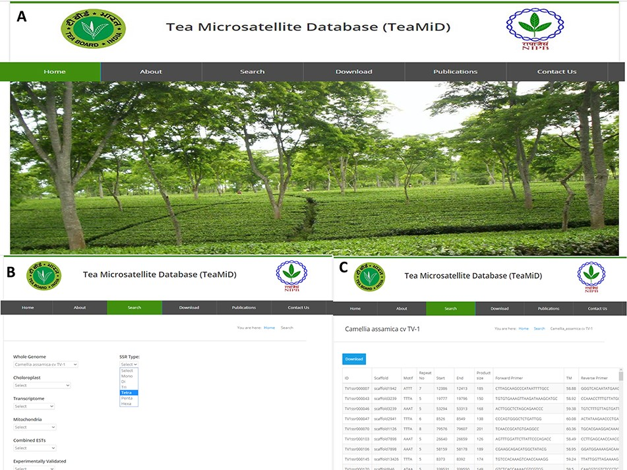
Figure 9 Database of tea SSR (TeaMiD) (a) front page of the database, (b) ‘Search’ page of the database indicating ...
Notes:
Figure 9 Database of tea SSR (TeaMiD) (a) front page of the database, (b) ‘Search’ page of the database indicating various option, (c) example of CA SSR page under the ‘whole genome’ search option.
Unless provided in the caption above, the following copyright applies to the content of this slide: © The Author(s) 2020. Published by Oxford University Press.This is an Open Access article distributed under the terms of the Creative Commons Attribution License (http://creativecommons.org/licenses/by/4.0/), which permits unrestricted reuse, distribution, and reproduction in any medium, provided the original work is properly cited.

Slide 10
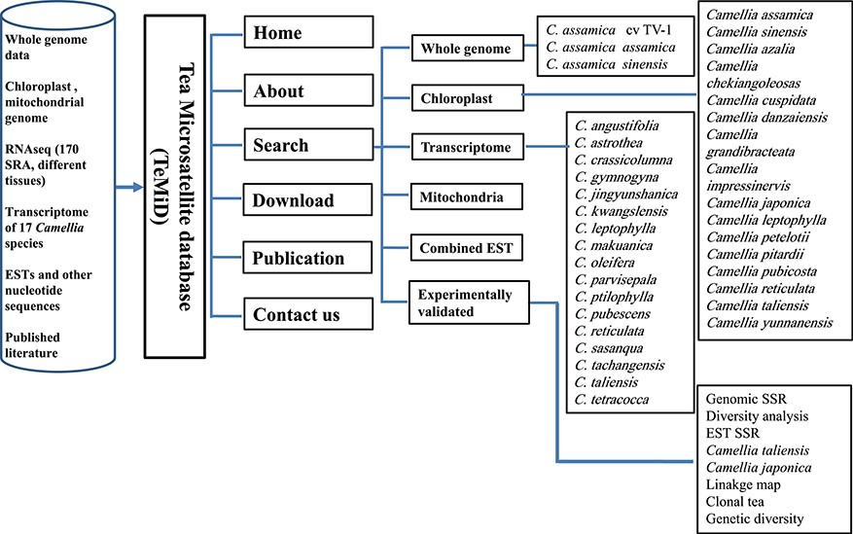
Figure 10 The structure of the SSR database (TeaMiD).
Notes:
Figure 10 The structure of the SSR database (TeaMiD).
Unless provided in the caption above, the following copyright applies to the content of this slide: © The Author(s) 2020. Published by Oxford University Press.This is an Open Access article distributed under the terms of the Creative Commons Attribution License (http://creativecommons.org/licenses/by/4.0/), which permits unrestricted reuse, distribution, and reproduction in any medium, provided the original work is properly cited.

