Slide 1
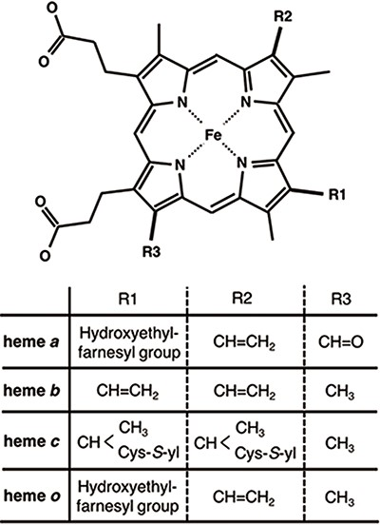
Figure 1. Chemical structures of hemes. R1, R2 and R3 in the upper structure correspond to those in the lower table. ...
Notes:
Figure 1. Chemical structures of hemes. R1, R2 and R3 in the upper structure correspond to those in the lower table. Heme c forms covalent bonds between the ethenyl groups in heme and the thiol groups of Cys residues in its host protein.
Unless provided in the caption above, the following copyright applies to the content of this slide: © The Author(s) 2020. Published by Oxford University Press.This is an Open Access article distributed under the terms of the Creative Commons Attribution License (http://creativecommons.org/licenses/by/4.0/), which permits unrestricted reuse, distribution, and reproduction in any medium, provided the original work is properly cited.

Slide 2
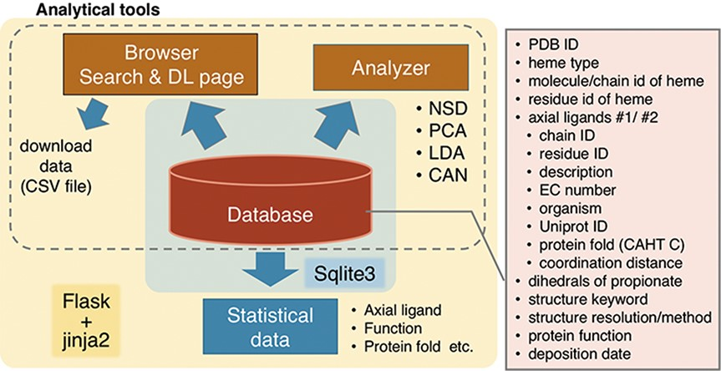
Figure 2. Overview of PyDISH.
Notes:
Figure 2. Overview of PyDISH.
Unless provided in the caption above, the following copyright applies to the content of this slide: © The Author(s) 2020. Published by Oxford University Press.This is an Open Access article distributed under the terms of the Creative Commons Attribution License (http://creativecommons.org/licenses/by/4.0/), which permits unrestricted reuse, distribution, and reproduction in any medium, provided the original work is properly cited.

Slide 3
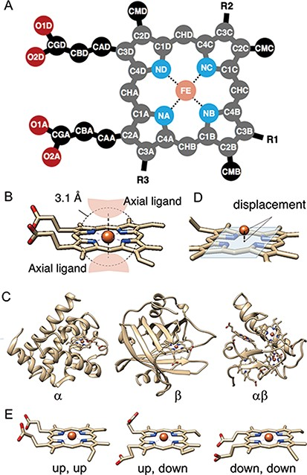
Figure 3. (A) The atomic nomenclature in heme. Twenty-five atoms of Fe-porphyrin (shown in lighter colors: grey, cyan ...
Notes:
Figure 3. (A) The atomic nomenclature in heme. Twenty-five atoms of Fe-porphyrin (shown in lighter colors: grey, cyan and orange) represent the porphyrin skeleton. (B) Identification of the axial ligand(s) of heme. The amino acids or other small molecules within 3.1 Å of the FE atom were identified as the axial ligands. (C) Representative structures of each protein fold in CATH level C (1: α, 2: β and 3: αβ). (D) The out-of-plane displacement of the iron ion from the least square fit plane of the 4 nitrogen atoms (NA, NB, NC and ND). (E) Schematic diagrams of the orientations of the propionate sidechains.
Unless provided in the caption above, the following copyright applies to the content of this slide: © The Author(s) 2020. Published by Oxford University Press.This is an Open Access article distributed under the terms of the Creative Commons Attribution License (http://creativecommons.org/licenses/by/4.0/), which permits unrestricted reuse, distribution, and reproduction in any medium, provided the original work is properly cited.

Slide 4
Figure 4. Schematic diagram of NSD. The left side represents the structural displacement from the equilibrium state. ...
Notes:
Figure 4. Schematic diagram of NSD. The left side represents the structural displacement from the equilibrium state. The right side is the linear combination of vibrational modes.
Unless provided in the caption above, the following copyright applies to the content of this slide: © The Author(s) 2020. Published by Oxford University Press.This is an Open Access article distributed under the terms of the Creative Commons Attribution License (http://creativecommons.org/licenses/by/4.0/), which permits unrestricted reuse, distribution, and reproduction in any medium, provided the original work is properly cited.

Slide 5
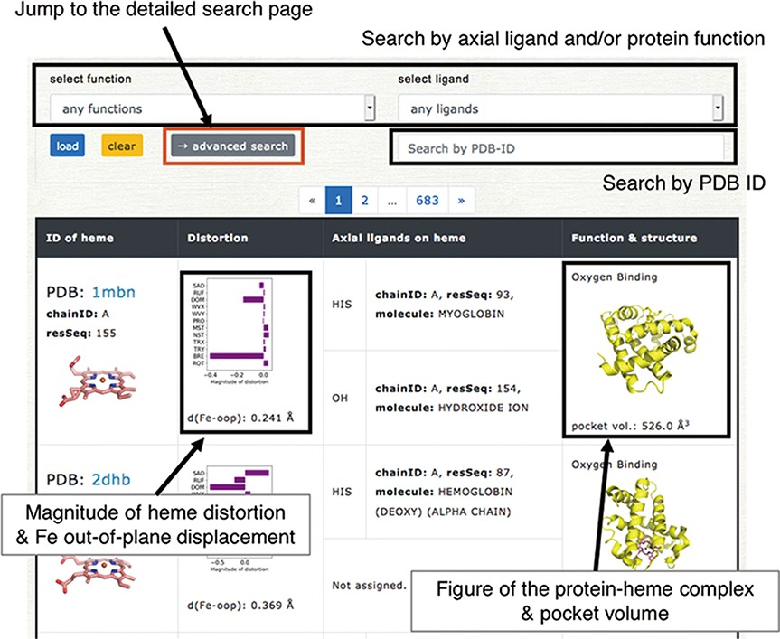
Figure 5. Browser in PyDISH. Select the axial ligand and protein function or enter a PDB ID, and click the ‘load’ ...
Notes:
Figure 5. Browser in PyDISH. Select the axial ligand and protein function or enter a PDB ID, and click the ‘load’ button, and then the relevant data will be listed. The images can be enlarged by hovering the mouse cursor over each item.
Unless provided in the caption above, the following copyright applies to the content of this slide: © The Author(s) 2020. Published by Oxford University Press.This is an Open Access article distributed under the terms of the Creative Commons Attribution License (http://creativecommons.org/licenses/by/4.0/), which permits unrestricted reuse, distribution, and reproduction in any medium, provided the original work is properly cited.

Slide 6
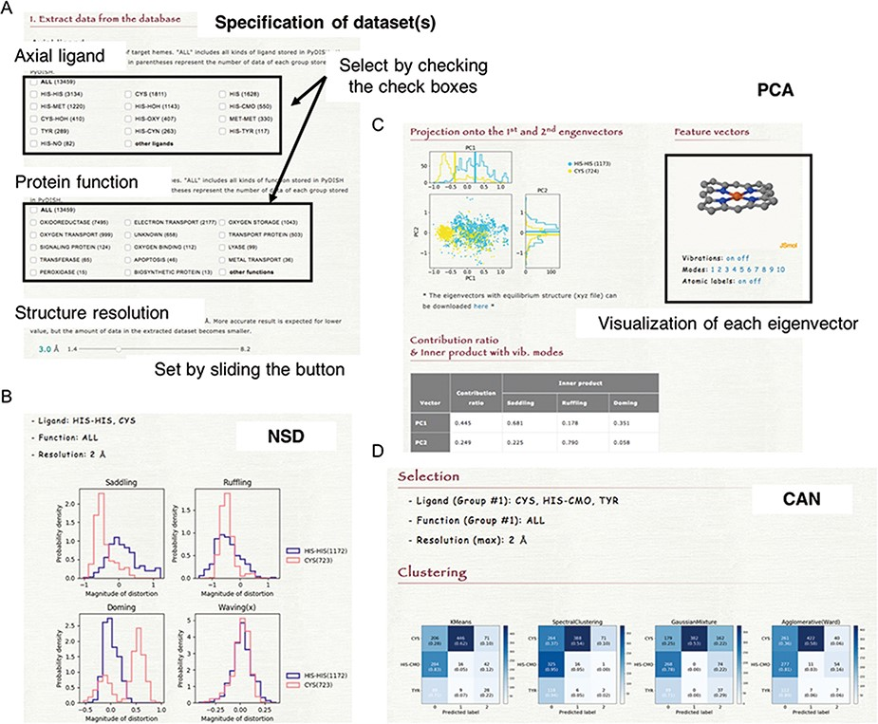
Figure 6. (A) How to specify the dataset(s). Select the axial ligand and the protein function according to the check ...
Notes:
Figure 6. (A) How to specify the dataset(s). Select the axial ligand and the protein function according to the check boxes, and set the threshold of structure resolution by sliding the button (1.4 ~ 8.2 Å). (B) Example of the NSD result page. (C) Example of the PCA result page. The motions of the first to 10th eigenvectors can be visualized by clicking the number of modes. The contribution ratio and inner product with the saddling, ruffling and doming modes of each eigenvector are listed as a table. (D) Example of the CAN result page.
Unless provided in the caption above, the following copyright applies to the content of this slide: © The Author(s) 2020. Published by Oxford University Press.This is an Open Access article distributed under the terms of the Creative Commons Attribution License (http://creativecommons.org/licenses/by/4.0/), which permits unrestricted reuse, distribution, and reproduction in any medium, provided the original work is properly cited.

