Slide 1
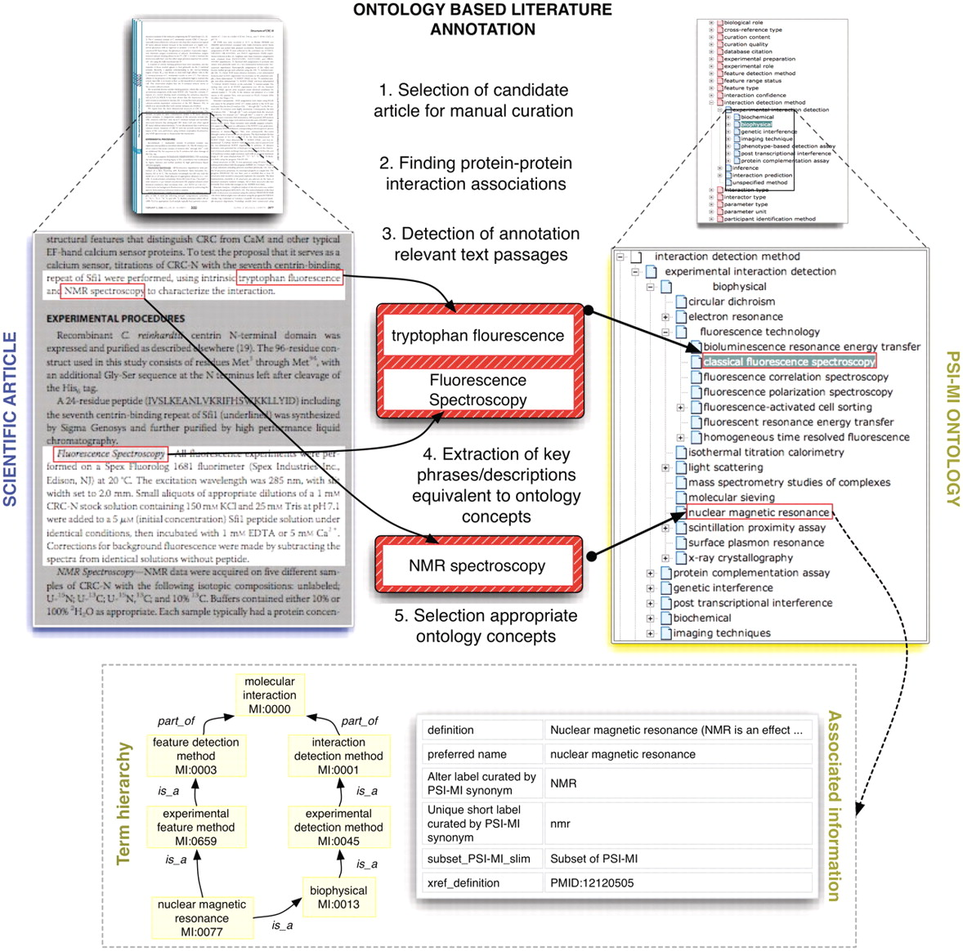
Figure 1. This figure shows schematically how protein interaction data is annotated and/or marked up using ontologies. ...
Notes:
Figure 1. This figure shows schematically how protein interaction data is annotated and/or marked up using ontologies. Systems such as MyMiner (myminer.armi.monash.edu.au/links.php), have been used for text labeling and highlighting purposes in the context of the BioCreative competition. The main steps illustrated in this figure have been addressed in the BioCreative challenges. Finding associations between textual expressions referring to experimental techniques used to characterize protein interactions and their equivalent concepts in the MI ontology is cumbersome in some cases when deep domain inference is required. Experienced curators are able to quickly navigate the term hierarchy to find the appropriate terms while novice annotators often need to search the ontology using method keywords as queries and consult associated descriptive information for potential candidate terms.
Unless provided in the caption above, the following copyright applies to the content of this slide: © The Author(s) 2012. Published by Oxford University Press.This is an Open Access article distributed under the terms of the Creative Commons Attribution Non-Commercial License (http://creativecommons.org/licenses/by-nc/3.0), which permits unrestricted non-commercial use, distribution, and reproduction in any medium, provided the original work is properly cited.

