Slide 1
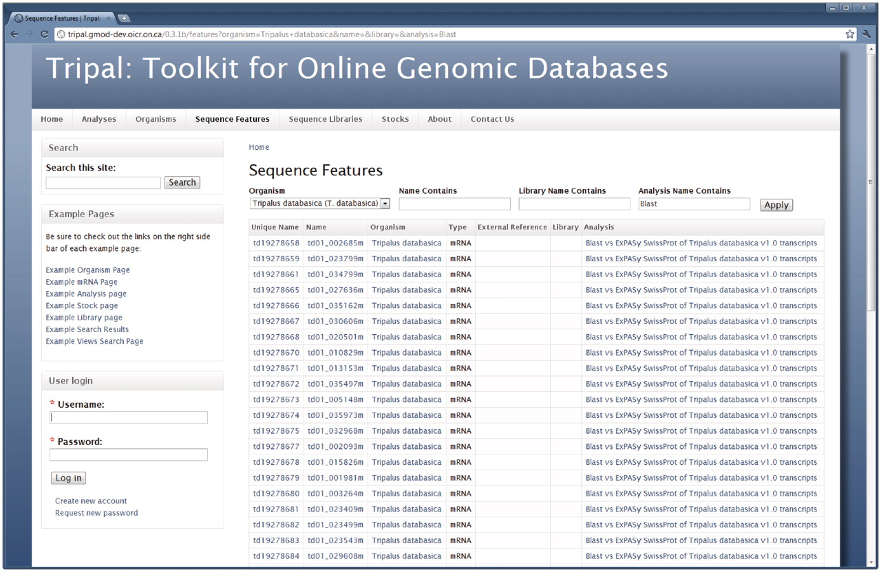
Figure 9. A Drupal Views query page. Tripal exposes the Chado database to the Drupal Views extension module. This ...
Notes:
Figure 9. A Drupal Views query page. Tripal exposes the Chado database to the Drupal Views extension module. This allows site administrators to create custom lists and search pages without the need for SQL or programming. When the Views module is installed Tripal will provide several pre-existing Views. This example shows the ‘Sequence Features’ View, which is available by clicking the ‘Sequence Features’ link in the primary menu. This View allows site visitors to search for features (sequences) within the database by filtering results by a specific organism or feature name. Visitors may also limit results to features that belong to a specific library or analysis. Here features for our example organism that are associated with a blast analysis are shown.
Unless provided in the caption above, the following copyright applies to the content of this slide: © The Author(s) 2011. Published by Oxford University Press.This is an Open Access article distributed under the terms of the Creative Commons Attribution Non-Commercial License (http://creativecommons.org/licenses/by-nc/3.0), which permits unrestricted non-commercial use, distribution, and reproduction in any medium, provided the original work is properly cited.

