Slide 1
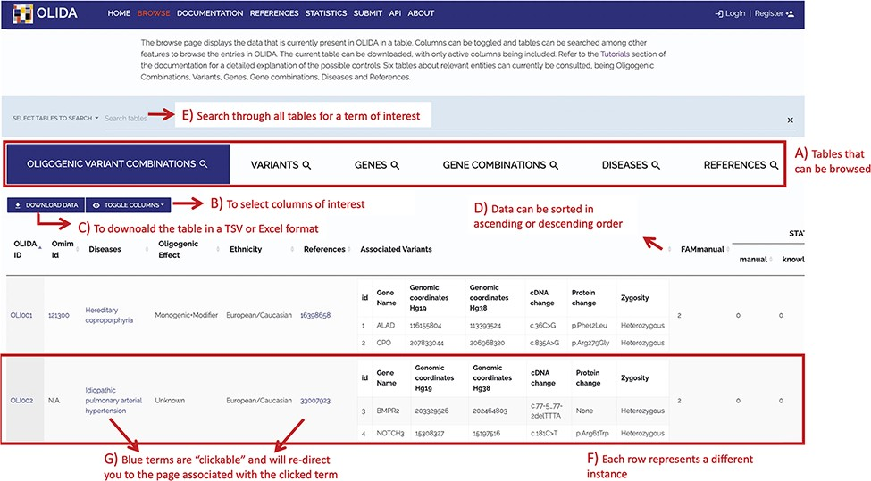
Figure 4. Screenshot of the Browse page of OLIDA with the Oligogenic Variant Combinations selected showing the ...
Notes:
Figure 4. Screenshot of the Browse page of OLIDA with the Oligogenic Variant Combinations selected showing the different possibilities that the database offers. Six different tables can be browsed (A) with the currently selected one shown in blue. (B) The user can then select the columns of interest to be displayed in the table and (C) download the table with the selected columns. (D) In a particular table, data can be sorted in ascending or descending order based on a particular column’s data. (E) A specific term (e.g. gene name and disease name) can be used to search all tables. (F) Each row represents a specific instance and (G) clicking on specific terms in blue will bring the user to the detail page for that specific instance.
Unless provided in the caption above, the following copyright applies to the content of this slide: © The Author(s) 2022. Published by Oxford University Press.This is an Open Access article distributed under the terms of the Creative Commons Attribution License (https://creativecommons.org/licenses/by/4.0/), which permits unrestricted reuse, distribution, and reproduction in any medium, provided the original work is properly cited.

