Slide 1
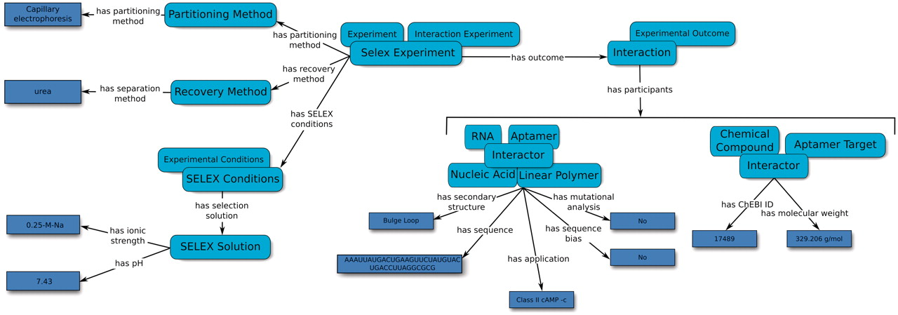
Figure 2. An overview of the relation map used by the Aptamer Base to describe SELEX experiments, the experimental ...
Notes:
Figure 2. An overview of the relation map used by the Aptamer Base to describe SELEX experiments, the experimental details and the resulting aptamers. Light blue ellipses denote types and arrows represent either properties between topics or between topics and values (dark blue rectangles).
Unless provided in the caption above, the following copyright applies to the content of this slide: © The Author(s) 2012. Published by Oxford University Press.This is an Open Access article distributed under the terms of the Creative Commons Attribution Non-Commercial License (http://creativecommons.org/licenses/by-nc/3.0), which permits unrestricted non-commercial use, distribution, and reproduction in any medium, provided the original work is properly cited.

