Slide 1
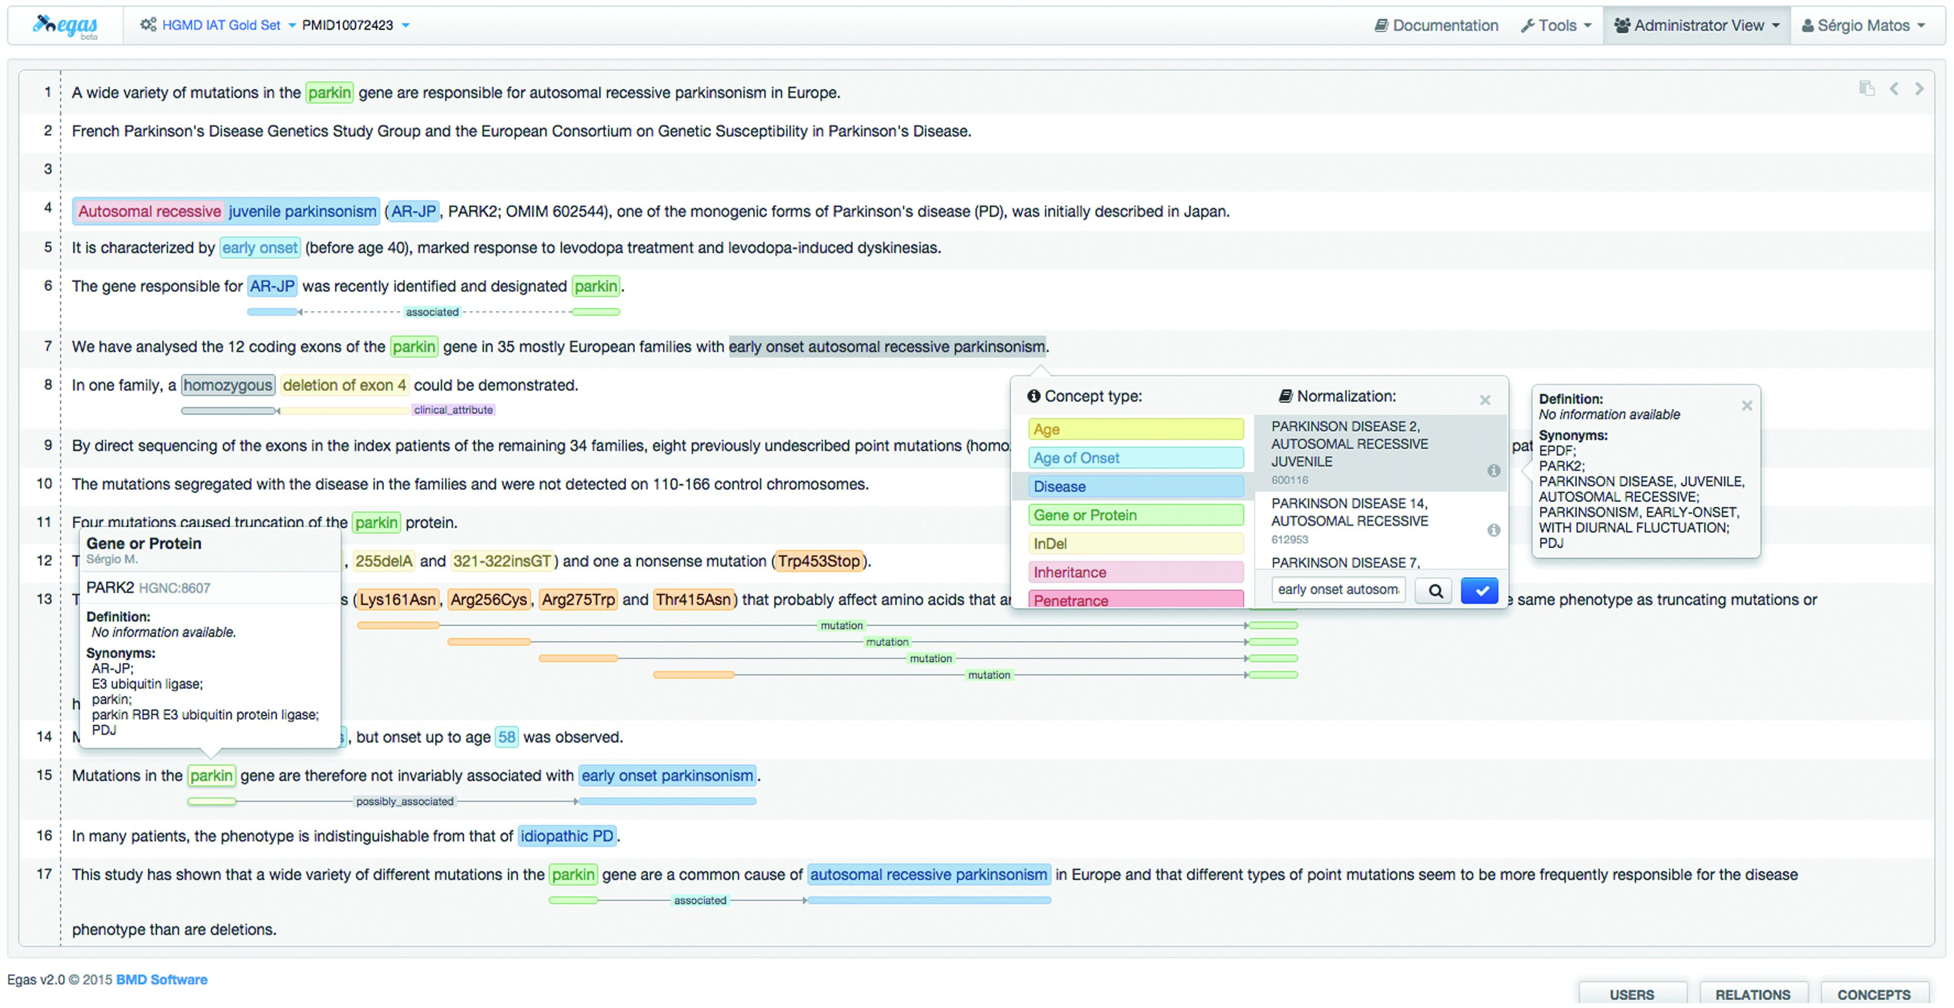
Figure 3. Egas annotation interface illustrating the addition of a new concept annotation of type ‘Disease’, and its ...
Notes:
Figure 3. Egas annotation interface illustrating the addition of a new concept annotation of type ‘Disease’, and its normalization to an OMIM concept. A concept information tooltip is shown when hovering the mouse pointer over an existing annotation.
Unless provided in the caption above, the following copyright applies to the content of this slide: © The Author(s) 2016. Published by Oxford University Press. This is an Open Access article distributed under the terms of the Creative Commons Attribution License ( http://creativecommons.org/licenses/by/4.0/ ), which permits unrestricted reuse, distribution, and reproduction in any medium, provided the original work is properly cited.

