Slide 1
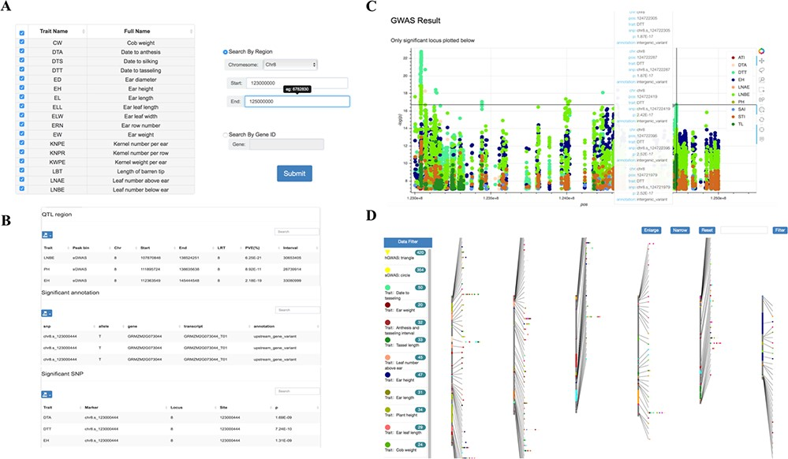
Figure 4 Tools for GWAS results search and visualization in MaizeCUBIC. (A) The GWAS signals could be searched by ...
Notes:
Figure 4 Tools for GWAS results search and visualization in MaizeCUBIC. (A) The GWAS signals could be searched by traits or gene ID and variant locations in GWAS search tools. (B) And detailed information of significant SNPs for you interested traits will show in downloadable tables on the results pages. (C) Each record in the search can be interactively visualizing. And clicking on your interested variations links to the relevant entry in genome browser tool. (D) Schematic of the GWAS diagram tool in MaizeCUBIC.
Unless provided in the caption above, the following copyright applies to the content of this slide: © The Author(s) 2020. Published by Oxford University Press.This is an Open Access article distributed under the terms of the Creative Commons Attribution License (http://creativecommons.org/licenses/by/4.0/), which permits unrestricted reuse, distribution, and reproduction in any medium, provided the original work is properly cited.

