Slide 1
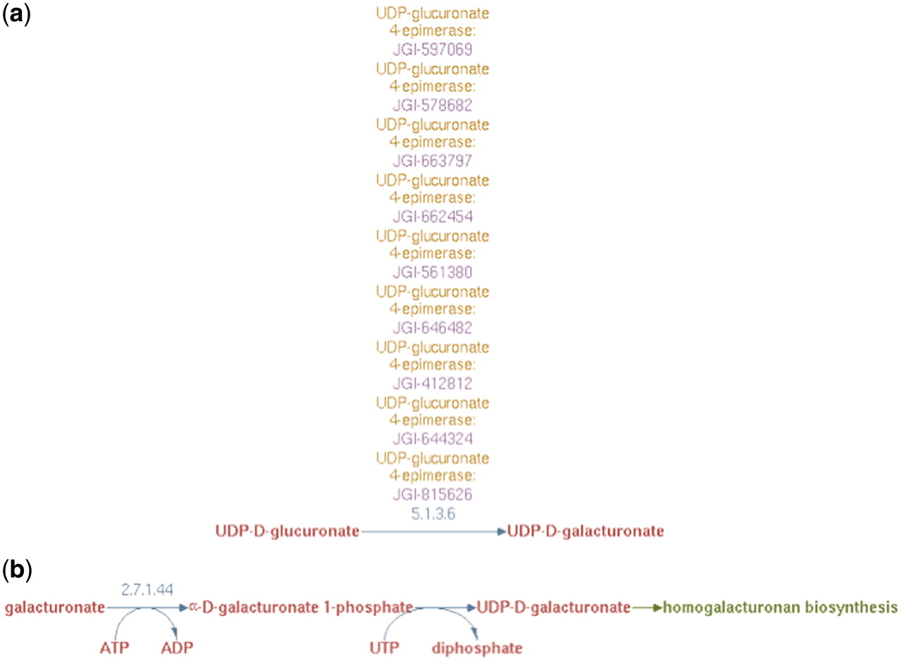
Figure 4. (a) UDP-d-galacturonate biosynthesis I (from UDP-d-glucuronate) pathway representation in PoplarCyc 1.0. Note ...
Notes:
Figure 4. (a) UDP-d-galacturonate biosynthesis I (from UDP-d-glucuronate) pathway representation in PoplarCyc 1.0. Note that no information is available to evaluate the source of UDP-glucuronate and how it becomes available to the UDP-glucuronate 4-epimerase (b) UDP-d-galacturonate biosynthesis II (from d-galacturonate) pathway representation in AraCyc 6.0.1 Note a pathway with a missing EC number for the conversion of galacturonate-1-P to UDP-galacturonate. For both parts (a) and (b), no information is available where these cellular processes occur in the cell.
Unless provided in the caption above, the following copyright applies to the content of this slide: © The Author(s) 2012. Published by Oxford University Press.This is an Open Access article distributed under the terms of the Creative Commons Attribution Non-Commercial License (http://creativecommons.org/licenses/by-nc/3.0), which permits unrestricted non-commercial use, distribution, and reproduction in any medium, provided the original work is properly cited.

